Slide 1
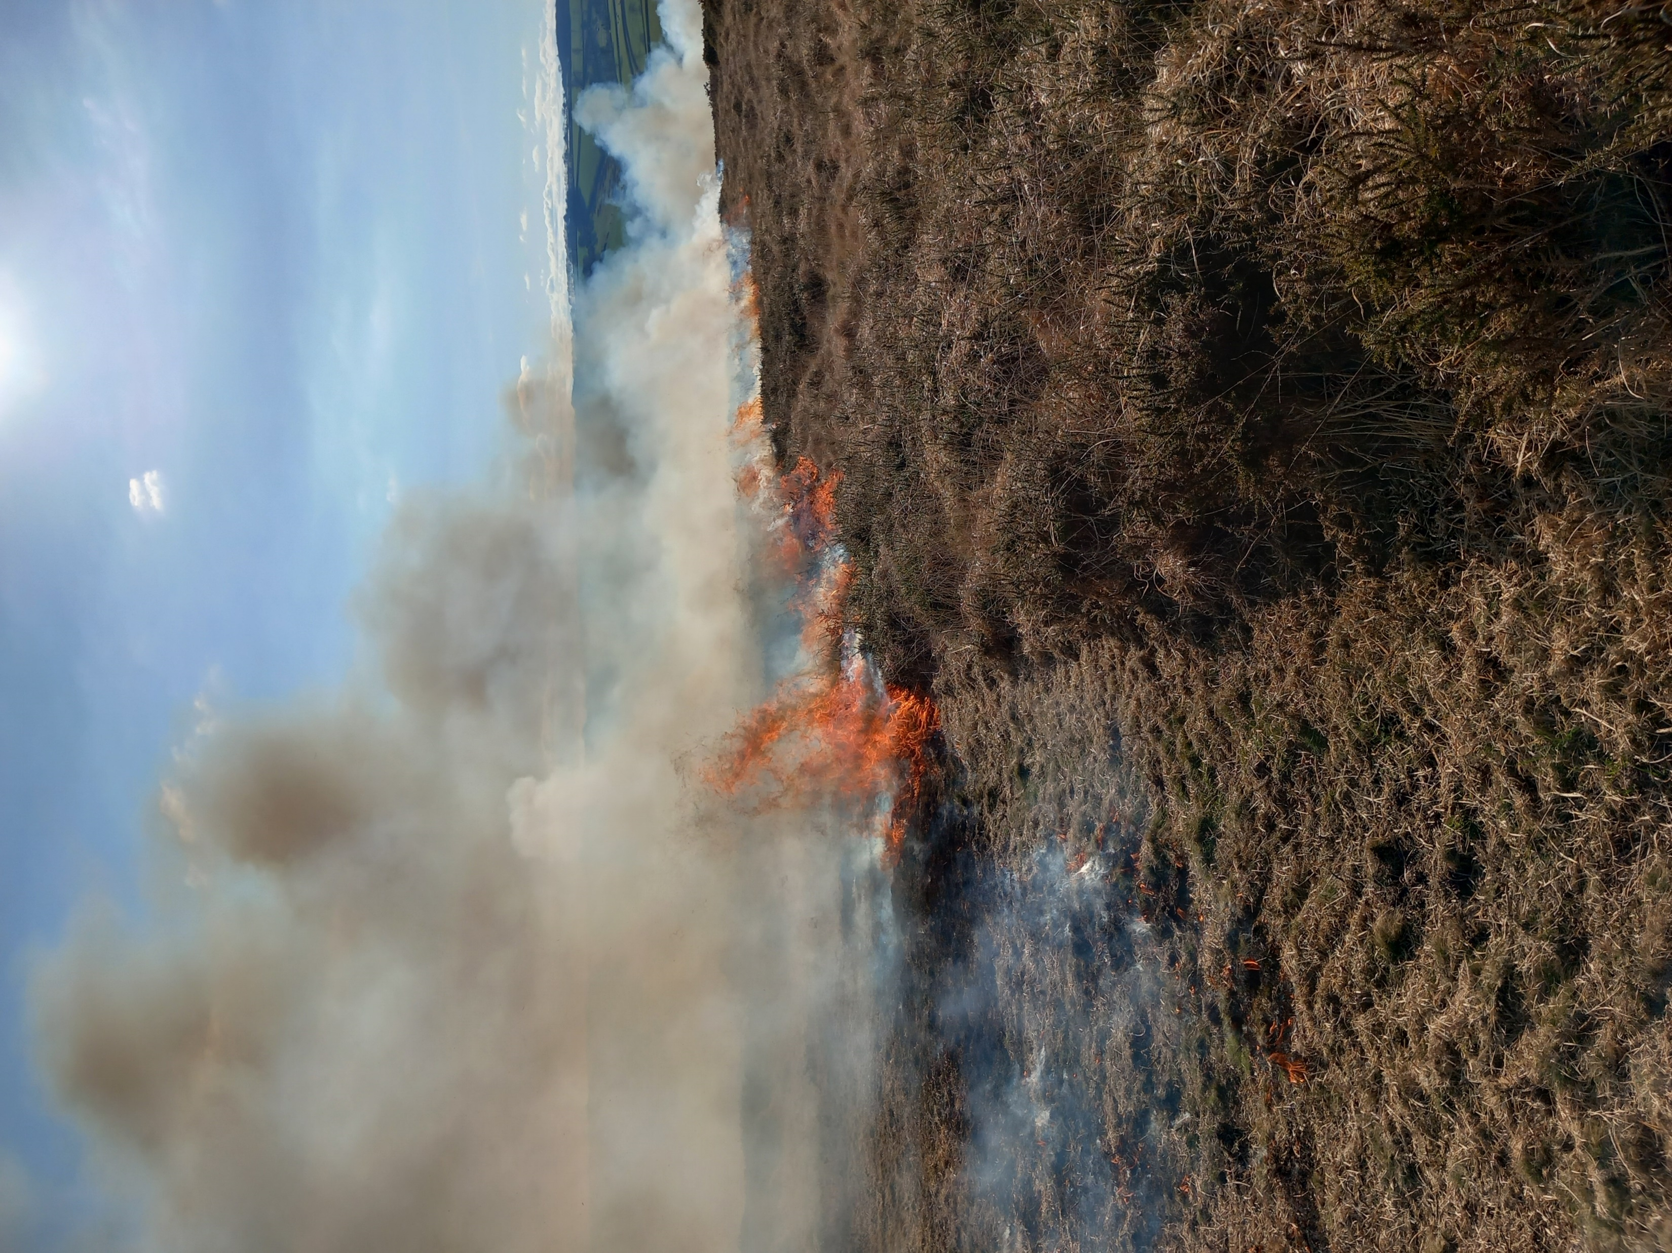
Devon & somerset fire & rescue
Ian donovan
Notes:
Theme: Outdoor Adventure

Slide 2


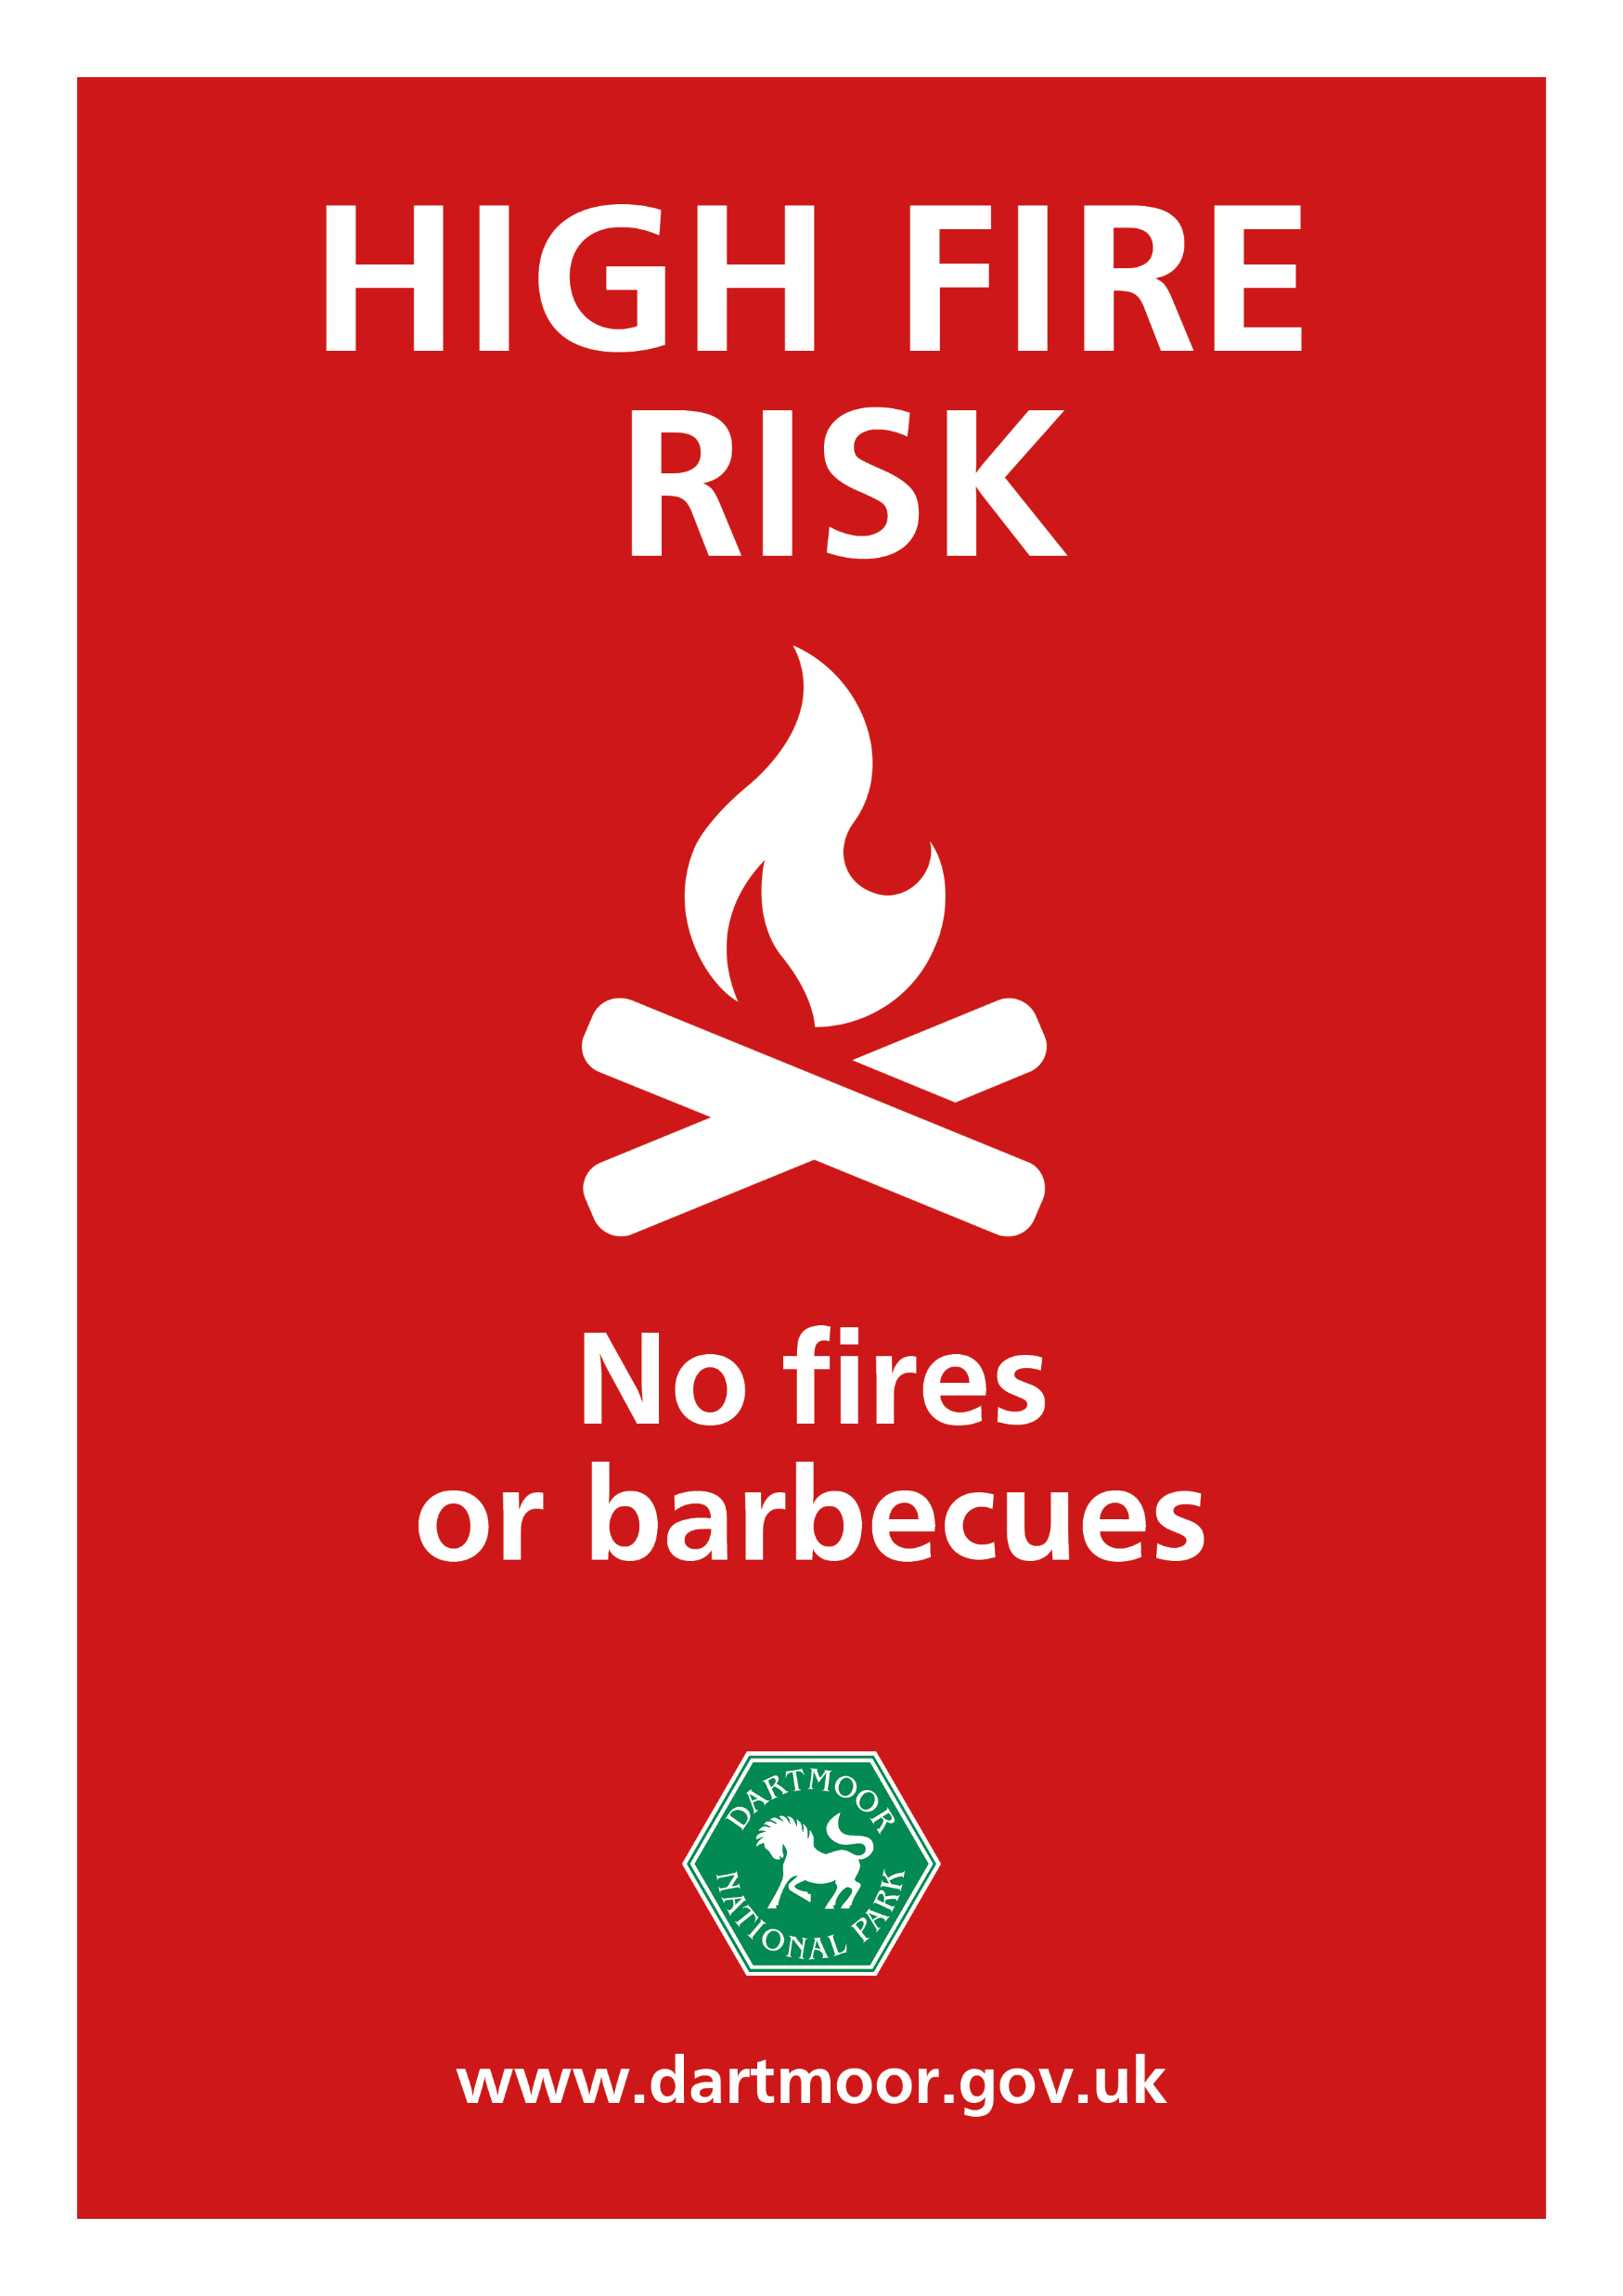
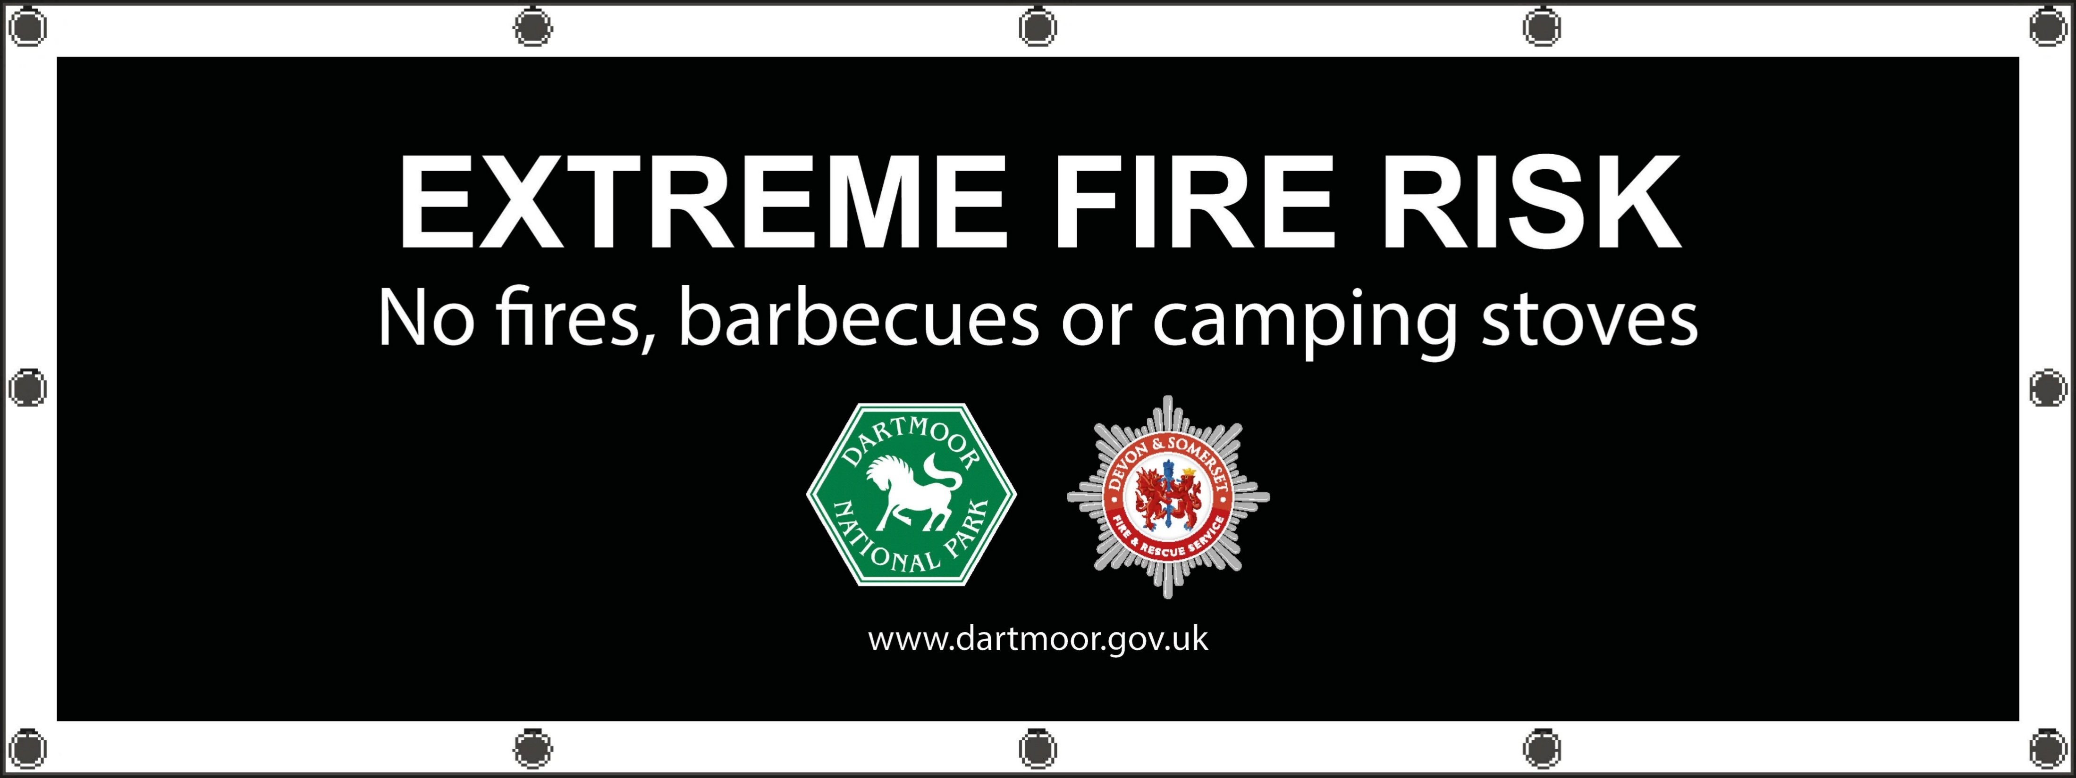
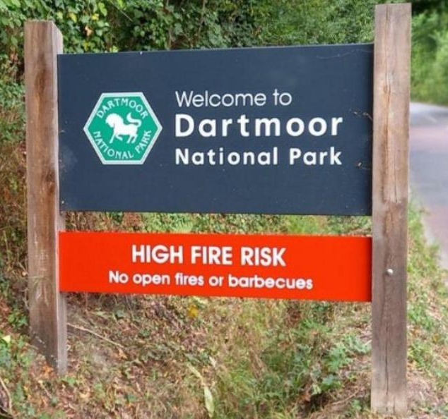

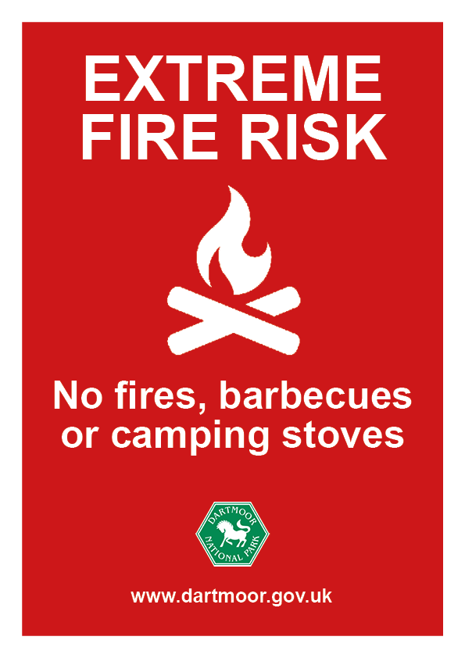
Introduction to ten tors
Devon and Somerset fire and rescue
Wildfire Prevention on Dartmoor
WHY IT MATTERS
Long-lasting damage to wildlife and habitats
Significant impact on the Dartmoor landscape
Risk to livestock, walkers and participants
SERIOUS THREAT
Flame lengths can exceed 1.5 metres
Fires can spread rapidly across moorland
Wind speed and direction, humidity, temperature, all these variables have an impact in terms of wildfire.
LEVEL 0 | LEVEL 1 | LEVEL 2 | LEVEL 3
HOW YOU CAN HELP
Do not use barbecues on Dartmoor
Dispose of cigarettes and matches safely
Take all litter home
Use camping stoves with extreme care
Report signs of fire immediately
PREVENTABLE
Disposable barbecues
Discarded cigarettes and matches
Unattended campfires
Incorrect use of camping stoves and fuel

Slide 3
Introduction to ten tors
Devon and somerset fire & rescue
WHAT TO DO IF YOU SEE A FIRE
Keep calm. Call 999 and ask for the Fire and Rescue Service and give your exact location.
Providing a six-figure map reference or What3words.
Make sure you download the What3words app on your phone – this can help the fire service pinpoint your exact location in the event of a fire.
Distance yourself from the fire
Contact your Team leader ( during training ) explain the situation and where you are heading.
Team Leader to contact Fire Control on 03333990014 or 999 to confirm that the team are distancing themselves from the fire and heading towards !!!!!!!

Slide 4
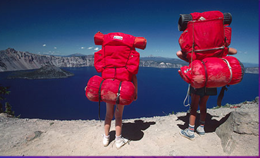
Clothing and equipment
Kevin scott
chief scrutineer
Notes:
Theme: Outdoor Adventure

Slide 5
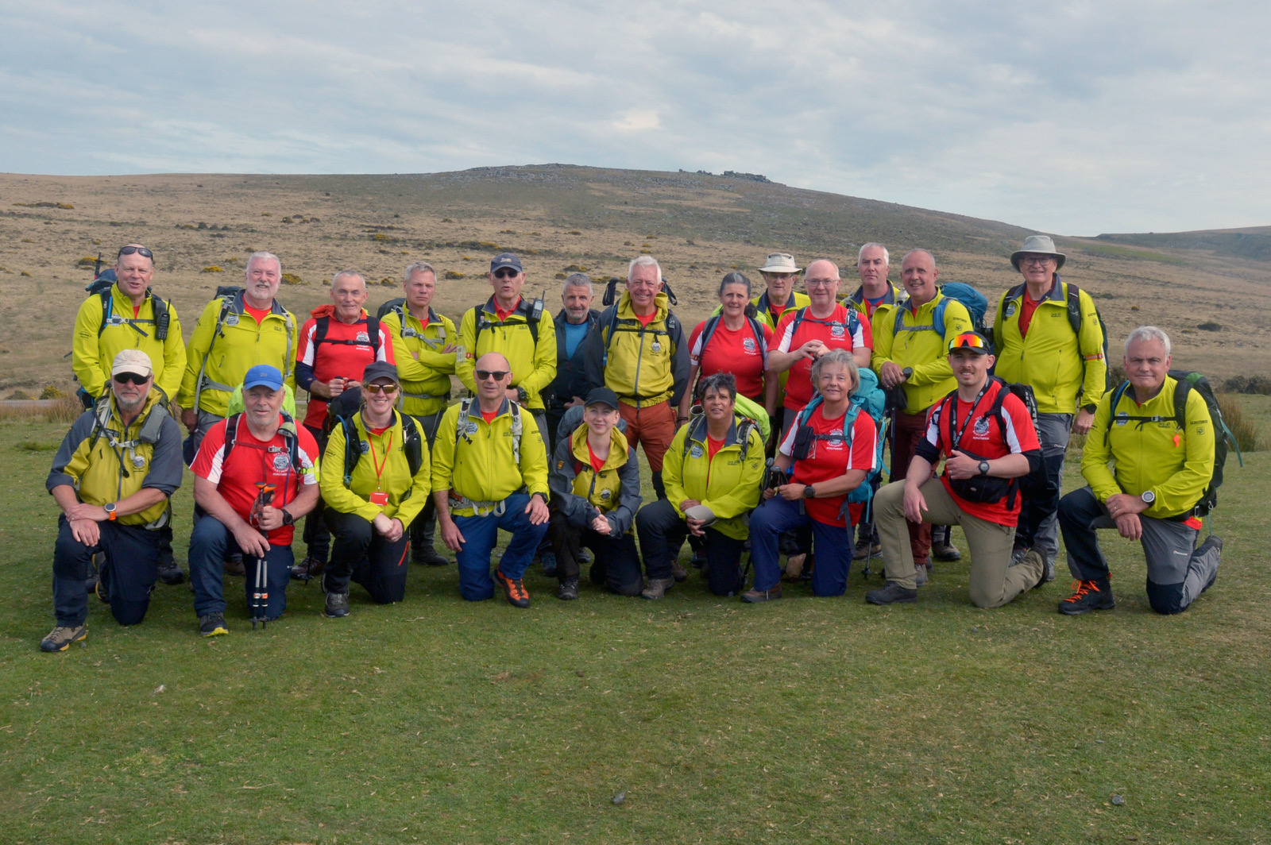

Clothing & equipment
SCRUTINEERS
WHO WE ARE
34 (mainly) ex military volunteers.
Dynamic safety on the moor.
Set standards for clothing and equipment.
600+ years of TT experience.
1000+ years of mountain experience.
Skills include; mountain & hill quals, Mountain Rescue, Paramedics, youth/adult training & mentoring, DBS, First Aid

Slide 6
Clothing & equipment
Annex b
TEN TORS 26
Event success – 90% of participants completed their challenge.
10% clothing and equipment check.
ONLY 35% fully complaint with Annex B.
ANNEX B
Developed for SAFETY of INDIVIDUAL and TEAM, irrespective of the weather.
MANDATORY – an official rule, law, or authority, meaning it is NOT optional.
Annex B = minimum event standard
Winter training: Carry additional equipment.
Train participants to use it correctly
TEN TORS 27
20% kit check - lottery D-1.
Ensure the SAFETY of participants and integrity of Ten Tors.
Monitoring compliance with ANNEX B.

Slide 7
Clothing & equipment
ANNEX B
RISK
HEAVY
LIGHT

Slide 8
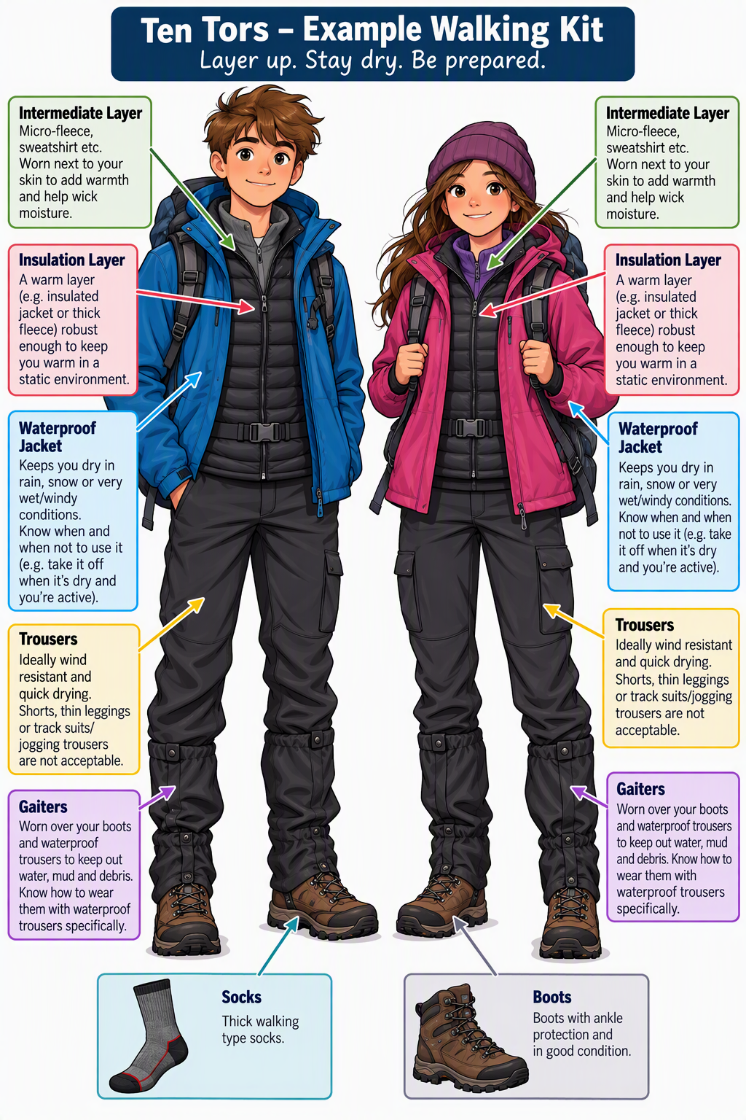
Clothing & equipment
ANNEX B
MANDATORY Clothing & Equipment – Personal
Intermediate Layer – Micro-fleece, sweatshirt etc
Insulation Layer – Robust enough to keep the wearer warm in a static environment
Socks Pair – Thick walking type
Trousers – Ideally wind resistant and quick drying – Shorts/Thin Leggings
Tracksuits/Jogging Trousers are NOT acceptable
Waterproof Clothing – Knowledge of when and when not to use it
Boots – Ankle protection, in good condition
Gaiters – Know when to wear them with waterproof trousers specifically

Slide 9
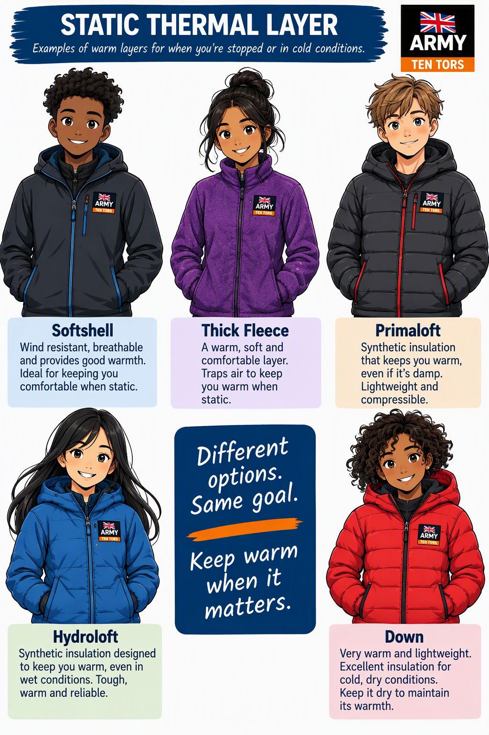
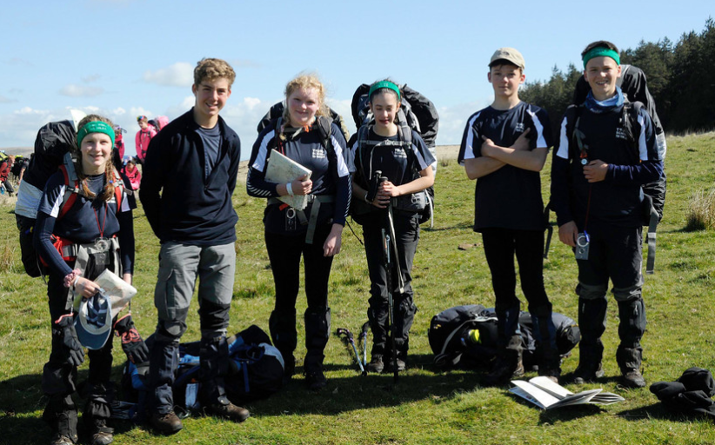
Clothing & equipment
STATIC THERMAL LAYER
STATIC THERMAL LAYER
Softshell
Thick Fleece
Primaloft
Hydroloft
Down

Slide 10
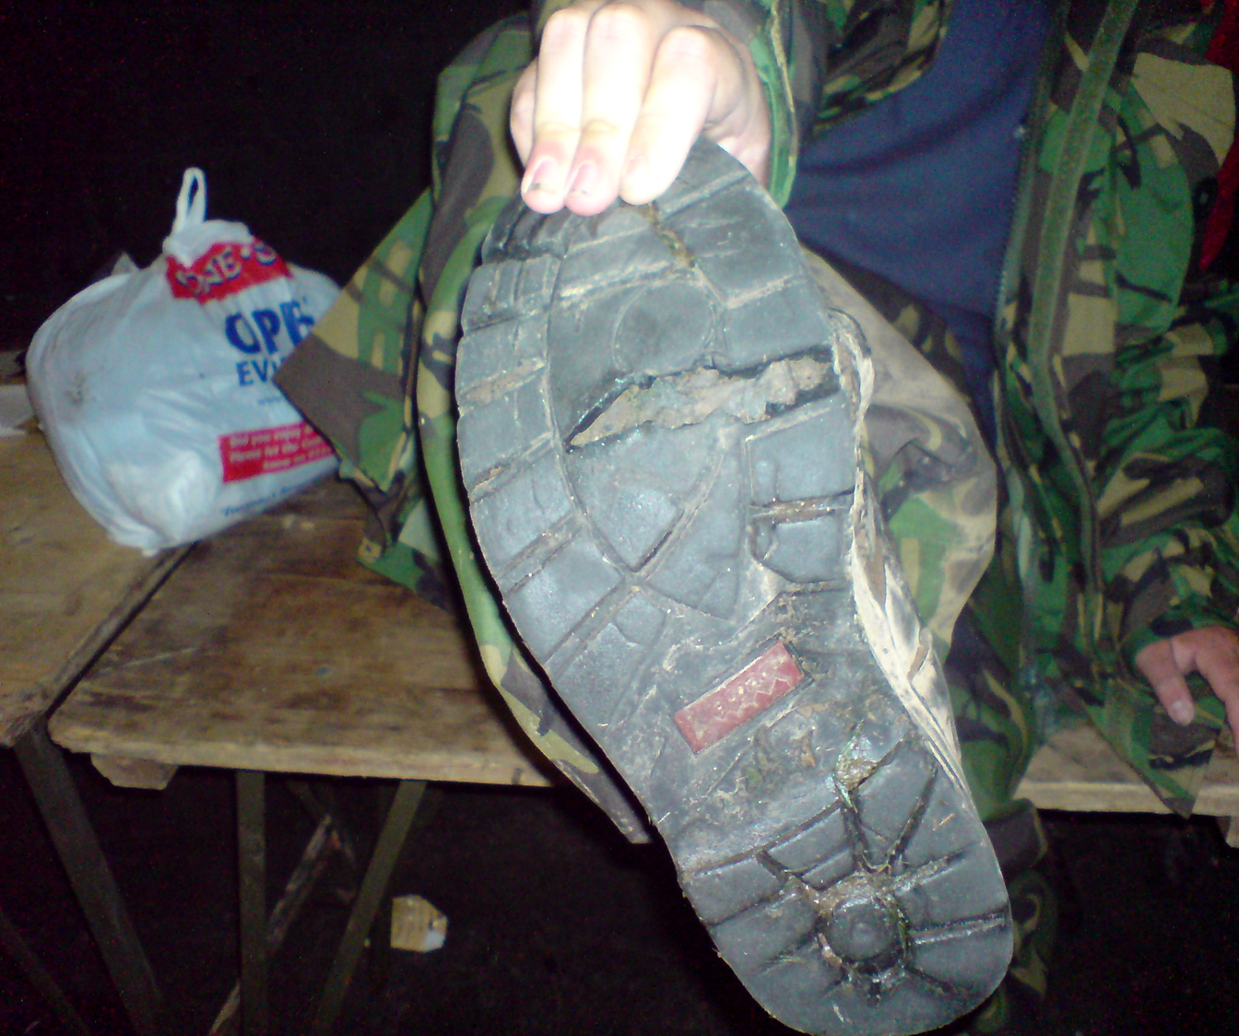
Clothing & equipment
FOOTWEAR
Boots – with ankle protection and in good condition

Slide 11
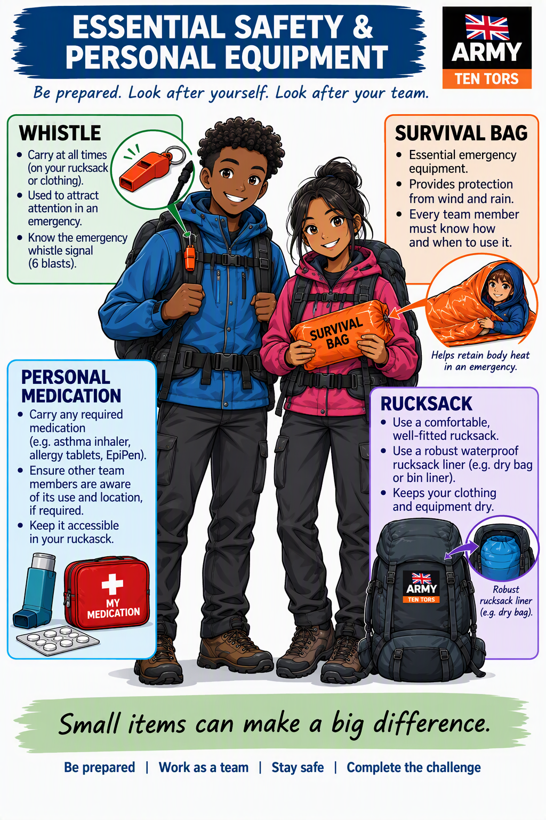
Clothing & equipment
PERSONAL

Slide 12
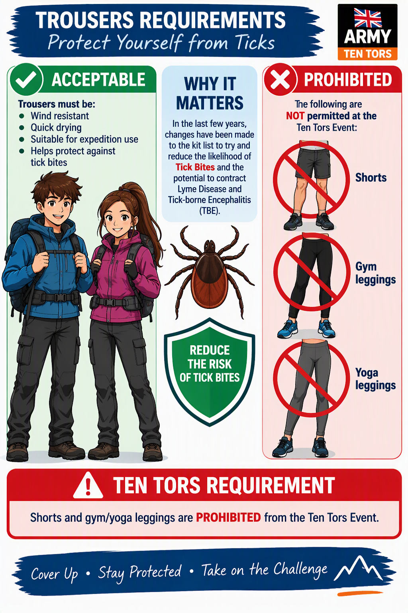
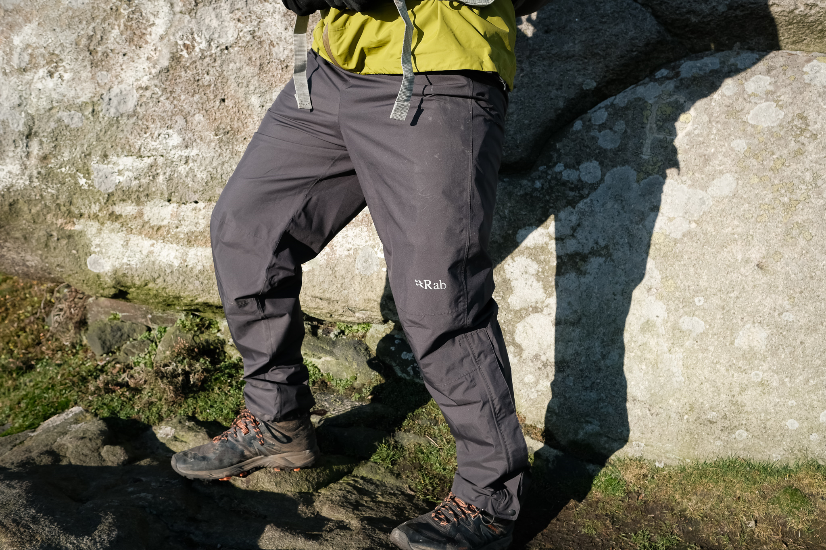
Clothing & equipment
ANNEX B
Waterproof Trousers

Slide 13
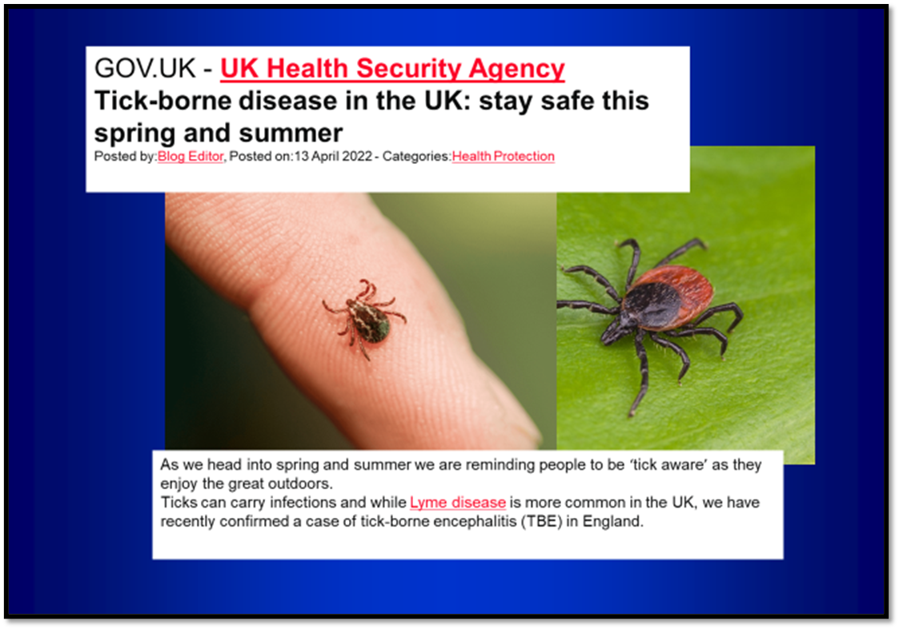
Clothing & equipment
HEALTH

Slide 14

Clothing & equipment
HEALTH

Slide 15
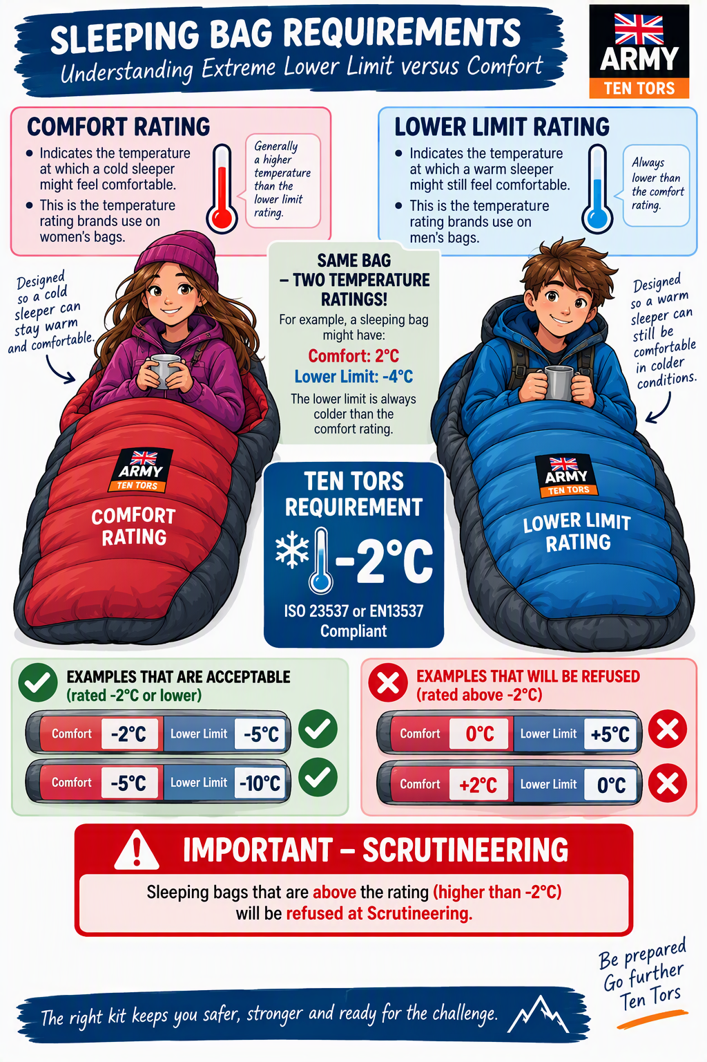
CLOTHING & EQUIPMENT
SLEEPING BAGS
TEN TORS REQUIRMENT
ISO 23537 or
EN13537
Compliant to -2 degrees C
Temperature Ratings Are Estimates, Not Guarantees
Sleeping bag ratings are tested in laboratory conditions.
Actual warmth varies depending on clothing, sleeping mats, weather, and the individual sleeper.
Team Managers must ensure participants remain warm and comfortable throughout training and the Event.
If in doubt, choose a sleeping bag that exceeds the minimum requirement, rather than one that just meets it.

Slide 16
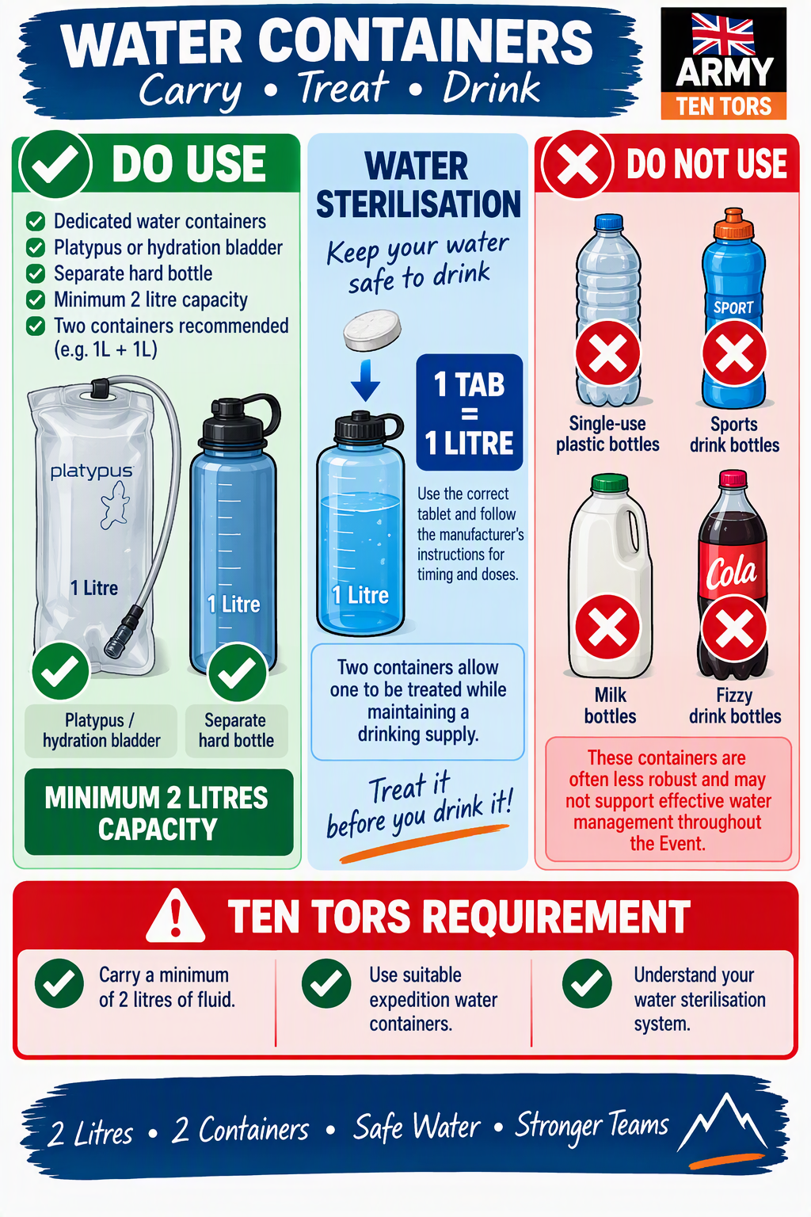
CLOTHING & EQUIPMENT
HYDRATION

Slide 17
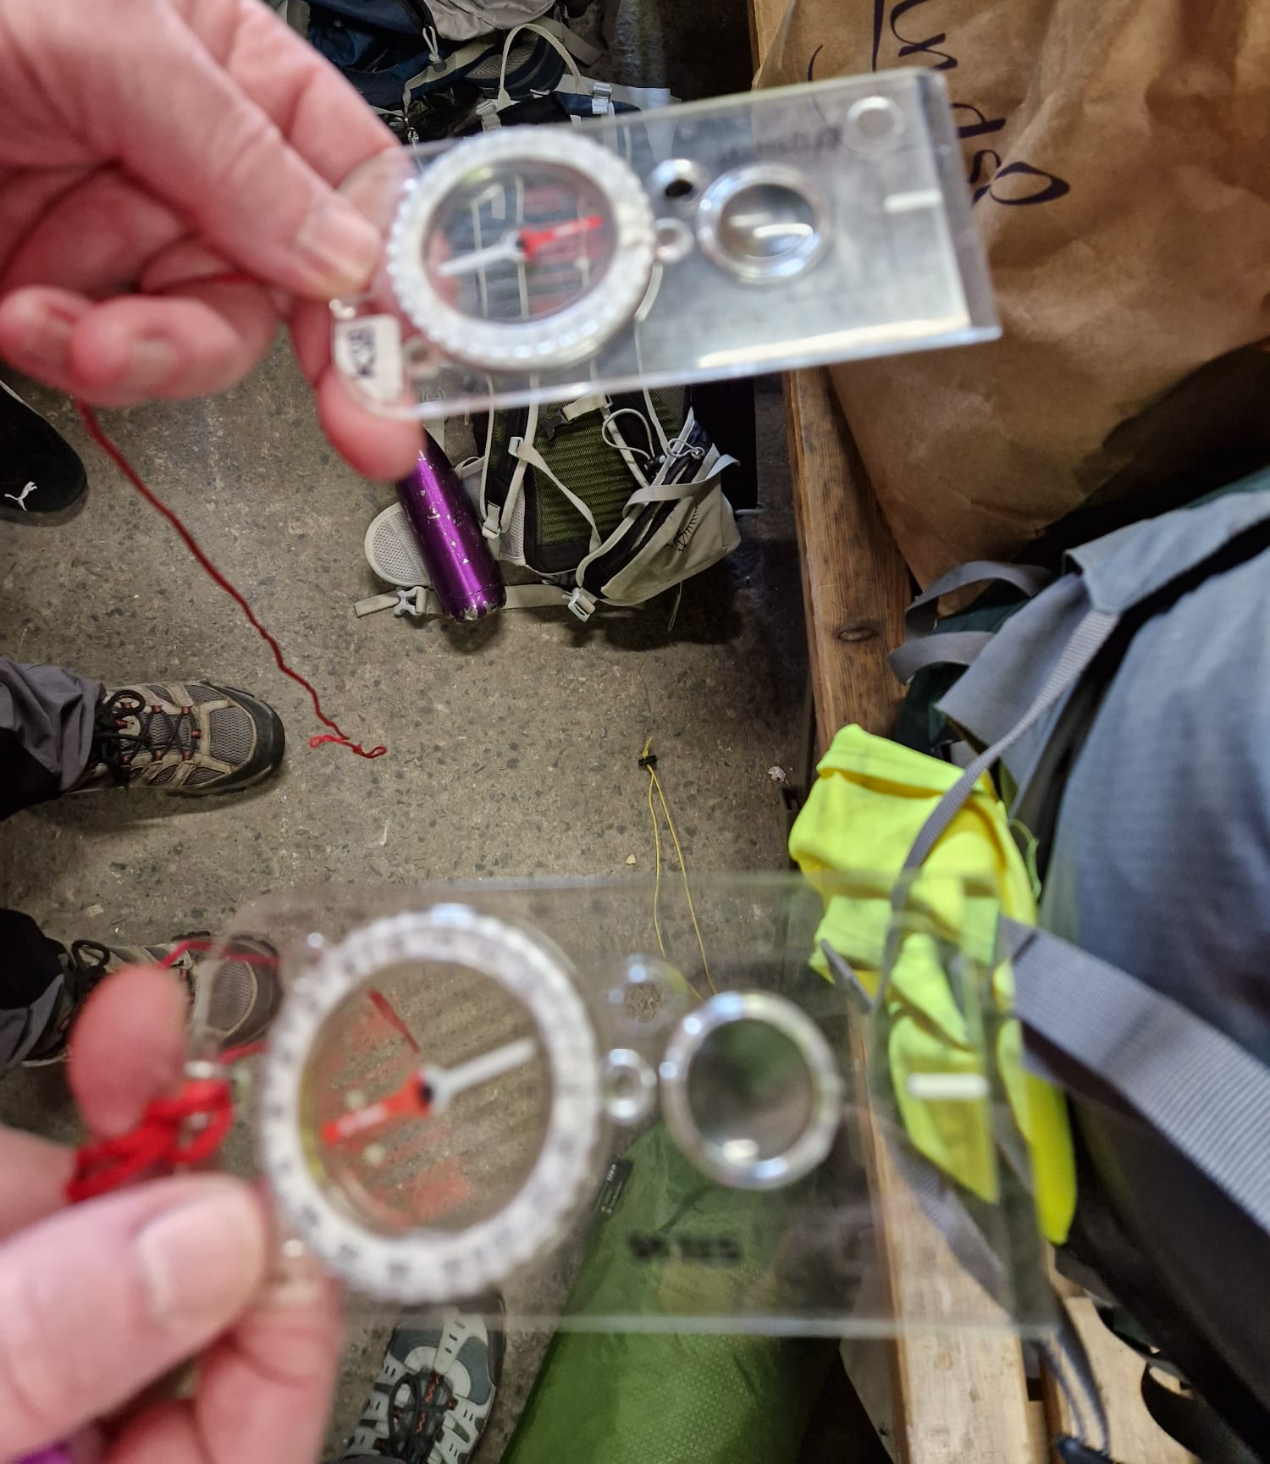
Clothing & equipment
TEAM
TT27 Map with Bird Nesting areas and Out of Bounds
Compass – Lightweight Compass with min 10cm baseplate
High Viz Jackets – knowledge how to use them on roads

Slide 18
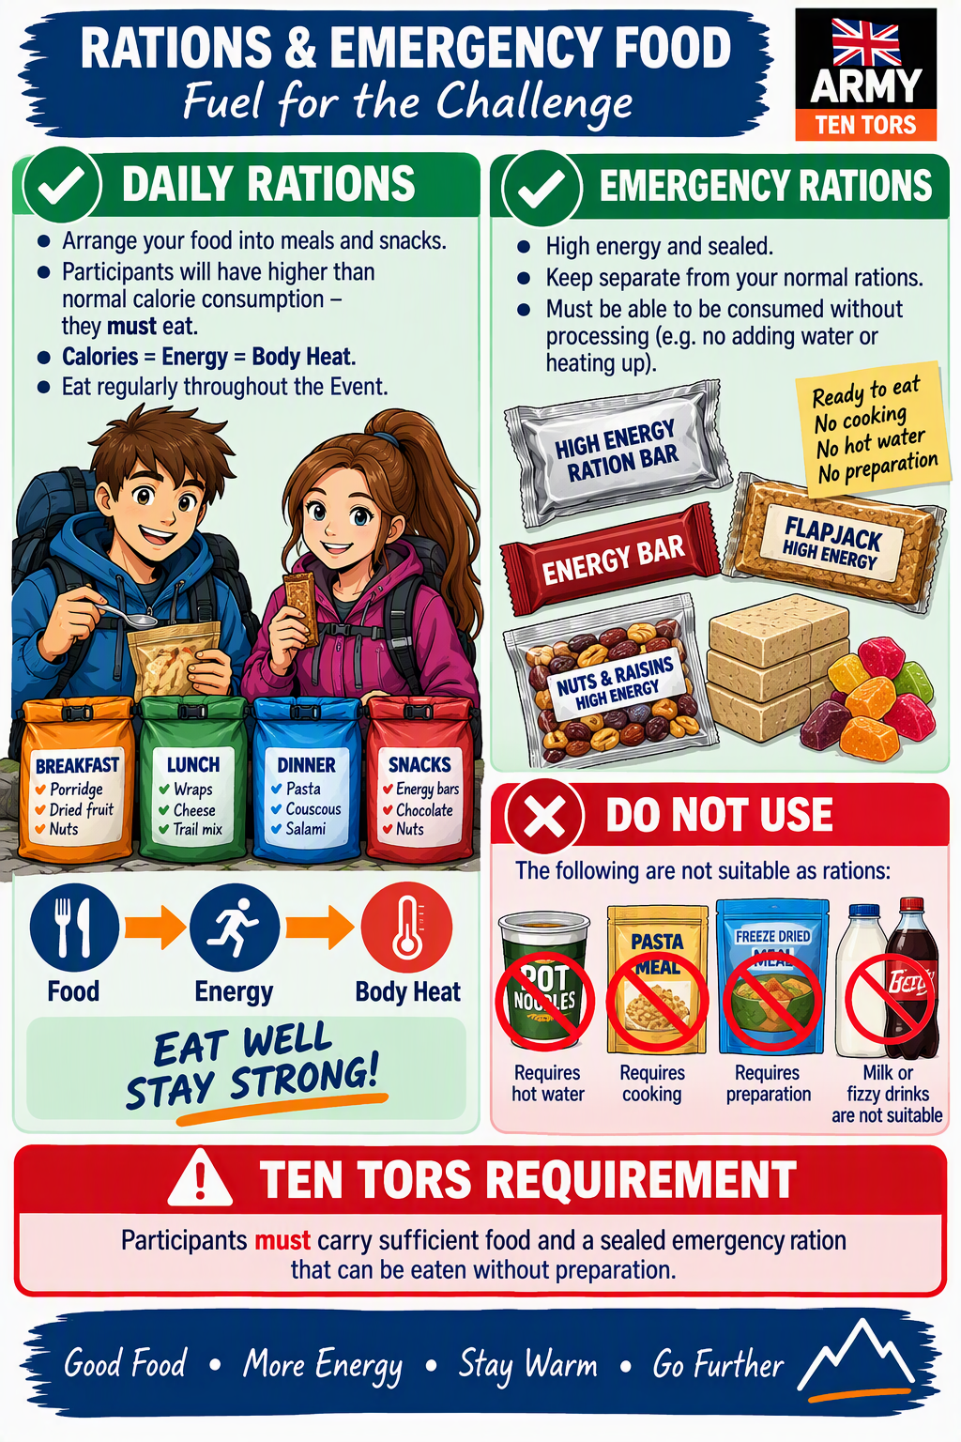
CLOTHING & EQUIPMENT
RATIONS

Slide 19
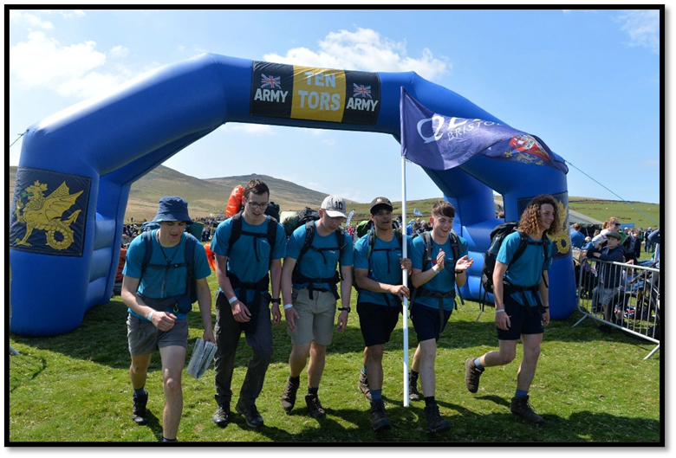
Clothing & equipment
ANNEX B
“Notwithstanding compliance with this list, the organisers WILL remove participants from a Challenge … if they consider them to be unsuitably clothed or equipped to complete it in the forecast conditions, or if the TEAM or INDIVIDUAL is missing VITAL SAFETY related ITEMS from the list.”

Slide 20
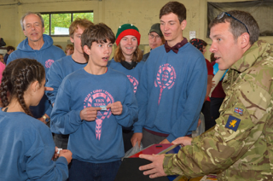
Clothing & equipment
Key points
Summary
20% kit check D-1.
Teams not complying with Annex B will be withdrawn from the event.
No SHORTS, GYM?YOGA LEGGINGS, TRACKSUITS
Ensure participants know how to get the best from their kit.
Good luck

