Slide 1

ENVIRONMENT COMPLIANCE MONITORING
Why do we have Environmental compliance monitors?
100

Slide 2
ECM
Why do we have to comply?
The Ten Tors Challenges only exist with the agreement and support of Dartmoor stakeholders.
The ECM team provide assurance that those venturing onto the moor under the guise of Ten Tors meet a promise in the form of a set of standards.
Everyone should want to uphold this promise.
Rules For Training on Dartmoor (Green Card) should be common sense for regular moorland visitors.

Slide 3
ECM
2026 Compliance data
31 ECMs covered all weekends from TMB to TTC
We spent a total of 206 days out
An average ECM day is 7-9 hours, most are part of an establishment’s training team
We met a total of 327 groups
79% of groups were compliant
53 (about 25% of establishments) did not meet minimum expectations, down from 91 in 2025

Slide 4
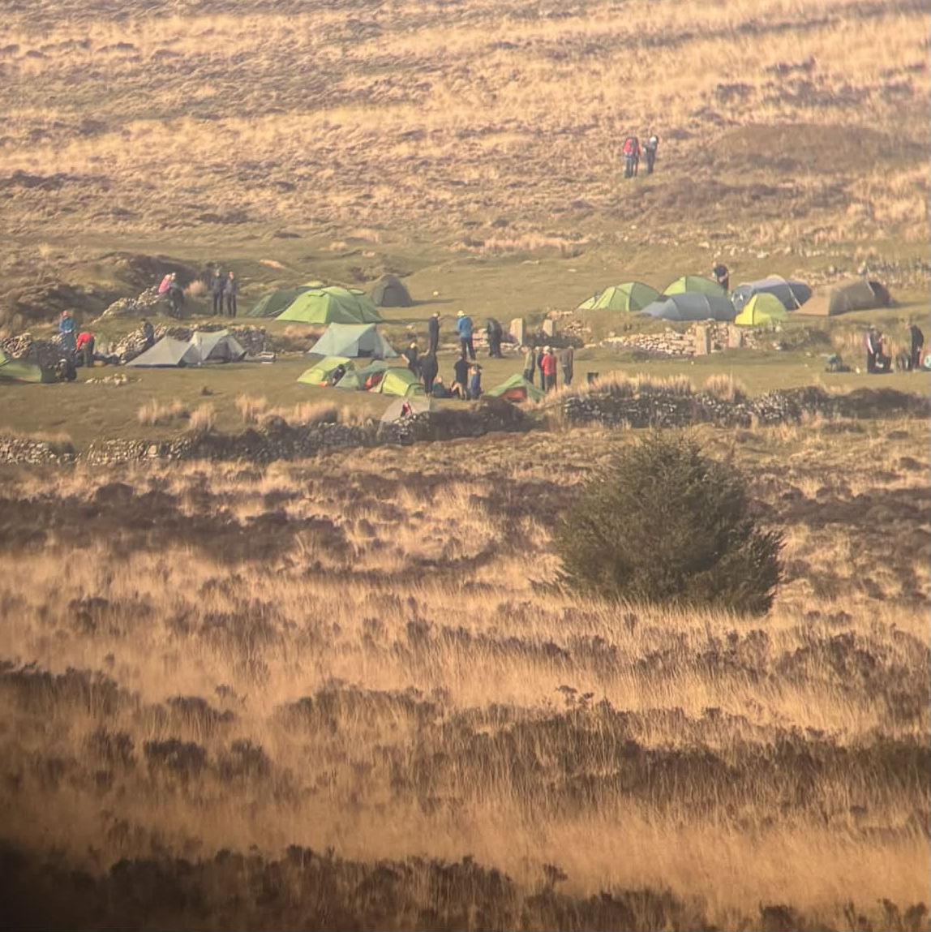
ECM
Training phase issues

Slide 5
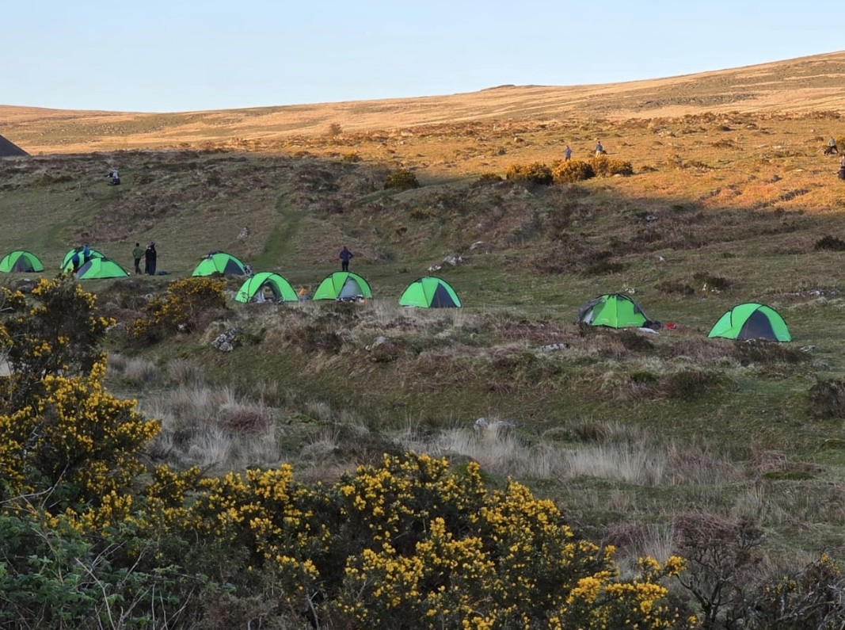
ECM
Training phase issues

Slide 6
ECM
Training phase issues
Biggest issues have the same root cause:
Badmin
ALL activity on Dartmoor from this point forward is under Green Card Rules
Team must always have toilet materials, inc trowels
Log training before 0800 Weds
Green Cards – not carried, not completed, out of date
Id panels – covered, unreadable, blown away (litter?)
Camping – group size,“reserving” areas mid afternoon
Parking – Nodden Gate, >50% car park use
Firing Range - CHECK

Slide 7
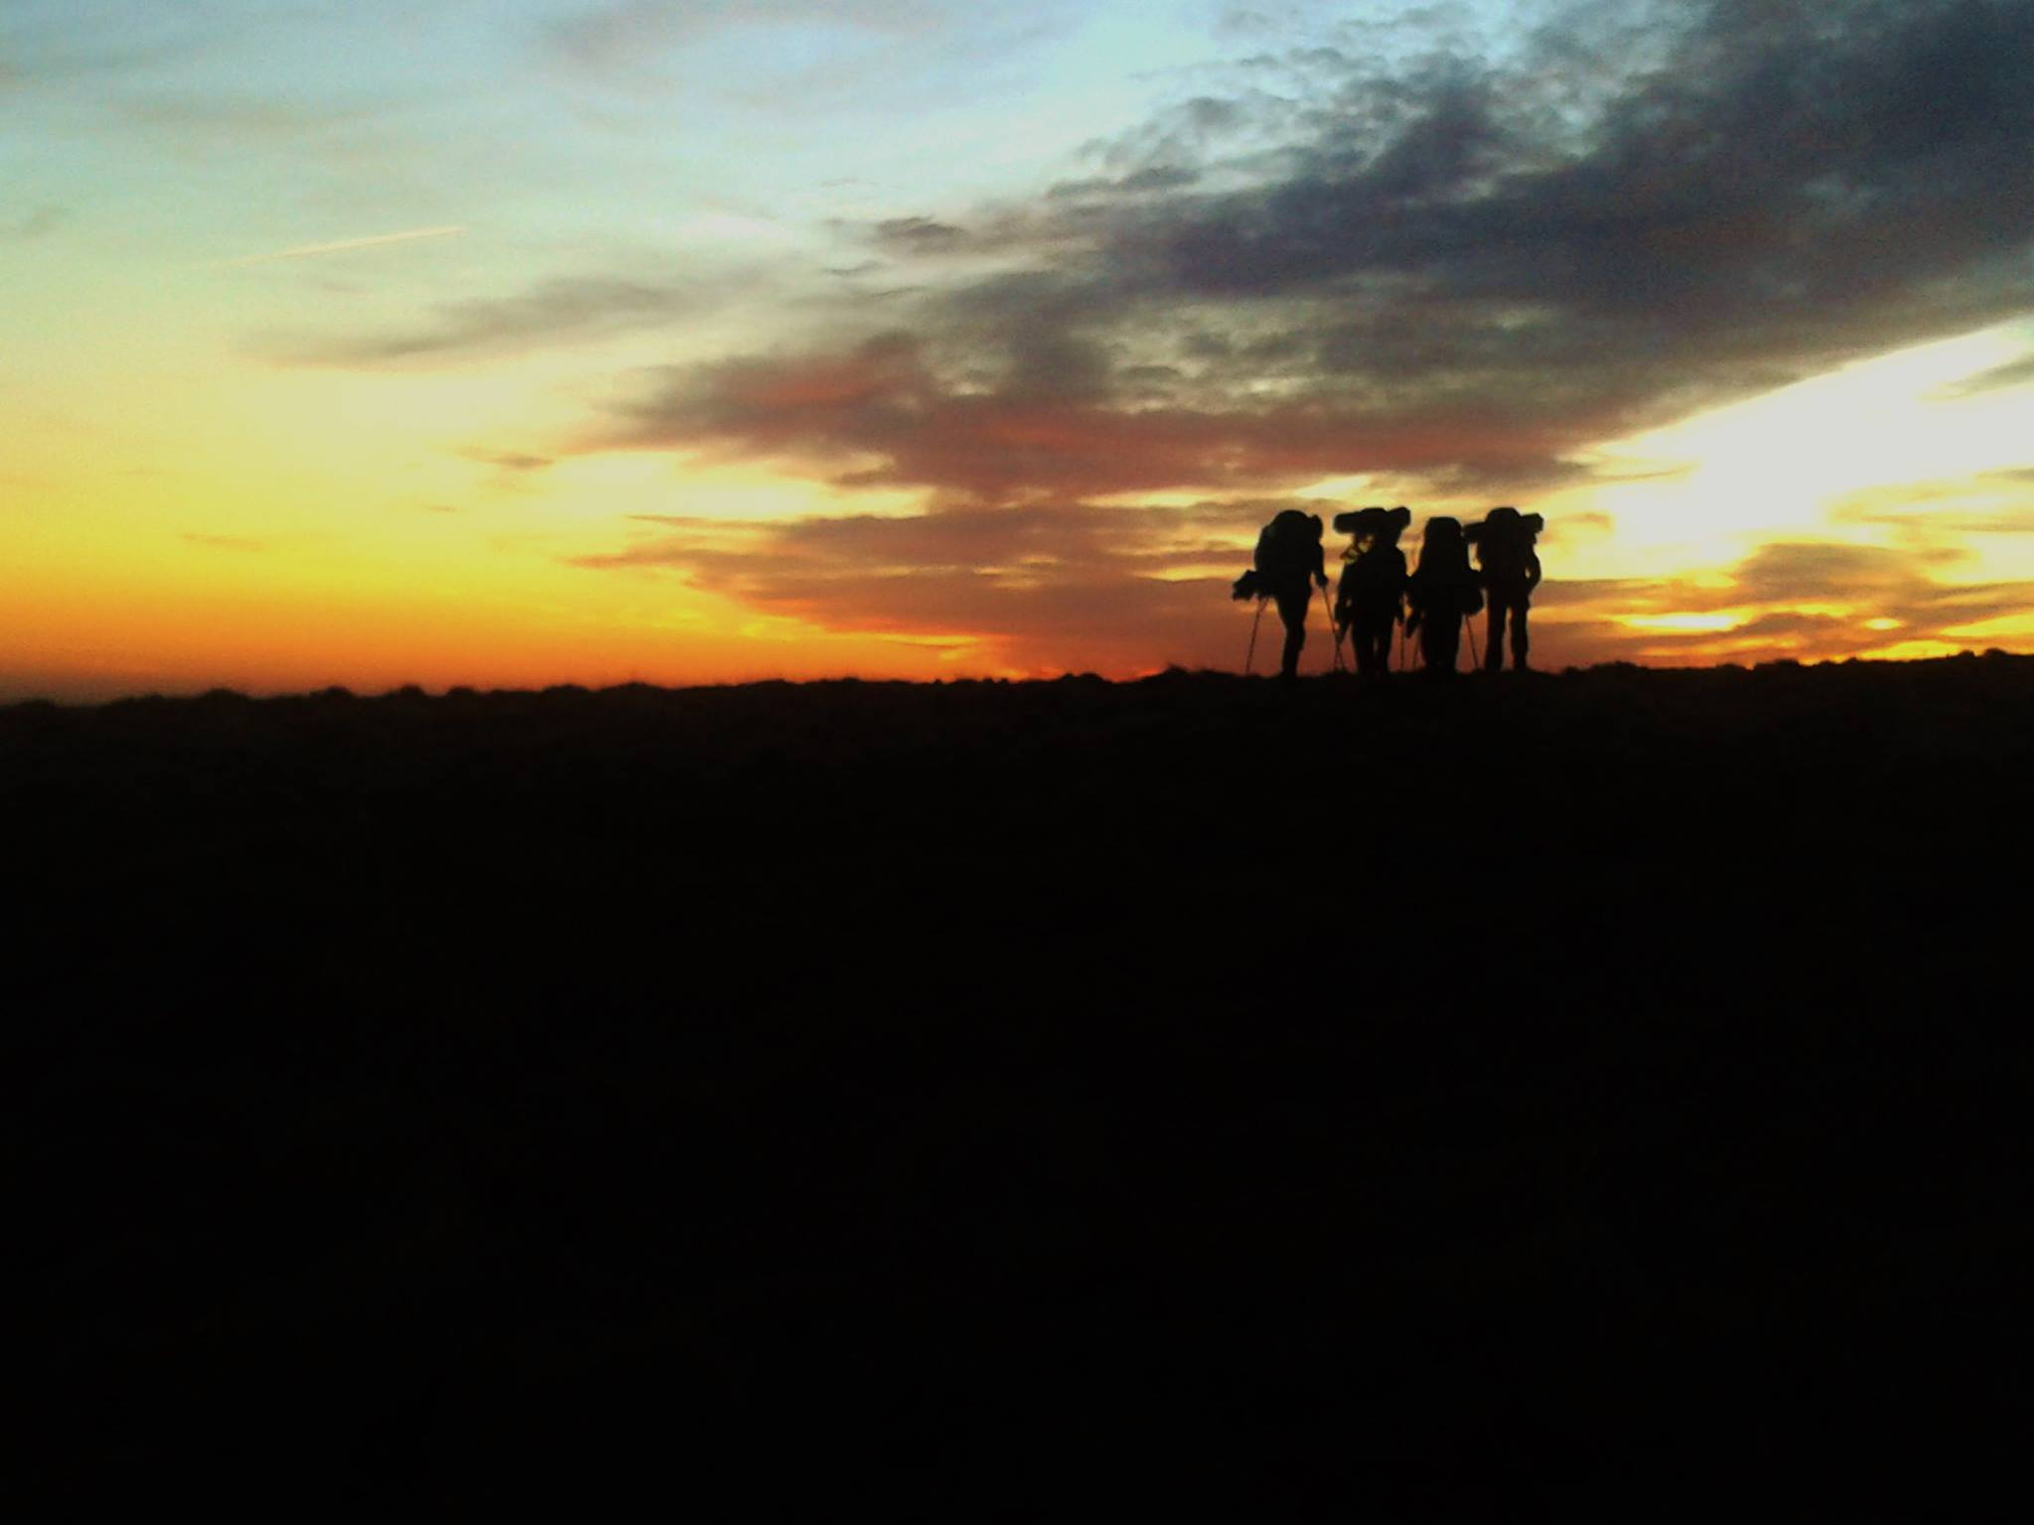
ECM
What should a meeting with an ECM be like?

Slide 8
ECM
What should a meeting with an ECM be like?
An ECM should approach and identify themselves - Ten Tors ID card
ECMs will ask/check:
  Where the group has been and where they are heading
  RBNA – is the map correctly marked
  Green card
    Questions on its contents
    Is it filled in correctly
    Emergency procedures
  Correctly marked ID panels on at least two rucksacks
  General pertinent questions

Slide 9
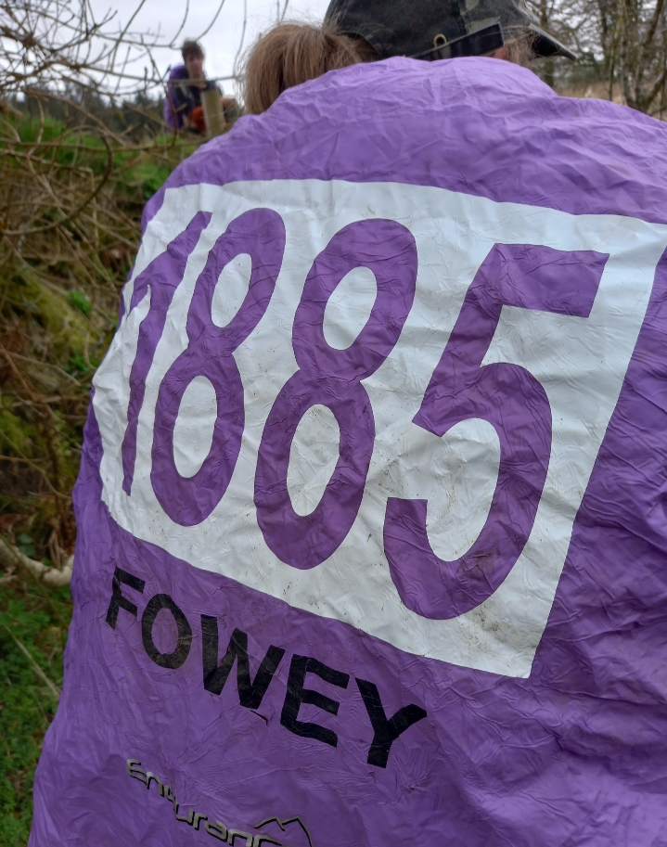
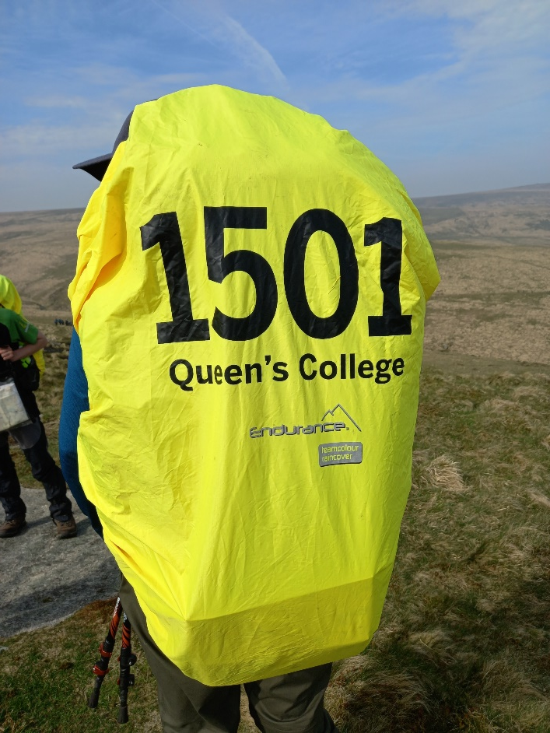
ECM
What should an identification panel look like?
A minimum of two identification panels are to be displayed at all times.

Slide 10
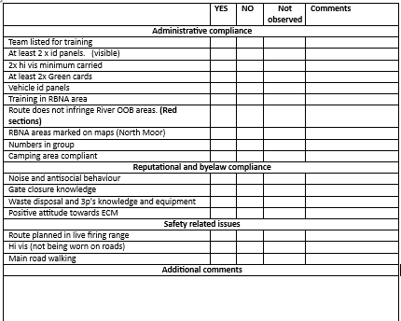
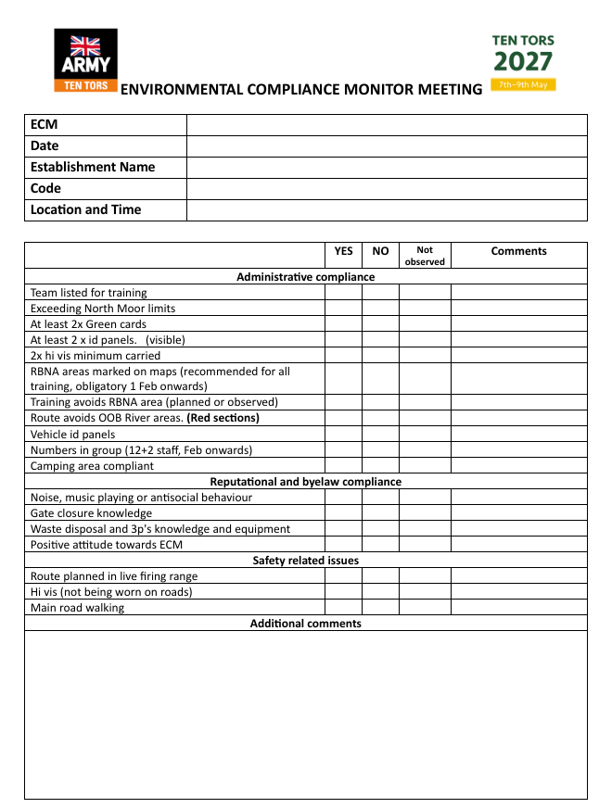
ECM
ECM to Team Manager feedback

Slide 11
ECM
ECM Event Team
The ECM Team take on three roles on the event:
Ops Desk: to monitor team progress
to identify teams of concern
to advise on likelihood of finishing
Tor Support: to assist tor parties on early tors
Postbridge: to assist checkpoint

Slide 12
ECM
Event infringement Hotspots
A few examples of beacon traces covering common infringements and locations
River Crossings: Walkham
Rattlebrook and Tavy
Camping: Postbridge private land
Fernworthy
Teignhead Farm
Checkpoints – 45 and 55
Private land: Bearwalls Farm
Thornworthy House Hotel

Slide 13
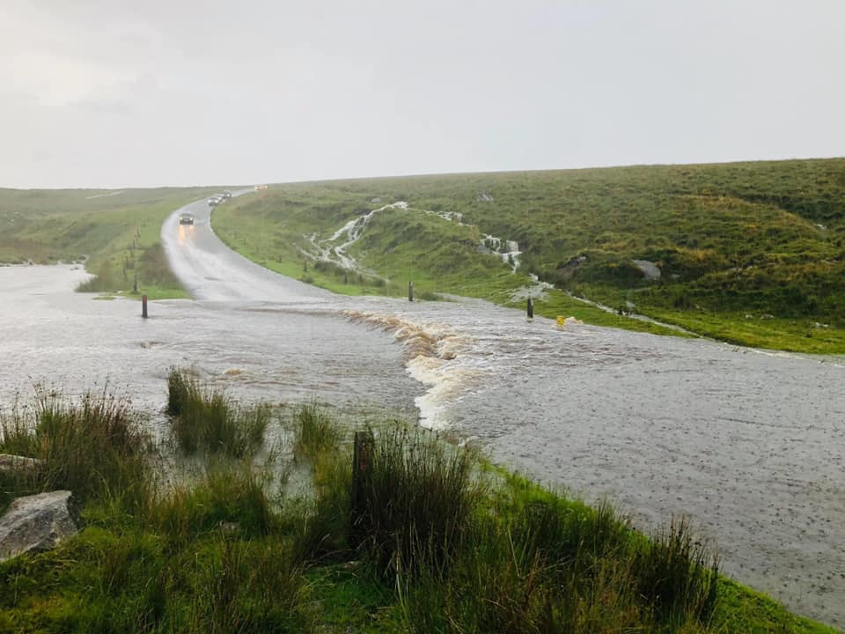
ECM
EVENT issues: rivers

Slide 14
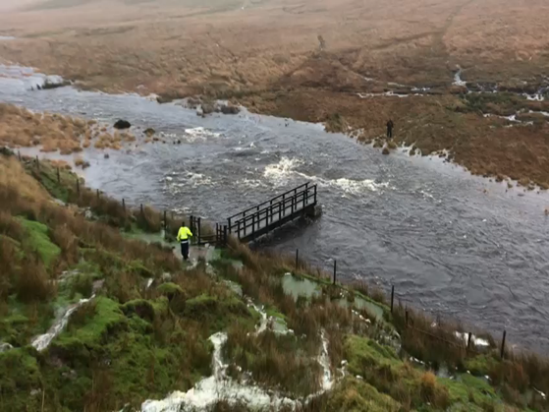
ECM
EVENT issues: rivers

Slide 15
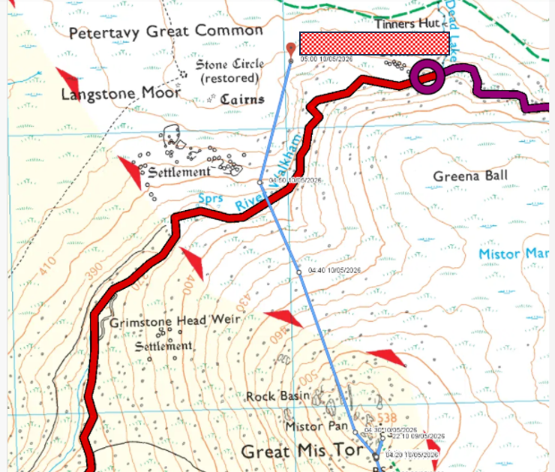
ECM
EVENT issues: rivers

Slide 16
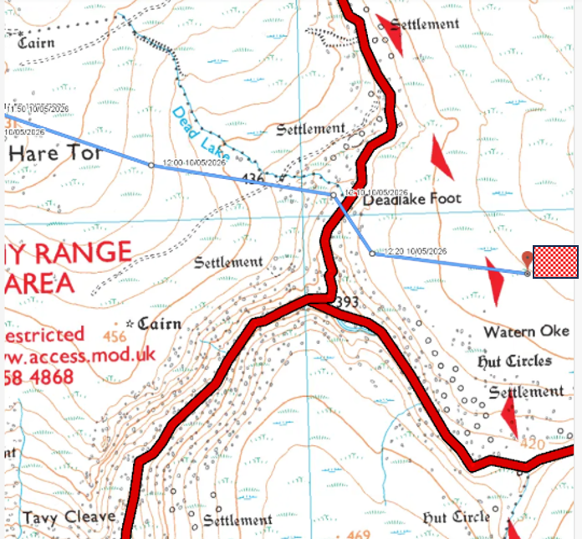
ECM
EVENT issues: rivers

Slide 17
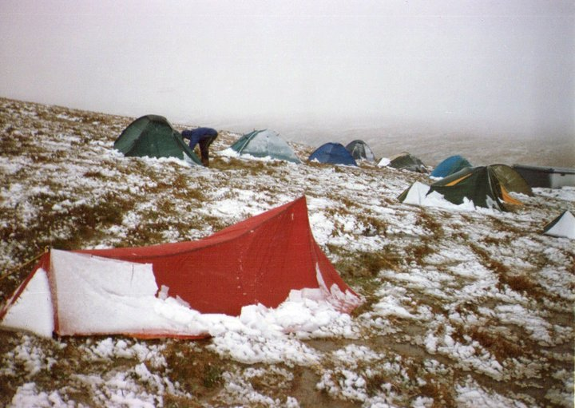
ECM
Event issues: camping

Slide 18
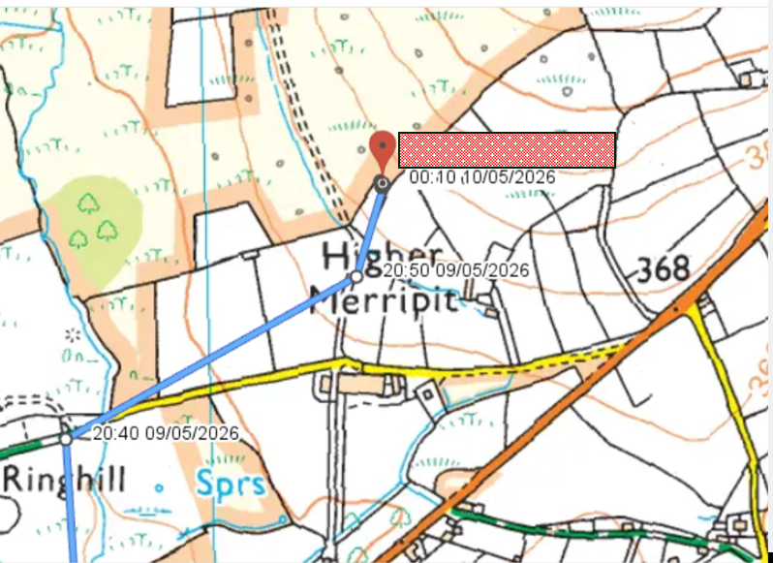
ECM
EVENT issues: camping

Slide 19
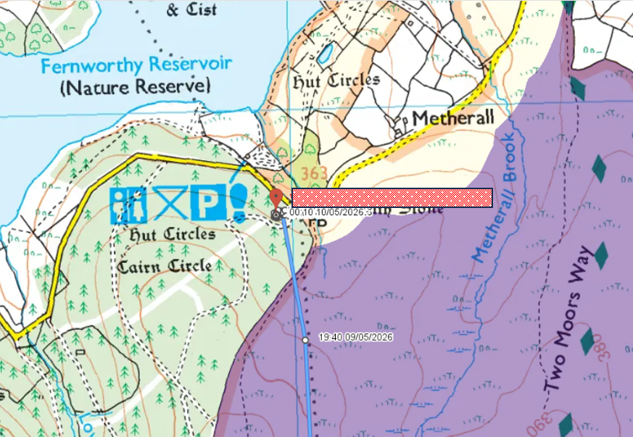
ECM
EVENT issues: camping

Slide 20
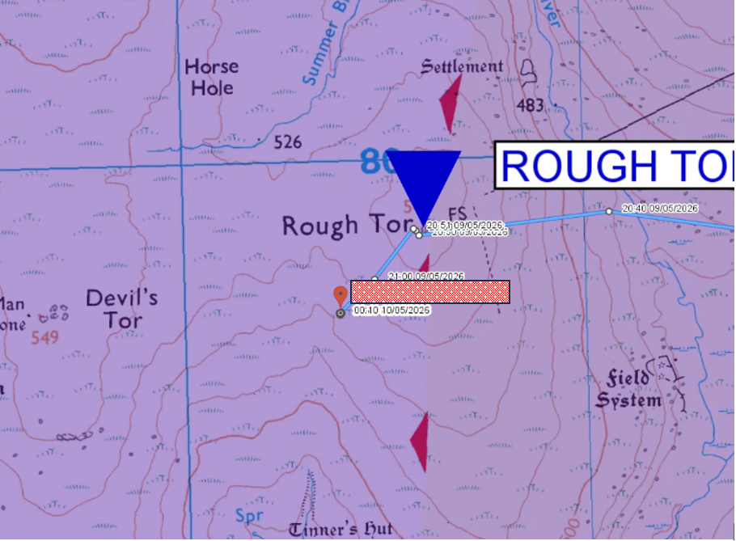
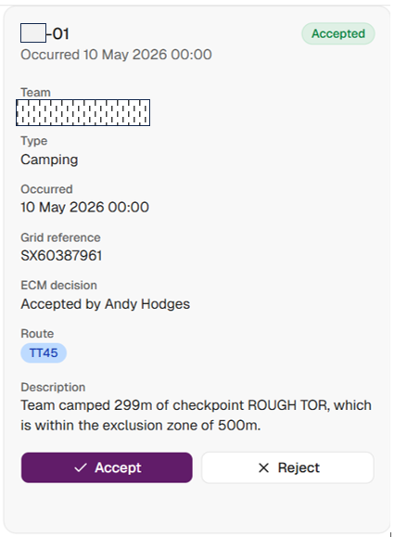
ECM
EVENT issues: camping
Camping: the importance of pacing

Slide 21
ECM
EVENT issues: camping
They asked whether they could camp at the proposed site and were told that it would be okay.
Why did they need to ask Tor Party staff?
Could this be viewed as external assistance?
Teams should know the rules and camp site choice needs be part of 45 and 55 training.

Slide 22
ECM
How can we improve our training for this?
It was dark, they had been pushing themselves physically
The reason for the infringement was tiredness
Their excuse, which I have told them is entirely inadequate, was that other teams were camped there.
Team were very tired and thought they were further east than they were.

Slide 23
ECM
How can we improve our training for this?
Fatigue will impede decision making
Teams rarely choose camp areas during training so are not familiar with success criteria
Not being aware of restricted camping areas
Camping amongst 35s will be good “cover”

Slide 24
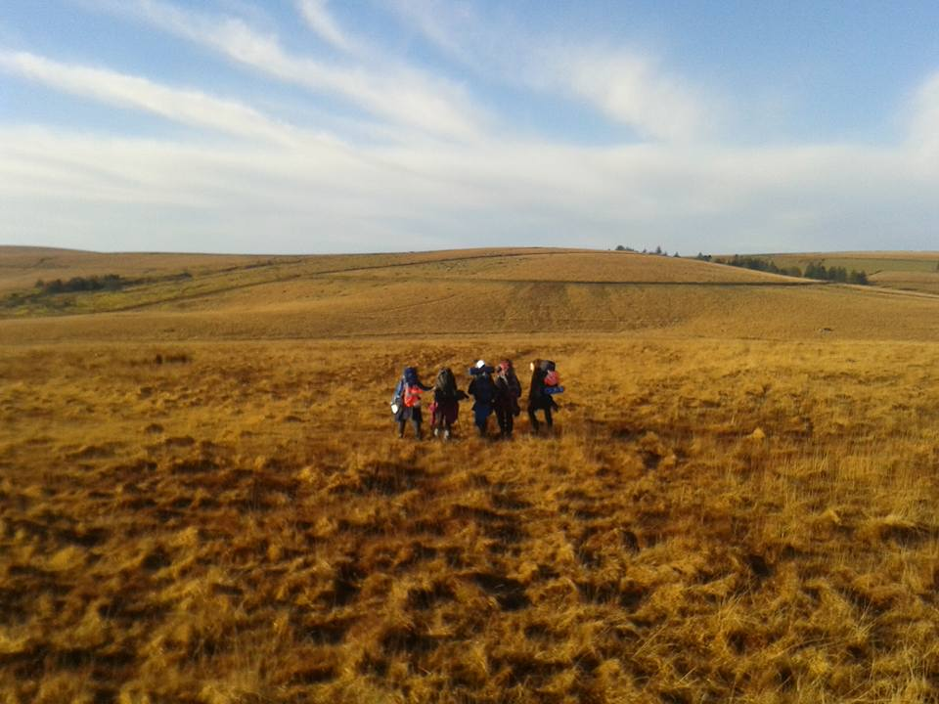
ECM
Event issues: private land

Slide 25
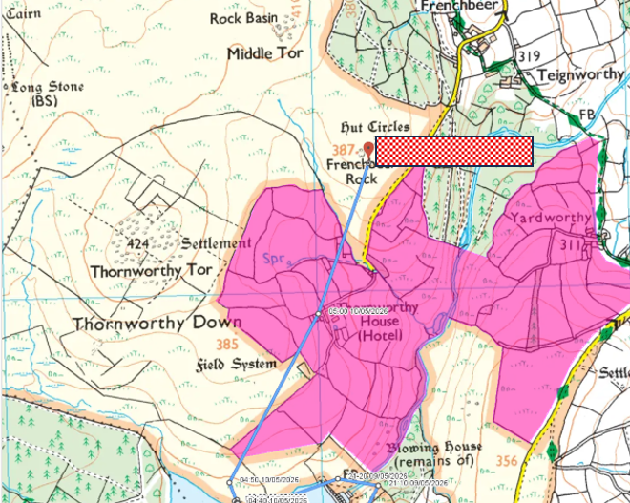
ECM
EVENT issues: private land

Slide 26
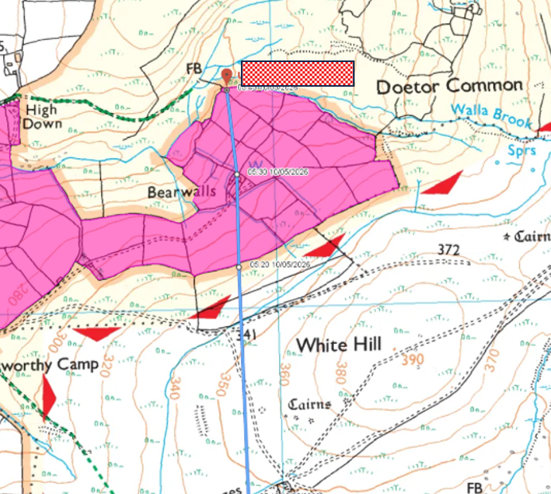
ECM

Slide 27
ECM
Post-EVENT issues
After the event all infringements logged by trackers are manually reviewed (290 individual infringements this year).
Those considered clear breaches of rules are logged.
Emails are sent to TM from JCSys.
NOTE: It is your responsibility to ensure filters don’t refuse emails from JCSys
Replies are expected before end July, either contesting the infringement or explaining how training will address the shortcomings.
Team certificates are then available.

Slide 28
ECM
Team Manager feedback
Logging Fridays on North Moor:
up to an hour? No.
more than this? Yes
An optional ECM feedback form will be available for you to use if you wish to do so.
If multiple groups train together all involved must understand their TM structure
Car park hogging is an increasing problem, expect problems

Slide 29
ECM
Critical information to take away
Rules For Training On Dartmoor start NOW
RBNA MUST be on maps from…1st February is mandatory, now is better!
Red river sections are OOB throughout training
Knowledge of the rules needs to be embedded BEFORE walking on Dartmoor
AT LEAST two Green Card and id panels at all times.
AT LEAST two hi vis on all roads.
Regularly check Firing Notices
All noncompliance is recorded and used in Selection

Slide 30
ECM
Establishment communication
Are you clear on the changes you need to inform your training team about?
When will you brief your training team on the changes and updates?
Will you have a system in place to ensure your groups inform you of any noncompliance?
When will RBNA be marked on maps?
Have you got sufficient numbers of ID panels, Green Cards and hi vis?
Do you have a system to check last minute Firing Notices changes?

