Slide 1
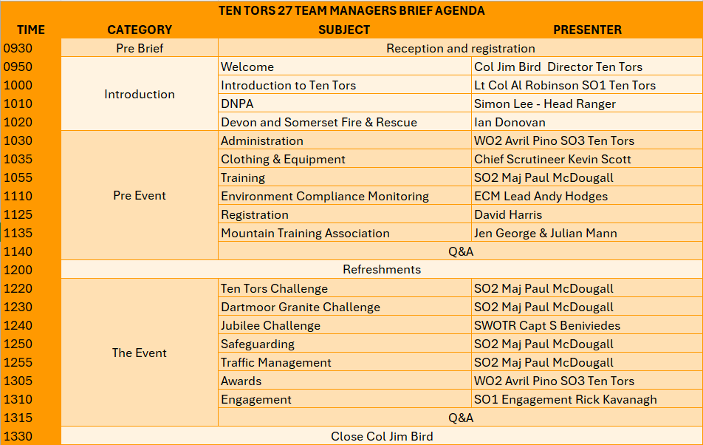


Slide 2
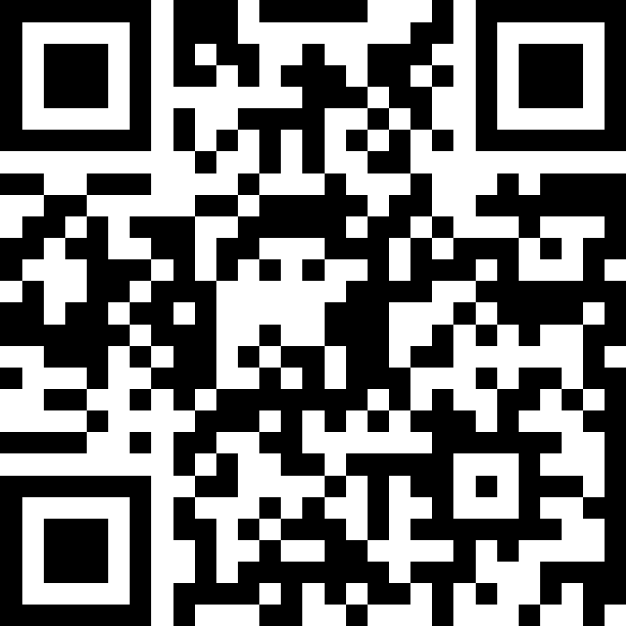
Team Managers brief
House keeping
🔥 Fire Procedures
Muster Point: Car Park
🚻 Toilets
Exit hangar
Turn right
Follow path uphill
Toilets located on the right
1472286
❓ Questions
General Q&A during breaks
Submit additional questions via QR code
Team-specific questions after the TMB
☕ Refreshments
Refreshment break scheduled
⚠️ Reminder
No gifted gear
Notes:
Slido
Avril.pino719@mod.gov.uk
Matthew1b

Slide 3
Team manager brief
Ten tors 27

Slide 4
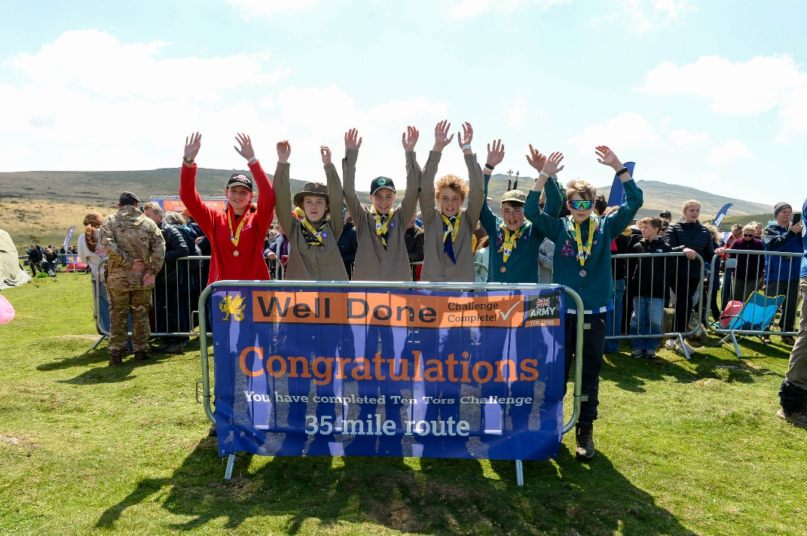
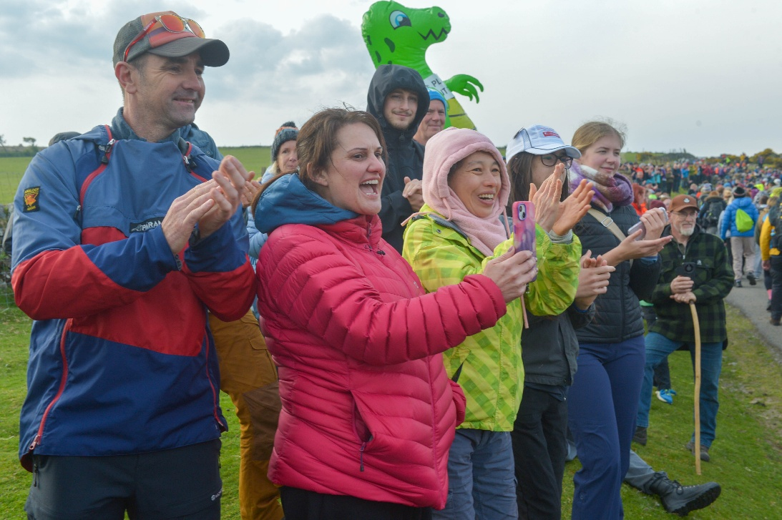
Opening address
Colonel Jim bird – director ten tors
Welcome and thank you
Ten Tors 26 feedback and lessons
Ten Tors 27

Slide 5
INTRODUCTION TO TEN TORS
Lt Col Al Robinson
so1 ten tors
Notes:
Theme: Outdoor Adventure

Slide 6
INTRODUCTION TO TEN TORS
TEN TORS OVERVIEW
TEN TORS 27
UK’s largest outdoor youth event
TEN TORS CHALLENGE
Team event
3 Distances – set by age
Saturday 0700 – Sunday 1700
‘Without outside assistance’
Limited to 400 teams
JUBILEE CHALLENGE
Individual / Team event
4 Routes – selected by Establishment
Saturday 0730 – 1800
Supervised and assisted as required
Limited to 450 participants
DARTMOOR GRANITE CHALLENGE
Individual / Team event
1 route
Saturday 0730 – Sunday 1100
Supervised at all times
Limited to 50 participants

Slide 7
INTRODUCTION TO TEN TORS
TEN TORS OVERVIEW
WHO
2400 TTC participants
450 JC participants
50 GC participants
2000 Team Staff
1000 enablers
6000 spectators
WHERE
Dartmoor Training Area
North & South Moor (45 & 55 routes only)
Duchy and other owners’ land
Dartmoor National Park
Dartmoor Commons
WHEN
Training Oct – May
W/E post-May Day BH
7th – 9th May 2027
WHY
Training benefit
Social responsibility MOD
Engagement

Slide 8
Introduction to ten tors
Selection committee – Ten Tors Challenge
APPLICATION & ALLOCATION
515 applications received.
400 available places.
451 teams allocated.
211 establishments.
COMMITTEE DECISIONS
Max 3 teams per establishment
Distance changes allowed
  No more than 2 teams at 1 distance
3 out of area establishments met criteria
  Allocated 1 team each
RESERVE TEAMS
No reserve places allocated at TT26
NO reserve places TT27 - reviewed 01 Apr
WITHDRAWALS
After payment, no refunds
Notify TT as soon as possible

Slide 9
Introduction to ten tors
Selection committee – jubilee challenge
APPLICATION & ALLOCATION
631 applications received
450 available places
631 teams allocated
49 establishments
COMMITTEE DECISIONS
Distance changes allowed
WITHDRAWALS
After payment, no refunds
Notify TT as soon as possible

Slide 10
Introduction to ten tors
Selection committee – Dartmoor granite challenge
APPLICATION & ALLOCATION
39 applications received
50 available places
39 teams allocated
11 establishments
COMMITTEE DECISIONS
Distance changes allowed
WITHDRAWALS
After payment, no refunds
Notify TT as soon as possible

Slide 11
training
MAJ Paul Mcdougall
so2 ten tors
Notes:
Theme: Outdoor Adventure

Slide 12
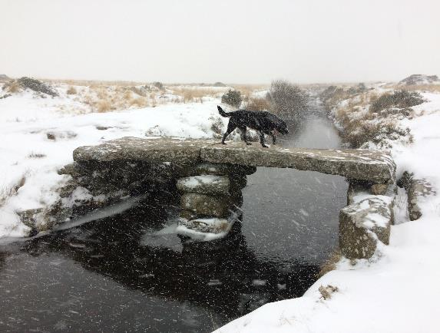
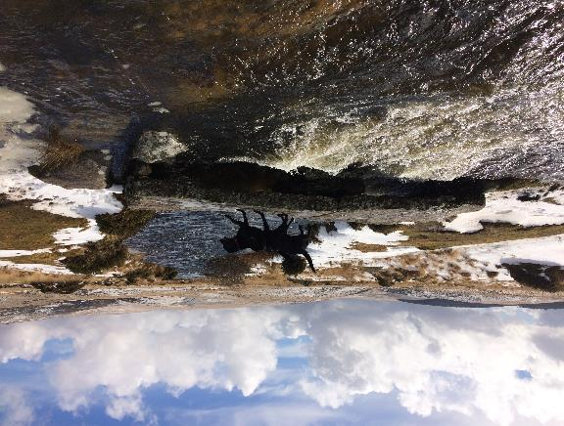
training
scope
Overview
Training on Dartmoor
Environmental Compliance Monitoring

Slide 13
training
Rules - HOE RESPONSIBILITIES
2. Head of Establishment (HoE). The HoE … is responsible, on behalf of the employer, for the safety of their participants in training, although this may be delegated to a designated Team Manager (completed online via TM Dashboard).
The HoE must assure the Director Ten Tors that all the team management are competent and suitable for the role to which they are assigned.
By sponsoring an entry the HoE accepts responsibility for all participants’ behaviour in training … this includes individuals who are not members of their own establishment.
HoE Assurance to be completed via the dashboard before
you can start training.
Notes:
Check para numbers are correct

Slide 14
training
Rules - TM RESPONSIBILITIES
3. Team Manager. The TM, appointed by the HoE, is responsible for all aspects of their Team’s training.
With the agreement of the HoE, the TM may delegate training and other duties to competent and qualified Training Event Leaders, deputies and assistants.
Prior to the start of a Challenge, the TM is required to assure the Director that all participants … are sufficiently trained [and] physically prepared… to complete [their Challenge] unaided even in adverse conditions.
Notes:
Check para numbers are correct

Slide 15
training
Rules - OVERVIEW
22. [General] Requirement. The Challenges are demanding expeditions. Thorough preparation and training are essential to complete the Challenges safely. The HoE is responsible, through their TM, for the conduct of training. The MOD accepts no responsibility for safety in training.
24. Incidents. The Ten Tors Secretary, or at weekends the Ten Tors Duty Officer, is to be informed within 48 hours of any incident in training that:
a. Involves the emergency services.
b. Results in hospital treatment.
c. May result in media coverage.
d. May lead to complaint from a 3rd party.
Notes:
Check para numbers are correct. Check content is updated.

Slide 16
training
Rules – TTC
16. Individual training requirement. Before the Event participants must complete a structured and progressive programme of training which includes as a minimum:
a. Minimum of 4 days of training on Dartmoor.
b. 2 nights of wild camping on Dartmoor.
c. From 01 Feb no more than 4 days on North Moor
d. Experience of walking in an unsupervised group.
17. Team training requirement. In addition to the above, Teams must:
a. Be sufficiently trained, physically prepared and suitably equipped to enable the team to operate safely on their own and complete the Challenge unaided even in adverse conditions.
b. Train as a team on at least one expedition noting that best practice would be to conduct regular training as a defined team. Last minute composite teams are not permitted.
Notes:
Check para numbers are correct. Check content is updated.

Slide 17

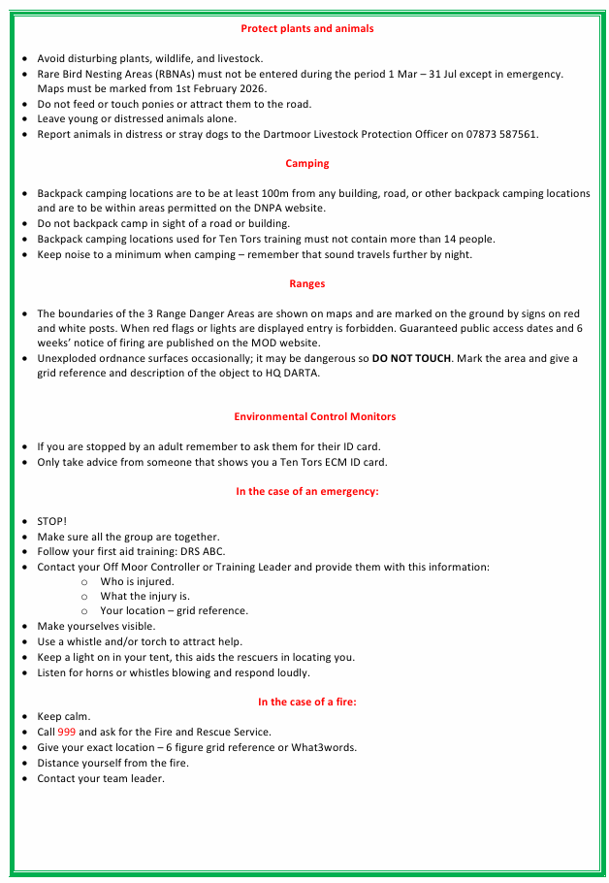
training
Rules – green card TEAM MANAGER

Slide 18
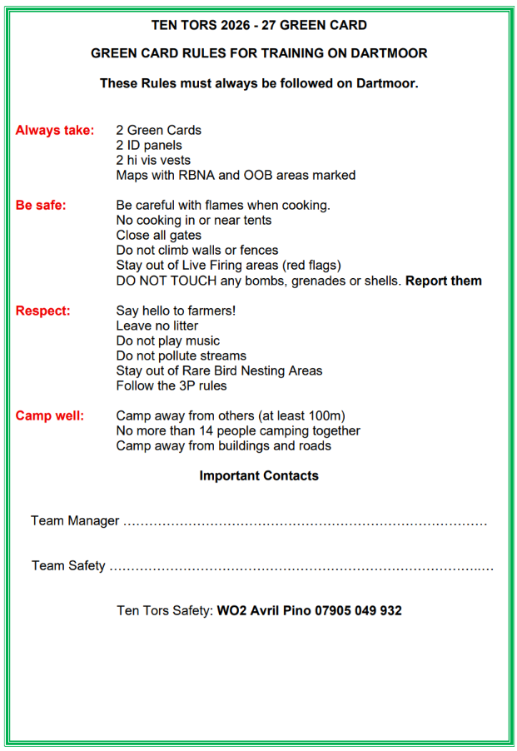
training
Rules – NEW green card ACCESSIBLE

Slide 19
JCSYS
Oliver parker

Slide 20
Agenda
JCSys
JCSys support Ten Tors through:
  Trackers with the teams on moor
  Website in the cloud
  Management Information System (MIS)
    Points of presence
    Highlight the importance of correct data in the MIS
Tracking
Website (for pre-registration)
Management Information System
Ongoing streamlining of Registration
  Printing own control cards and wristband inserts
  Self Help system at Registration
Key Dates

Slide 21
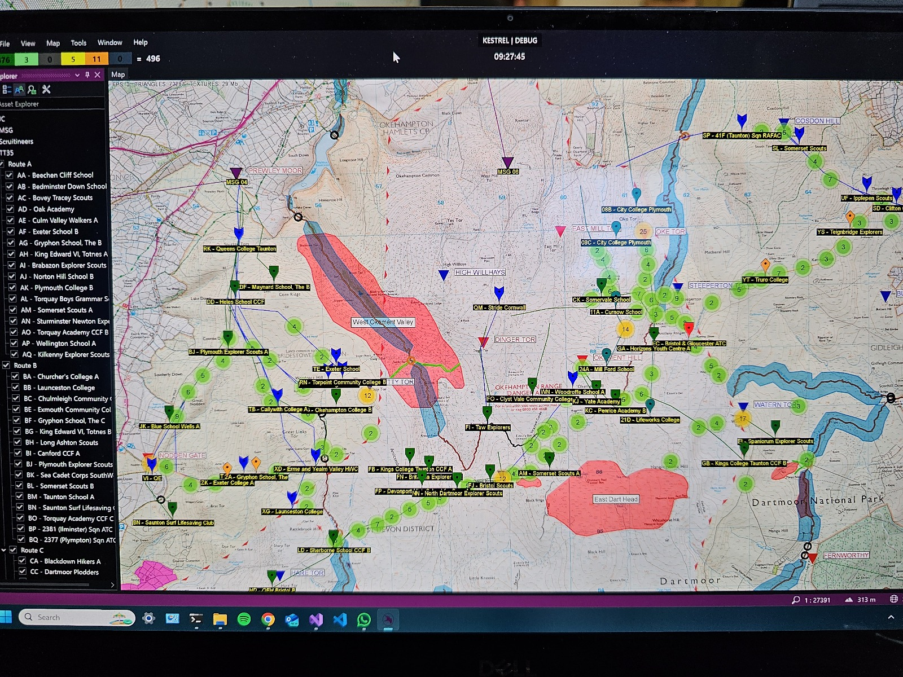
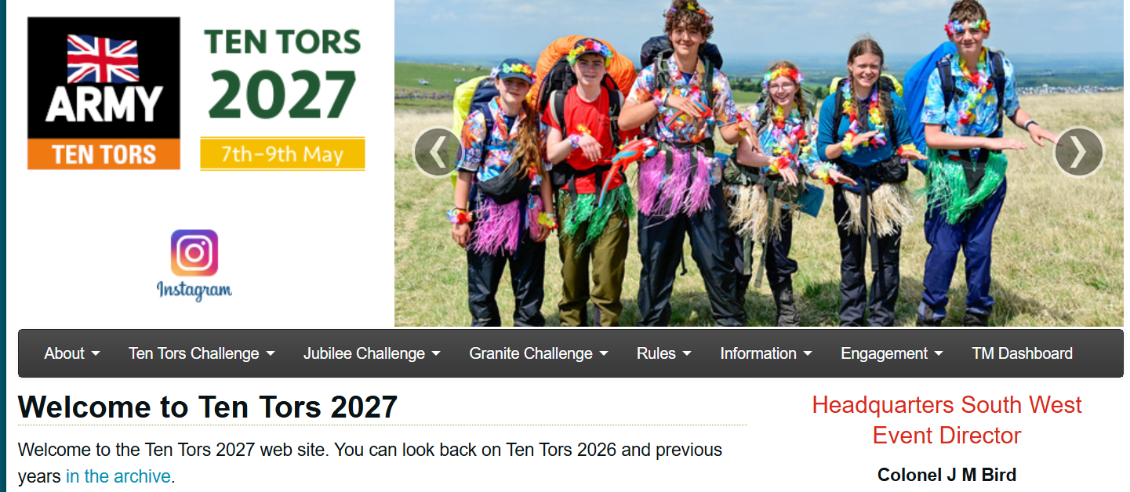
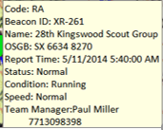

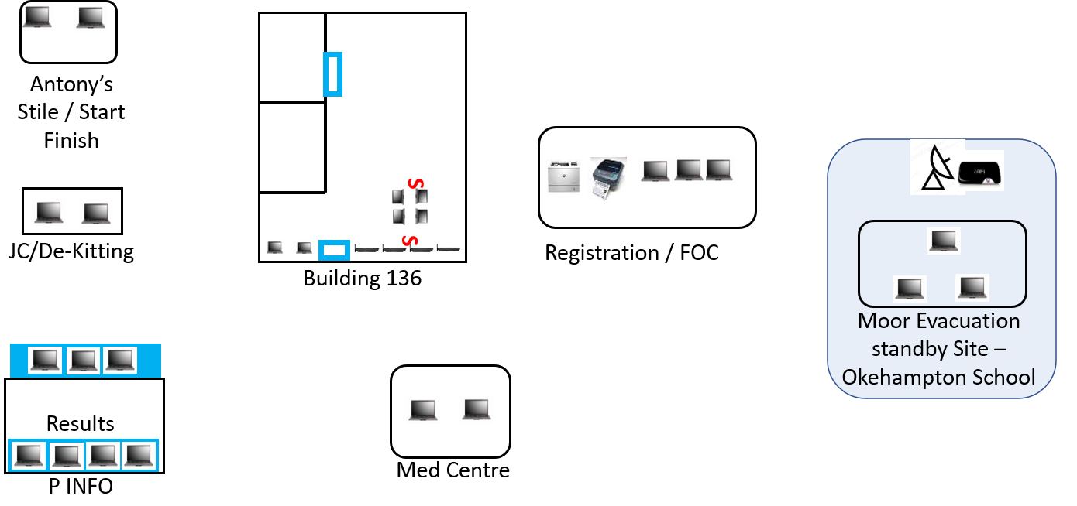

INTRODUCTION
JCSys
Tracking
Website
Management Information System

Slide 22
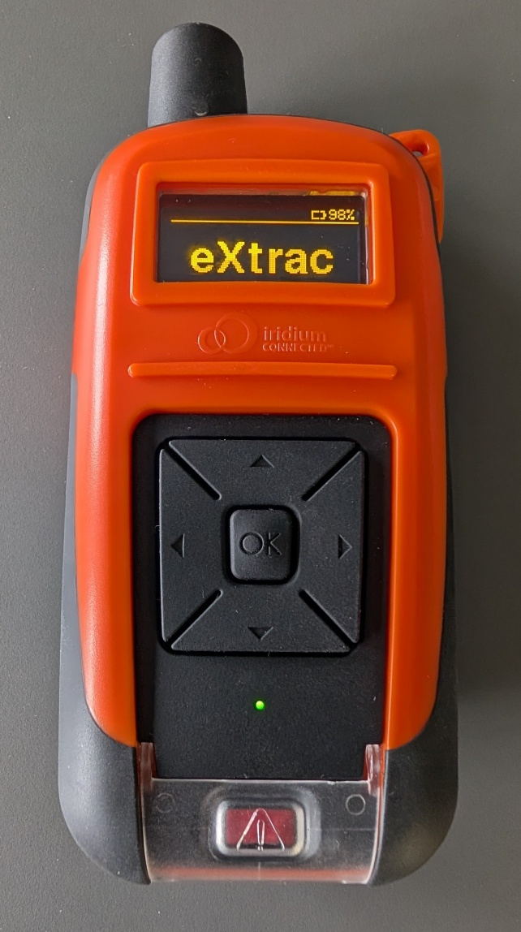
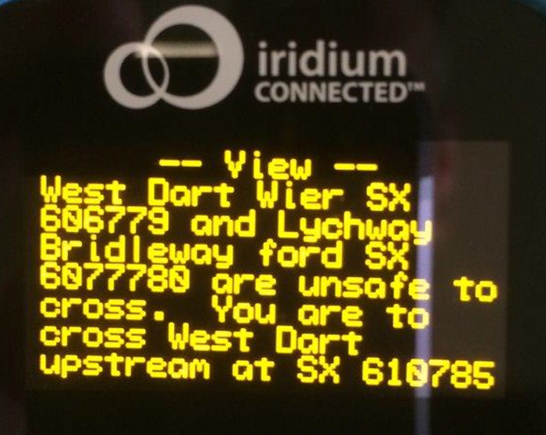
TRACKING
JCSys
GPS Location
2-Way Communicates via Iridium Satellite
  Worldwide
Emergency Button
  Sets off visual and audio alarms in Ops Room
2 Way Text Function
  River States
  Cancel Event
  Group or Individual Instructions
Team Tracks NOT published until after the event

Slide 23
TRACKING
JCSys

Slide 24
BEACON FAMILIARITY
JCSys
A training video on how to operate the beacon is available on the Ten Tors Website
Despite this it was found that many teams were still not familiar with Beacon operation
  Spurious Emergency call as opposed to manual position location
  Many beacons handed in “Beeping” hence unread message
  Poor location of beacon
In 2026 a new Beacon issue procedure was introduced:
  A team member must attend to collect the beacon otherwise it will not be issued
  A short briefing on how to use the Beacon is provided by JCSys
This proved successful and will be repeated in 2027

Slide 25

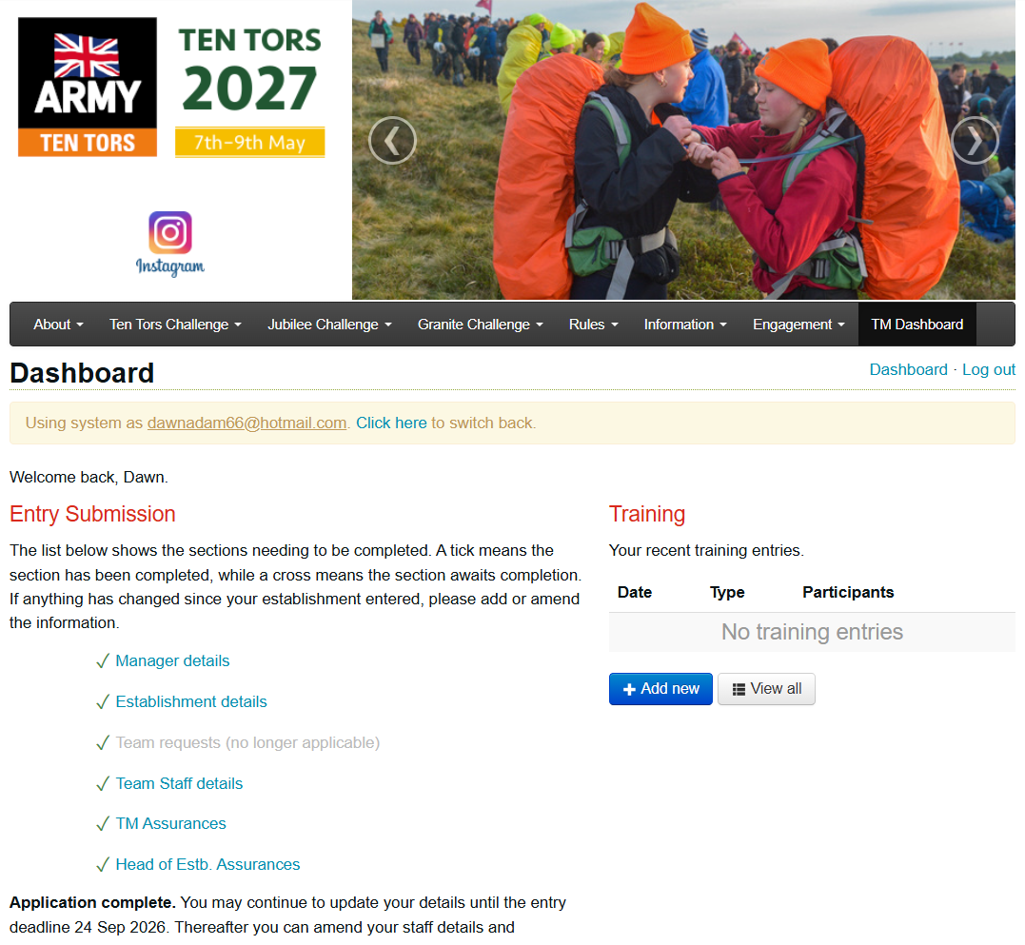
WEBSITE
JCSys

Slide 26
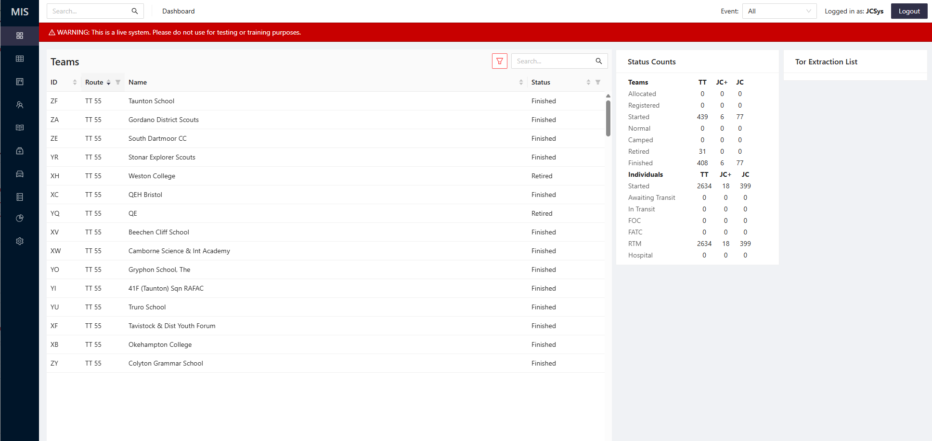
MANAGEMENT INFORMATION SYSTEM
MIS
JCSys

Slide 27
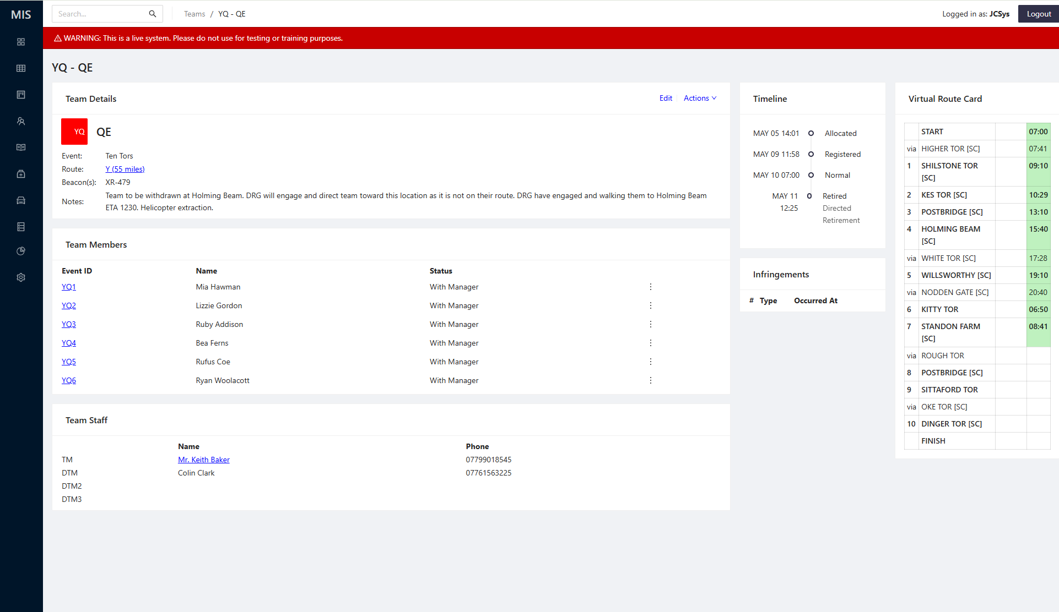
MANAGEMENT INFORMATION SYSTEM
MIS
JCSys

Slide 28
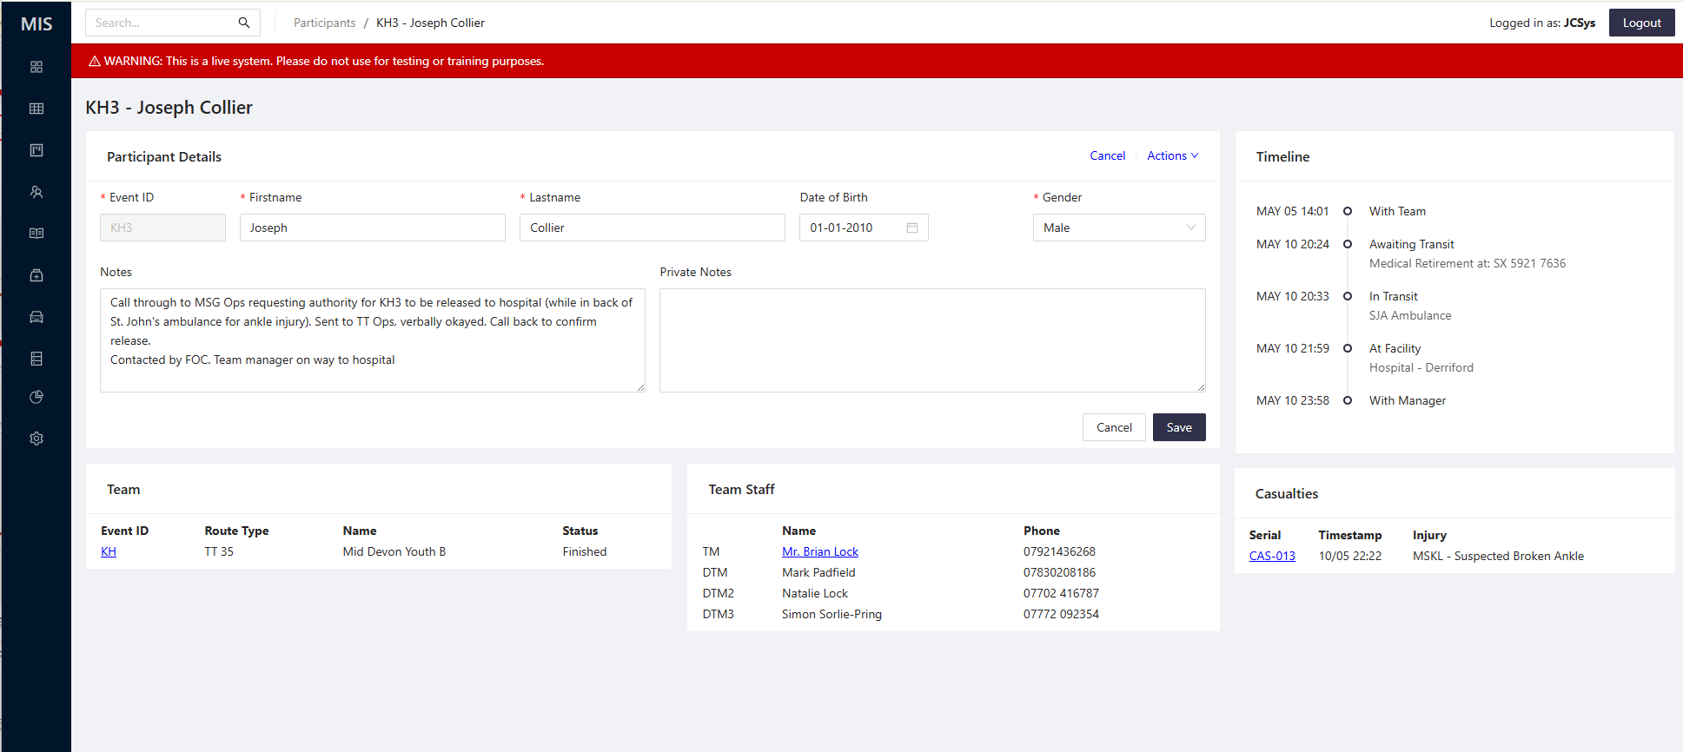
MANAGEMENT INFORMATION SYSTEM
MIS
JCSys

Slide 29
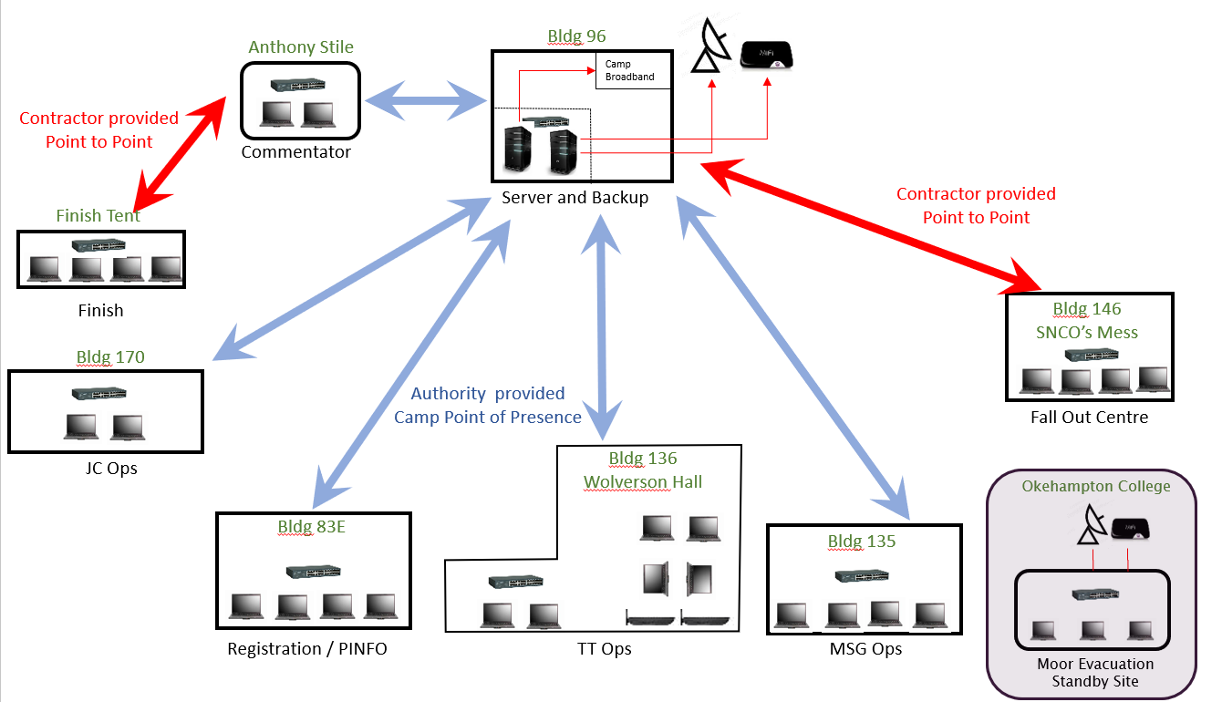
MIS POINTS OF PRESENCE
JCSys

Slide 30
Registration
JCSys
Managing Ten Tors Online
Documents and briefs to be accessed via the website:
  Safety Brief (inc. Tracker Brief)
  Tent Panel (for 35 Mile TTC only)
  TMs’ Certificate (electronically signed)
  Control Card
  Wristband Insert
  Documents to be printed out by TMs
 | TTC | JC | GC
Item
Tent Panel | X
Control Card | X | X | X | Available from 0900 Tue 4th May
Wristband Insert | X | X | X | Available from 0900 Tue 4th May

Slide 31
Registration
JCSys
  Venue will be signposted. On Arrival:
    Handover completed tent location form
    Collect replacement map (if required)
    Confirm MIS team(s) details’
    Self help area for change with laptops and MIS access.
      Registration and JCSys staff will be on hand to help
    Tracker Issue:
      TTC: Team member to receive face to face tracker brief
      JC: Issued to TM
    Only when the tracker is issued are the team registered and can start TT
    Notes:
    If no team member available, the TMs can do the first 4 steps and send a team member to collect later
    Registration will be open till 1700 on Friday and at 0600 on Saturday AM

Slide 32
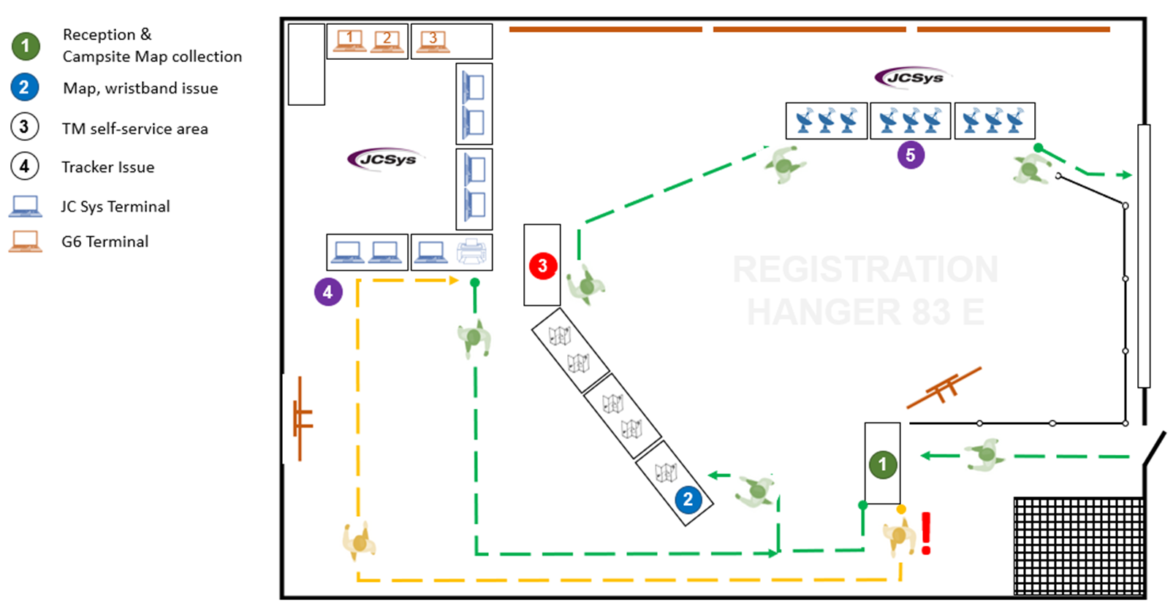



Registration
JCSys

Slide 33
Key DATES
JCSys
Entries Submitted, via Team Mangers Dashboard | Complete
Selection committee results published, on website | Complete
Team Managers' Briefing, Okehampton Camp | Sat 10 Oct 2026
Payments, via Team Managers Dashboard | 04 Jan 2027 to 1800 hrs Fri 29 Jan 2027
Pre-Registration, via Team Managers Dashboard | 01 Apr 2027 to 2200 hrs Thu 06 May 2027
Routes published on website | Tue 04 May 2027 at 0900 hrs
Ten Tors Event, Okehampton Camp | Fri 07 May 2027 to Sun 09 May 2027
Notes:
TMs will be able to change their entry and reprint their control cards and wristband inserts until pre-registration closes 2000 hrs Thursday D-2
Changes after this time can be sent to SWHQ-TenTors-MAILBOX@mod.gov.uk (info david.harris@jcsys.co.uk) so that they can be actioned before Registration opens on D-1

Slide 34
Mountain training association
JEN GEORGE
JULIAN MANN

Slide 35
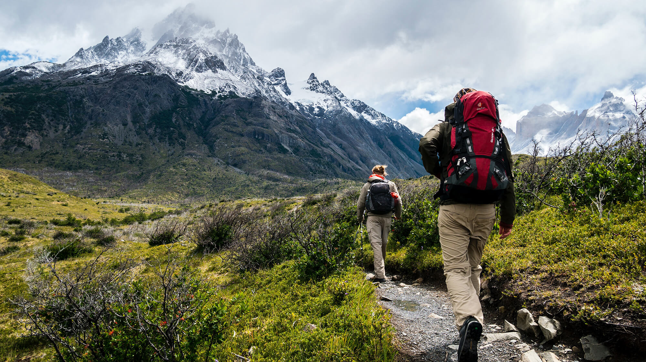
Mountain Training Association

Slide 36
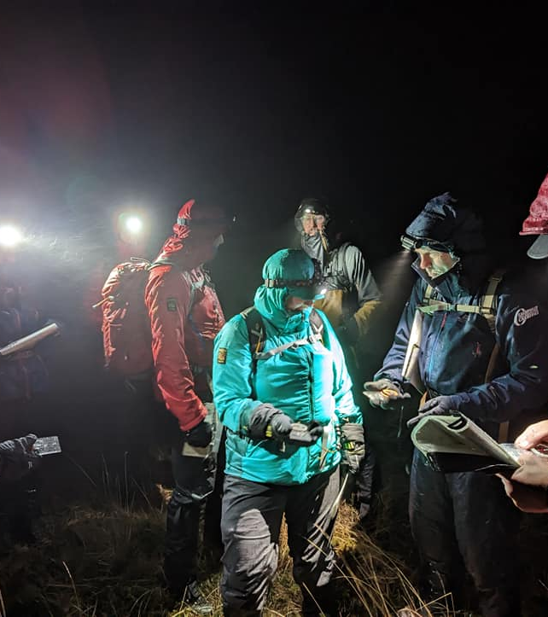
Regional Volunteers
Jen George
Cornwall
Julian Mann
Devon

Slide 37
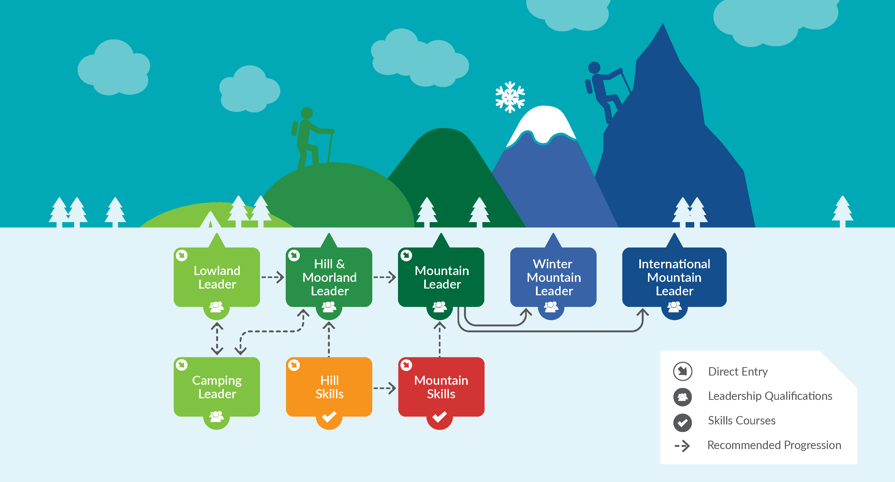
Walking qualification pathway

Slide 38

We provide members with support and development opportunities, workshops and events to help those working towards their qualification and to keep skills and knowledge current for those already qualified.

Slide 39


South Moor questions Q&A part 2
QUESTIONS
Please keep questions relevant to what has been presented so far
1472286
Notes:
Theme: Outdoor Adventure

Slide 40

refreshments
sausage or vegan sausage ROLLS, Tea & Coffee
Hangar next door
Toilets – out of the hangar Turn Right, Walk up the hill, on the right
Return no later than 1220 hrs please
CONTACT
SO3 – 07905 049 932
SO2 – 07905 049 934
Notes:
Theme: Outdoor Adventure

Slide 41
The event – general information
MAJ Paul Mcdougall
so2 ten tors
Notes:
Theme: Outdoor Adventure

Slide 42

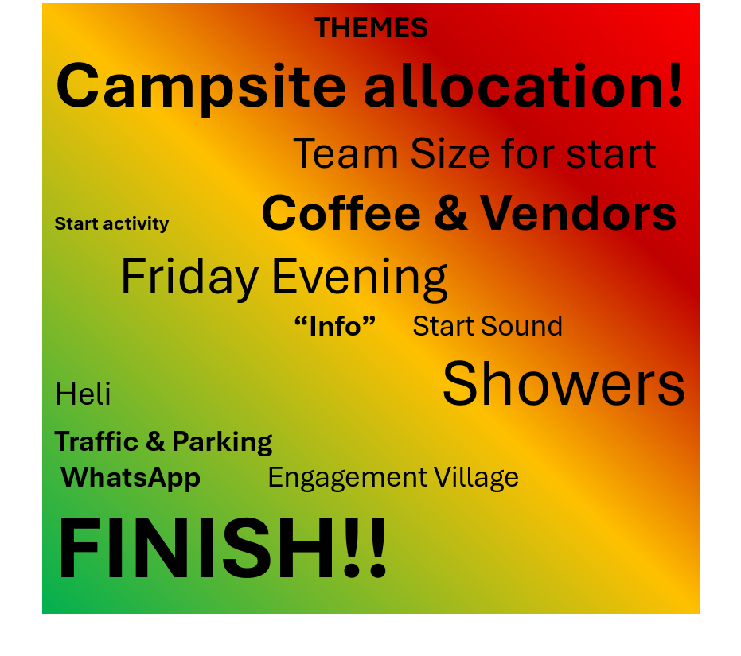
THE EVENT
Feedback & update

Slide 43
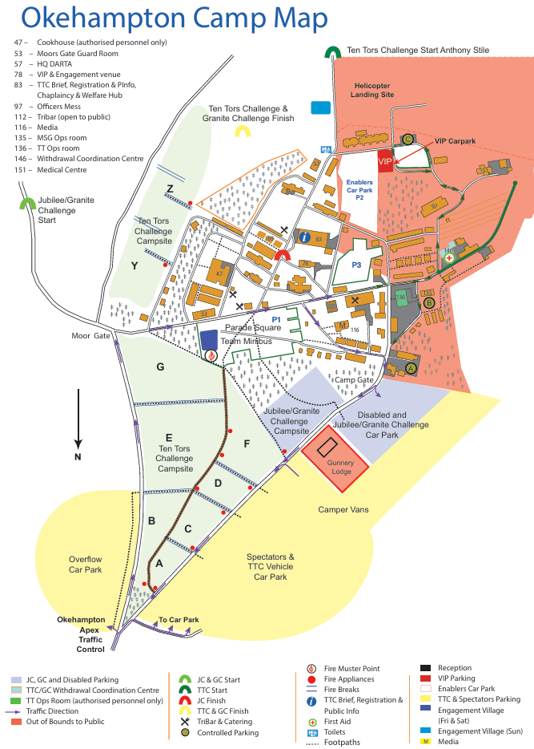
THE EVENT
TTC Start
Camp plan
JC & GC
Start
JC Finish
Registration (Pinfo)

Slide 44
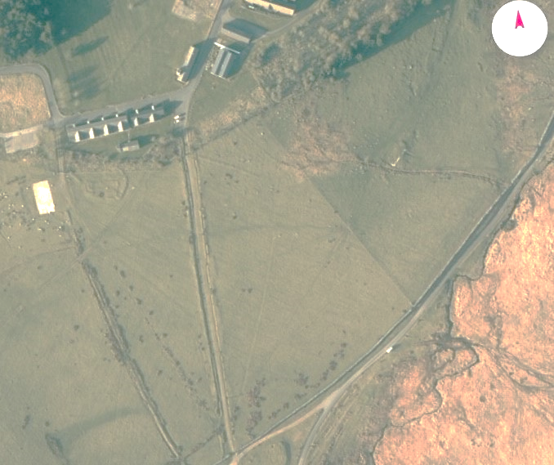

THE EVENT
Ten Tors Challenge & GC Finish
Presentation Tent
Power
6
3
Scrutineers Tent
Generator
Finish Tent
Safety Zone
1
Team stacking
area
High Voltage Power cable
5
Medal presentation area x 3
Medal Holding Area
Spectator cut-through
Out of Bounds Area
HLS
Spectators
B. Engagement Village
Spectators
Key
4
Key OCdt Positions
Finish Tent 18”24
Scrutineers Tent 12”8
Presentation Tent 9”9
Participants
First Air Tent 9”9
Finish Arch
Fencing Barriers/Pickets and Rope (Fencing all around the Finish Arch and Finish Area to be made up of barriers)
Finish Announcers Pod
2

Slide 45
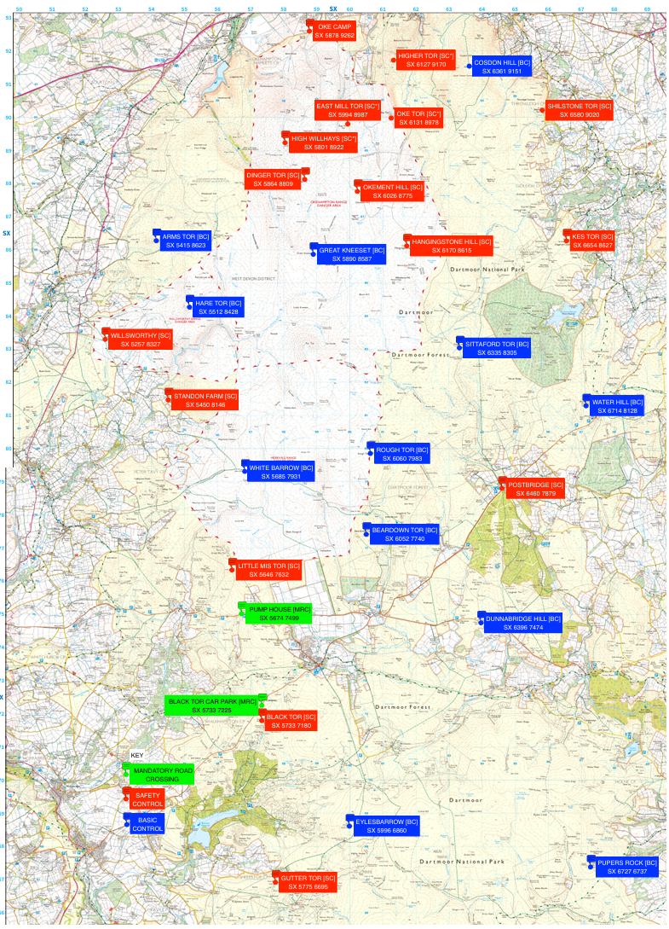
The event
Ttc controls
16 Safety Controls (SC)
13 support staff
Medical post
Road access
All JC locations are SCs
Will accept IVW
12 Basic Controls (BC)
4 support staff
No road access
Limited resources
Cannot accept IVW
2 Mandatory Road Crossings 45 & 55 only
Map available Jan 27 DNPA visitor centre

Slide 46
The event
Location | Code | Grid Reference | Category
HIGH WILLHAYS | HWH | SX 5801 8922 | SC
DINGER TOR | DIN | SX 5864 8809 | SC
EAST MILL TOR | EMT | SX 5994 8987 | SC
OKE TOR | OTR | SX 6131 8978 | SC
HIGHER TOR | HGT | SX 6127 9170 | SC
COSDON HILL | COS | SX 6361 9151 | BC
OKEMENT HILL | OKH | SX 6026 8775 | SC
SHILSTONE TOR | SHI | SX 6580 9020 | SC
HANGINGSTONE HILL | HAN | SX 6170 8615 | SC
GREAT KNEESET | KNE | SX 5890 8587 | BC
KES TOR | KES | SX 6654 8627 | SC
SITTAFORD TOR | SIT | SX 6335 8305 | BC
WATER HILL | WAT | SX 6714 8128 | BC
POSTBRIDGE | POS | SX 6460 7879 | SC
HARE TOR | HAR | SX 5512 8428 | BC
ARMS TOR | ARM | SX 5415 8623 | BC
WILLSWORTHY | WWY | SX 5257 8327 | SC
ROUGH TOR | ROU | SX 6060 7983 | BC
BEARDOWN TOR | BDT | SX 6052 7740 | BC
LITTLE MIS TOR | LMT | SX 5646 7632 | SC
STANDON FARM | STA | SX 5450 8146 | SC
WHITE BARROW | BAR | SX 5685 7931 | BC
DUNNABRIDGE HILL | DUN | SX 6396 7474 | BC
BLACK TOR | BLK | SX 5733 7180 | SC
EYLESBARROW | EBW | SX 5996 6860 | BC
GUTTER TOR | GUT | SX 5775 6695 | SC
PUPERS ROCK | PUP | SX 6727 6737 | BC
controls

Slide 47
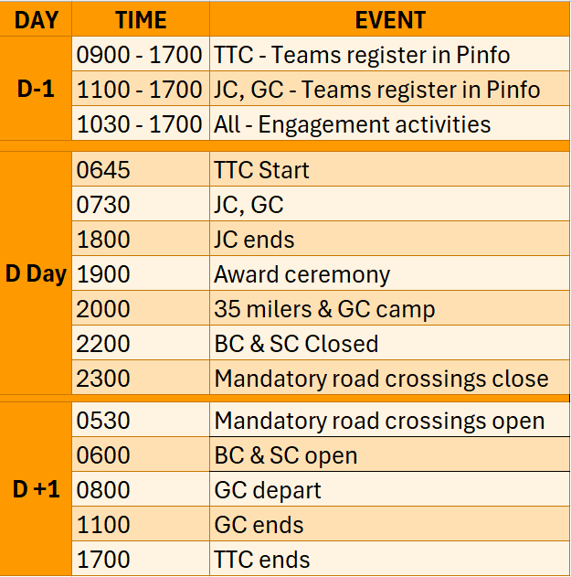
The event
Key timings

Slide 48

Ten Tors 2027 PINK Card Rules for PARTICIPANTS
These Rules must be carried by the Team / Walking Leader and Deputy and followed by all participants.
Ignoring them may disqualify your Team or Establishment from this or future Ten Tors.
Final details for the Pink Card will be updated and published by 1 May 2027.
The draft is available on the website.

Slide 49
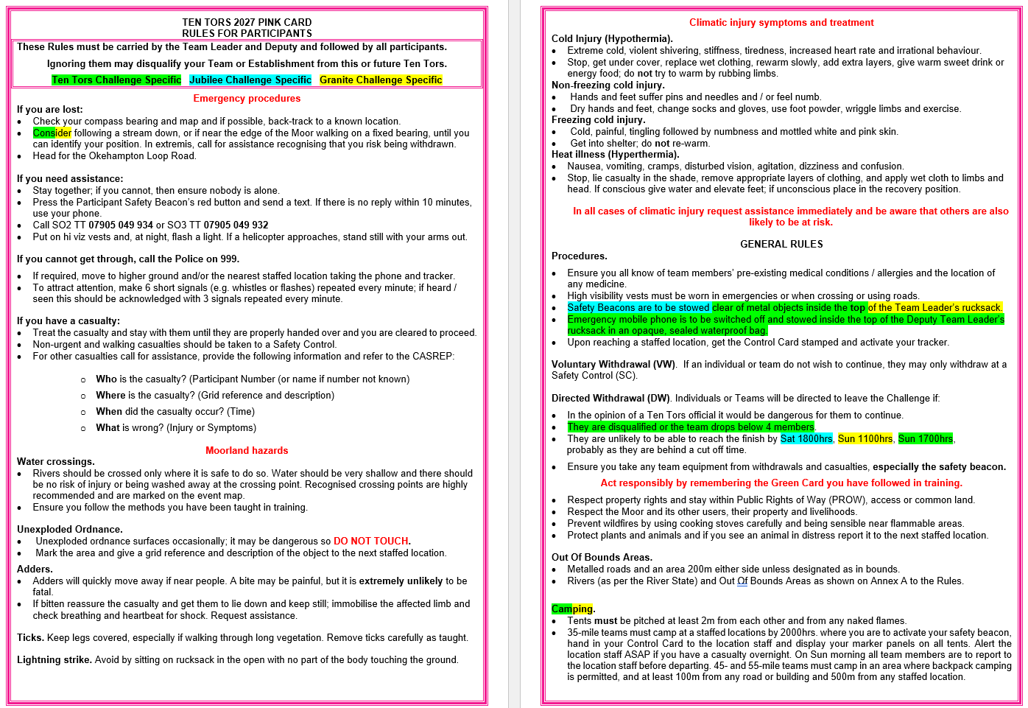
Ten Tors 2027 PINK Card Rules for PARTICIPANTS
Includes:
Emergency procedures
If you are lost:
If you have a casualty
Moorland hazards:
Water crossings.
Unexploded Ordnance.
Adders.
Ticks.
Thunderstorms.

Slide 50
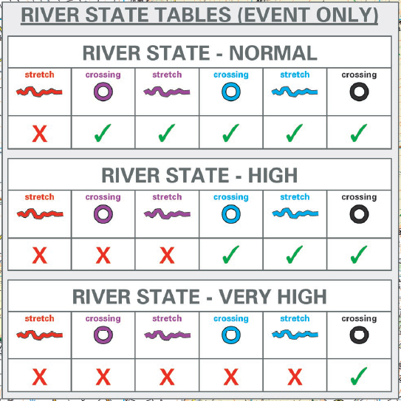
THE EVENT
RIVER STATE INFORMATION
No change to River and crossing point data, but notation on the maps has / will change and include South Moor.
Do not use old mapping; it will cause potentially dangerous confusion.

Slide 51
THE EVENT
THE RIVER STATE DIRECTS WHICH
RIVER STRETCHES AND CROSSINGS ARE UNSAFE AND THEREFORE OUT-OF-BOUNDS DURING THE EVENT
RIVER STATES EXPLAINED
Very High
High
Normal
Direction of Flow

Slide 52
Ten Tors 2027 Orange Card Rules for Team Staff
Ignoring these Rules may disqualify your Team or Establishment from this or future Ten Tors.
Final details for the Orange Card will be updated and published by 1 May 2027.
The draft is available on the website.

Slide 53
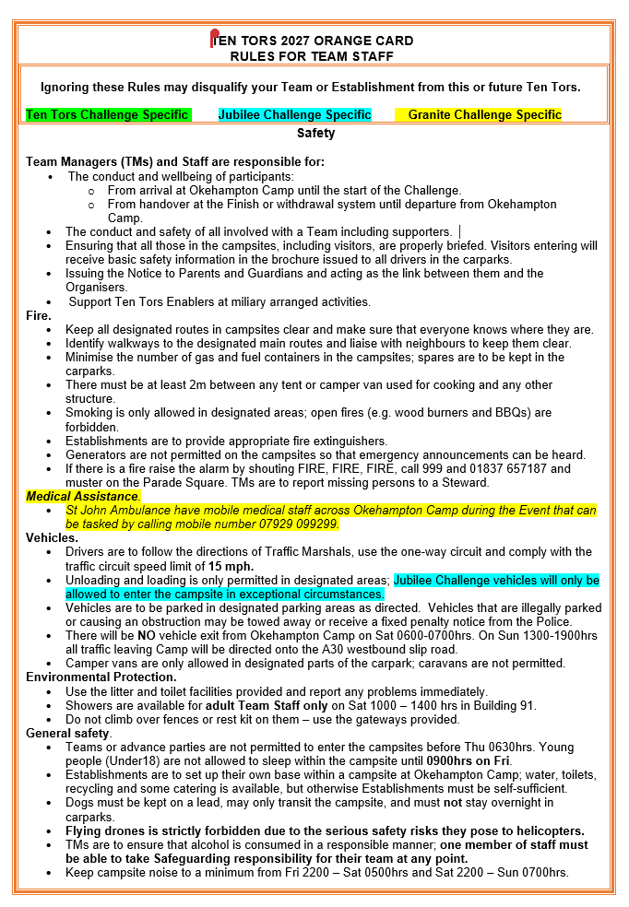
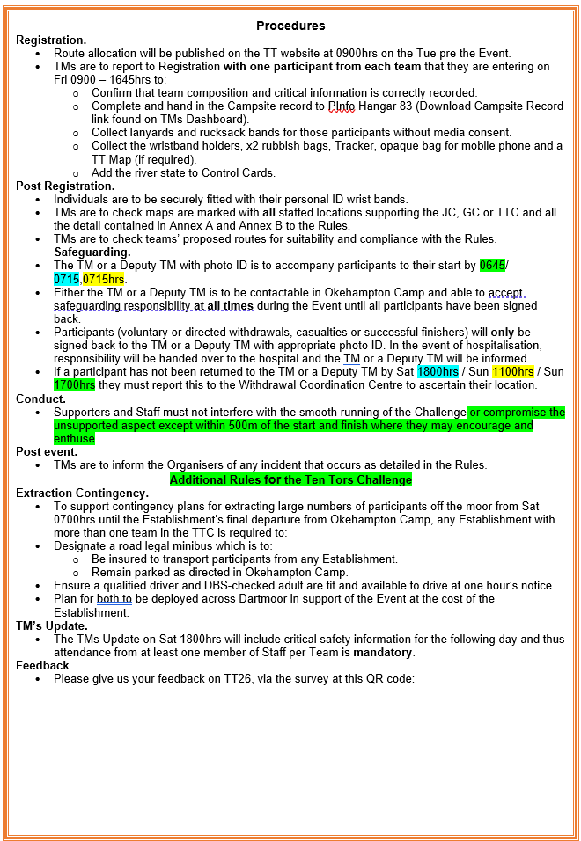
The event
Orange card rules

Slide 54
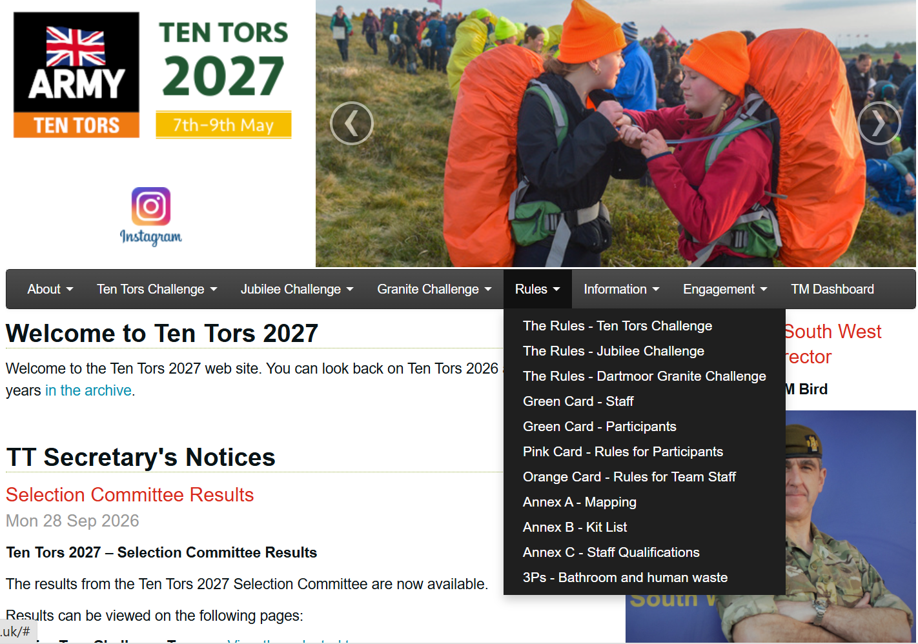
The event
Where to find the green, pink, & orange cards

Slide 55
Jubilee challenge
Capt S BenAvides
Southwest officer training regiment

Slide 56
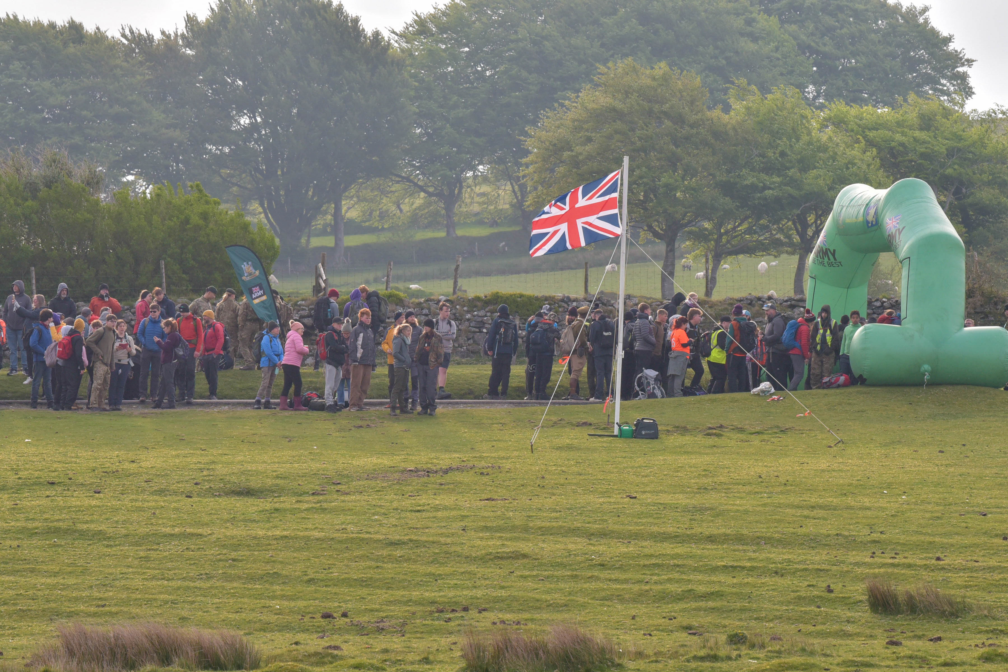
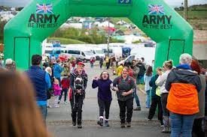
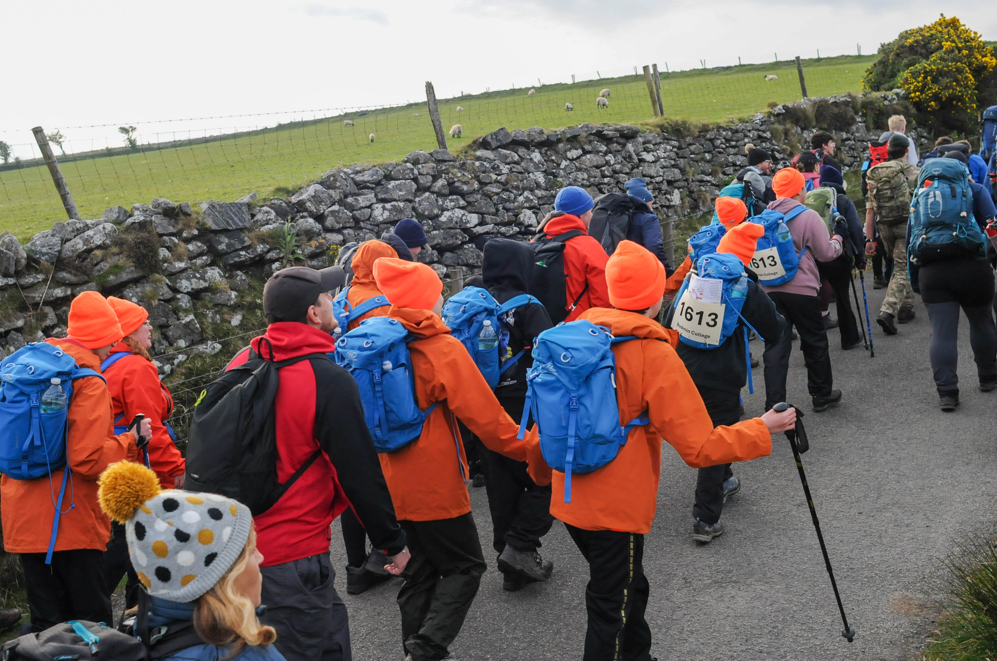
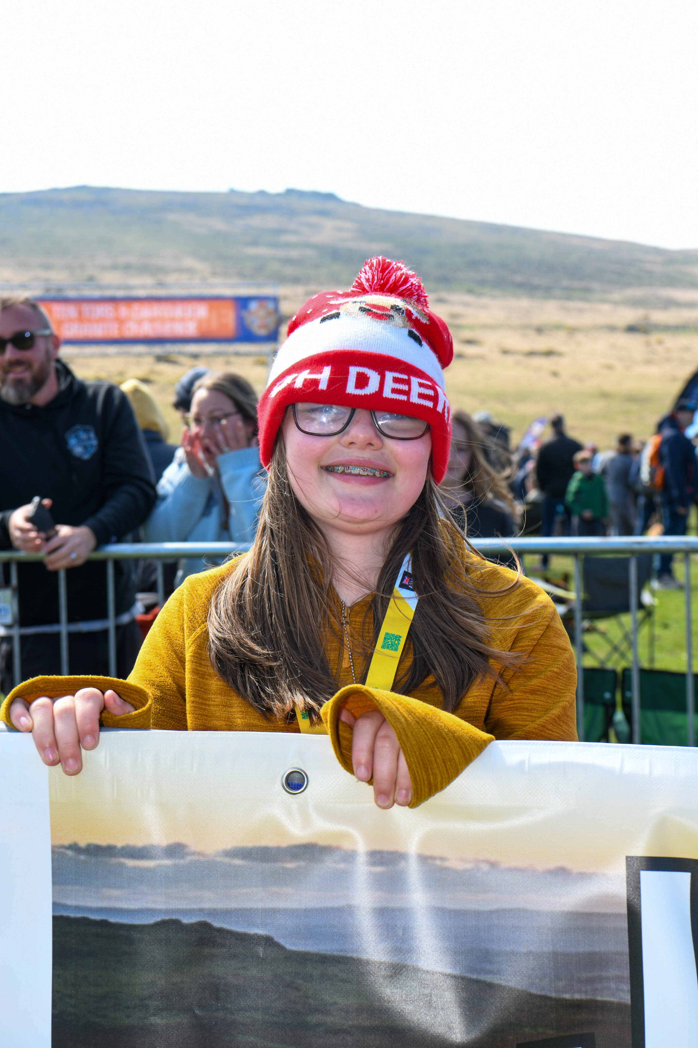
TEN TORS
JUBILEE CHALLENGE 2027
Notes:
The Jubilee Challenge is the inclusive event within Ten Tors, which allows for children with additional needs to take part with the support the need to succeed.
2026 we had 429 challengers take part, with 428 completing the challenge and only 1 withdrawal, next year we’d love to see every challenger complete the event.
2027 marks 50 years of the Jubilee Challenge. the Golden Anniversary will be celebrated with commemorative medals and certificate.

Slide 57
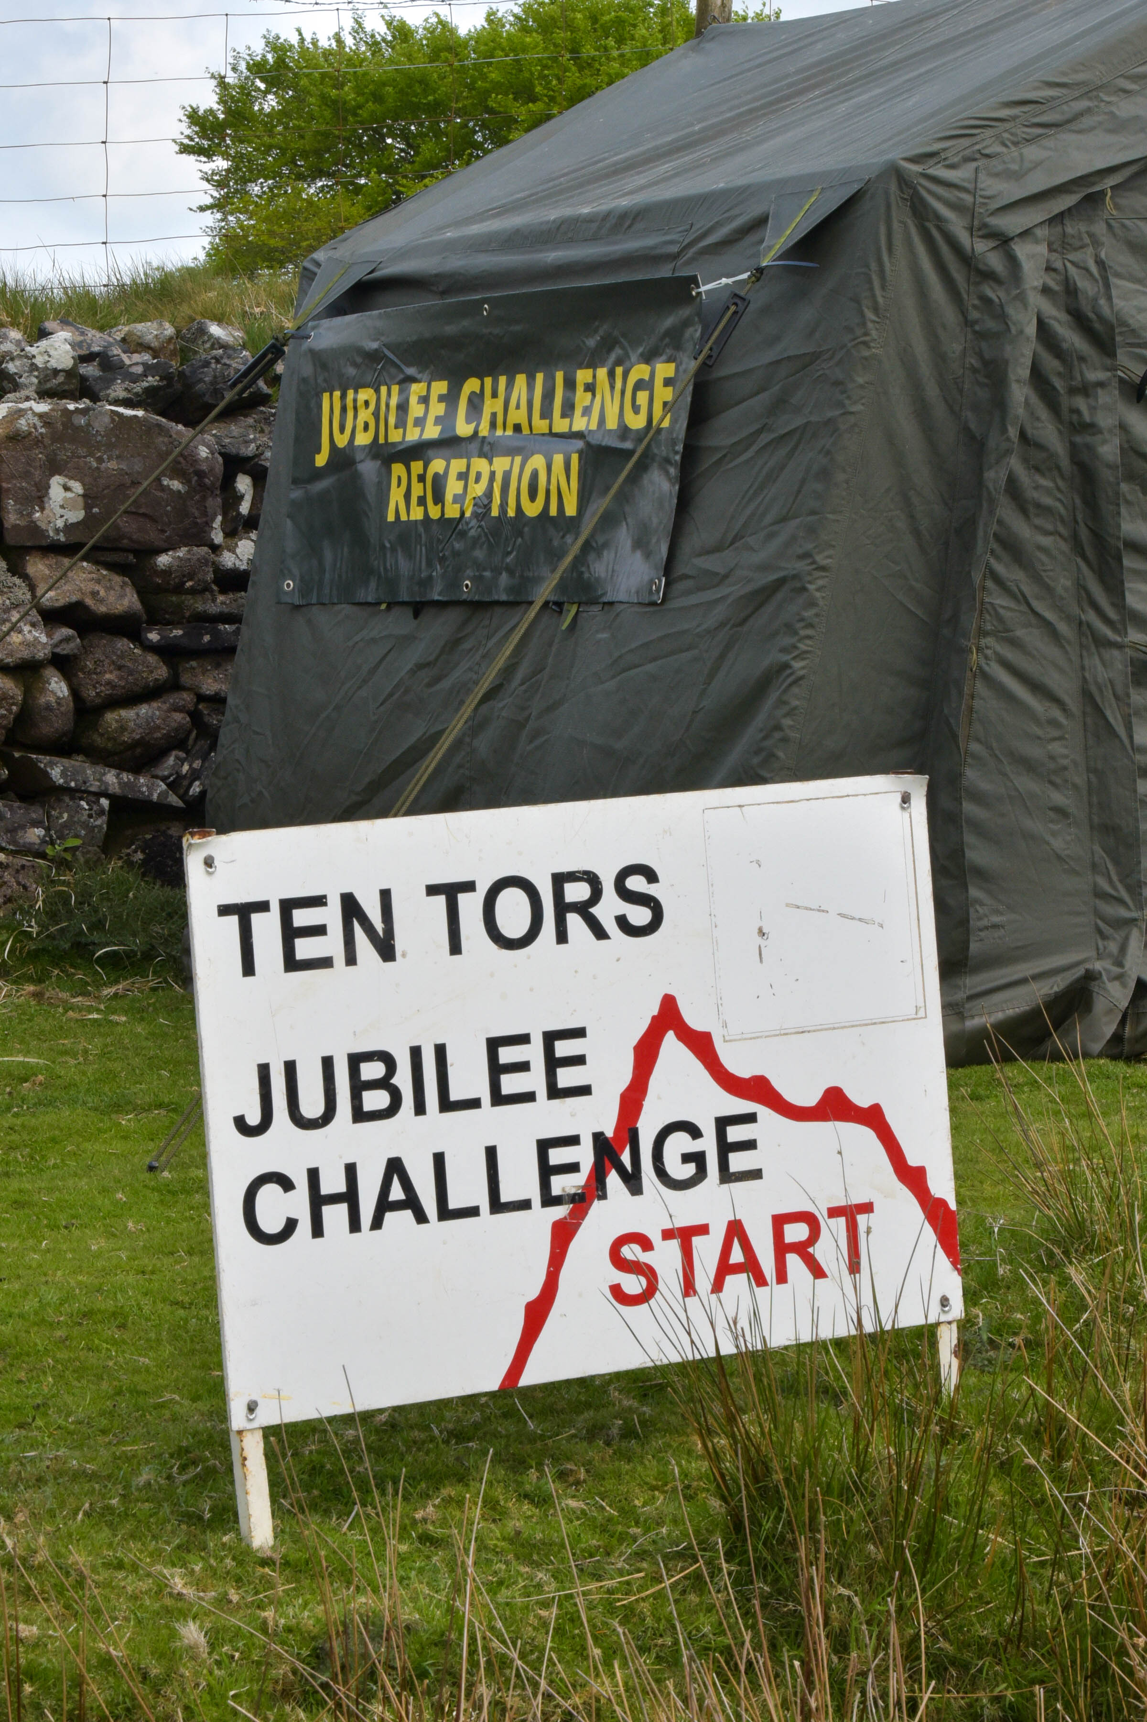
TEN TORS
JUBILEE CHALLENGE 2027
Southwest Officer Training Regiment
  Officer Cadets (University Students)
  Falmouth, Plymouth, Exeter, Bristol & Bath
Shadows – Request at Reception
(we will do what we can)
One day event
Four Testing Routes
  JC1 – 7.8 Miles
  JC2 – 8.7 Miles
  JC3 – 11 Miles
  JC4 – 15 Miles
400-450 Challengers
Finish Line in Camp Saturday 1000hrs – 1730hrs
Notes:
Made up of Bristol and Exeter UOTC. With students from Falmouth, Plymouth, Exeter and Bath volunteering to support the event, whilst in their exam periods.
Shadows are available on request. They are the Ocdts, who are available to accompany the groups. Shadows need to be requested at Reception, and allocation will bedepend on availability, will be prioritised by need. We don’t usually have an issue with having enough shadows, but do make sure you request them, as any unassigned Ocdts will be directed elsewhere.
1 day event, and will run until 1800hrs. Every team that finishes, whether its as 1000hrs or 1800hrs will get the same energetic and enthusiastic finish experience, If any teams have not completed the challenge by 1800hrs we’ll then send out the safety vehicles to locate them.
Jubilee Challenge finish by front of this building.

Slide 58
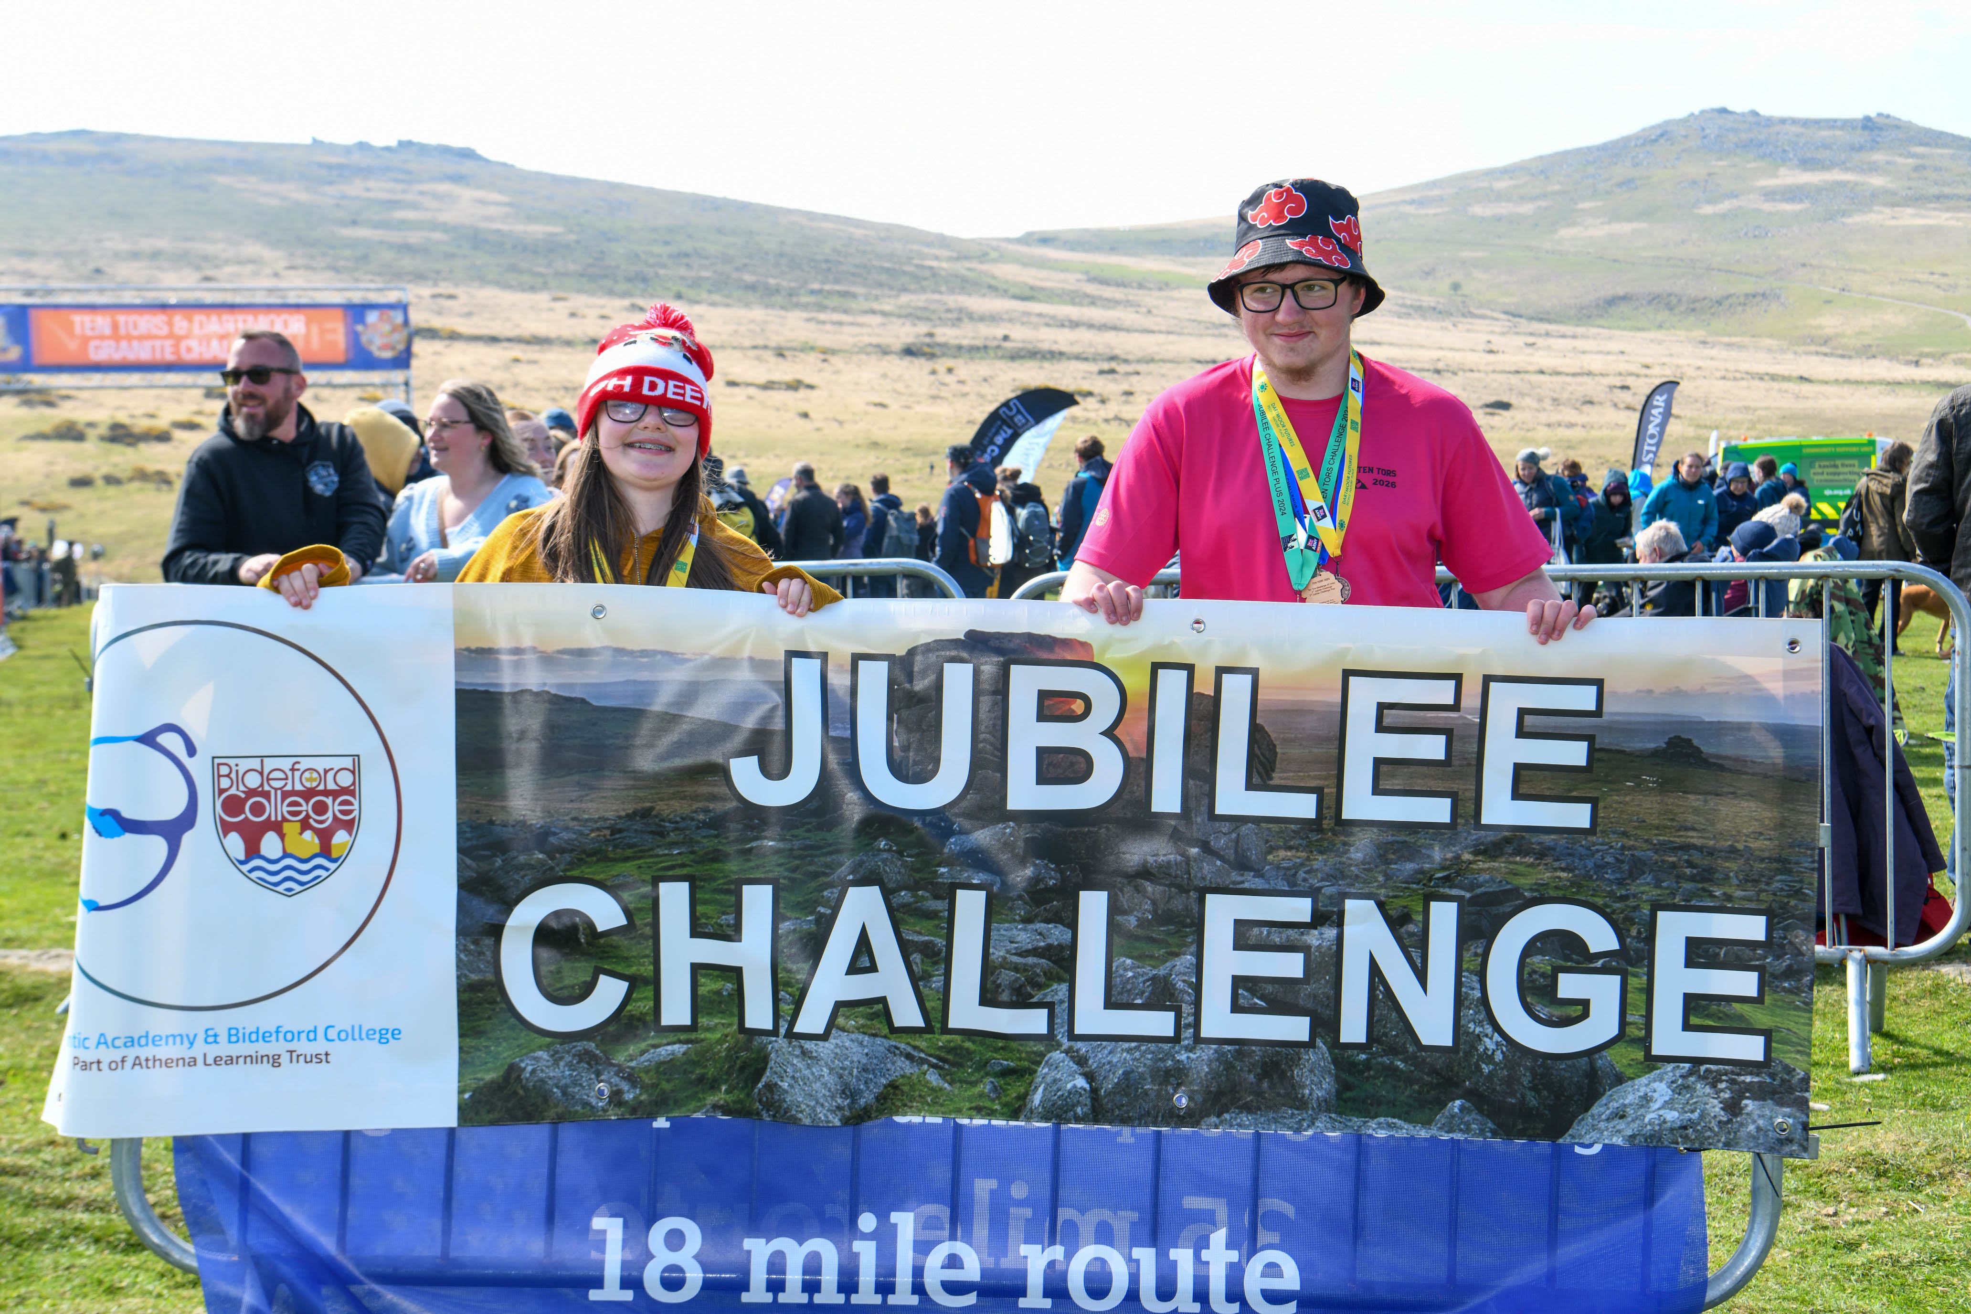
TEN TORS
JUBILEE CHALLENGE 2027
Registration – Online and with Ten Tors
Camping – Sports Field with marked Pitches. Please reply to emails to confirm Allocation (Late Apr). Space is limited!
Start/Finish – No Changes D+30min (0730hrs) to NLT 1800hrs
Control Points – No Changes 2 OCdts minimum on each.
Challengers Released to Team mangers – Off the Moor Certificate & Release point at Finish
Notes:
Registration is co-located by Ten Tors desk. Once you arrive the staff will direct you where to go.
Camping remains as previous years, with allocated pitches Jubilee Challenge. Emails will be sent out around April to confirm team numbers and allocate pitches.
Start/Finish – Teams start at 0730hrs. If you arrive by 0645hrs you’ll be in time to see all the start activity taking place. Teams should finish by 1800hrs.
Control Point locations remain as set out online. 2 OCdts will staff each CP, they will be well marked and easily visible. As usual CP7 (Okement Hill) will have extra toilets, and there will be warm drinks and squash, and some administration tents.
At the Finish line, trackers will be taken in and certificates issued, and teams will be formally handed back to Team Managers – please make sure the entire Team goes through our final control point so we can check them in as safe, and most importantly – we’ll direct you to the Pasty Tent from there.
Does anyone have any burning questions?

Slide 59
THE EVENT – Dartmoor Granite Challenge
So2 TT Maj Paul mcdougall

Slide 60
THE EVENT
Dartmoor Granite Challenge (GC)
DARTMOOR GRANITE CHALLENGE
18KM of challenging terrain.
Overnight camp – Cullever Steps
Individual / Team event (Max 4 in team)
Encourages resilience, teamwork and self-reliance through expedition-style activity.
Start D-Day 0730
Finish D+1 1100 (no move before 0800)
WHO IS IT FOR
Aimed at young adults with SEND.
Bridges the gap between the Jubilee Challenge and Ten Tors for young people with SEND.
Contact SO3 TT to discuss individual suitability if unsure

Slide 61
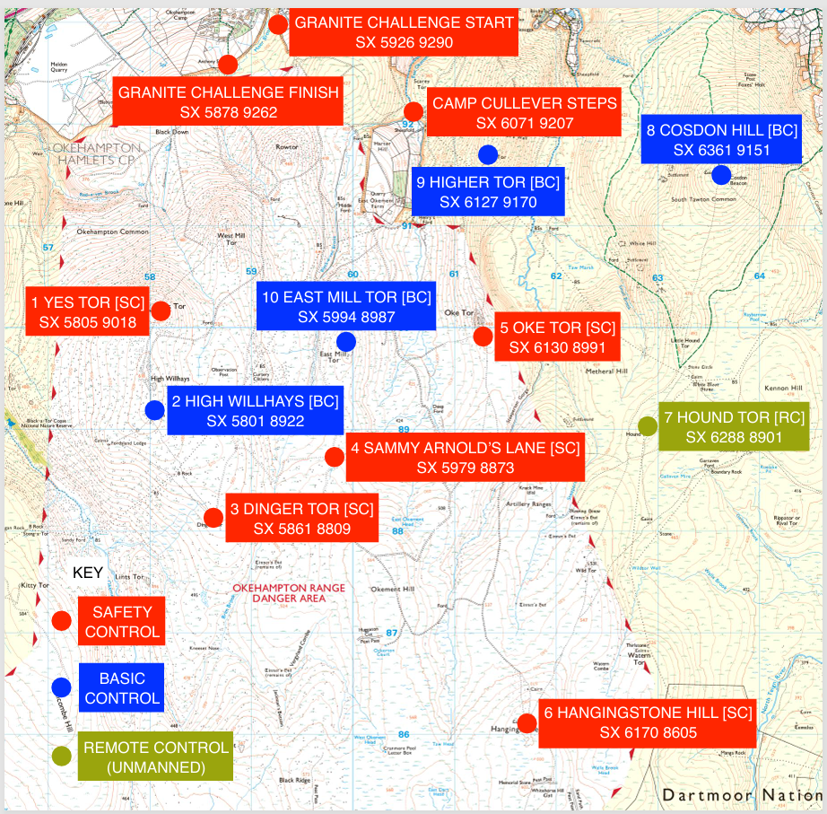
THE EVENT
Dartmoor granite challenge controls
Campsite GC

Slide 62
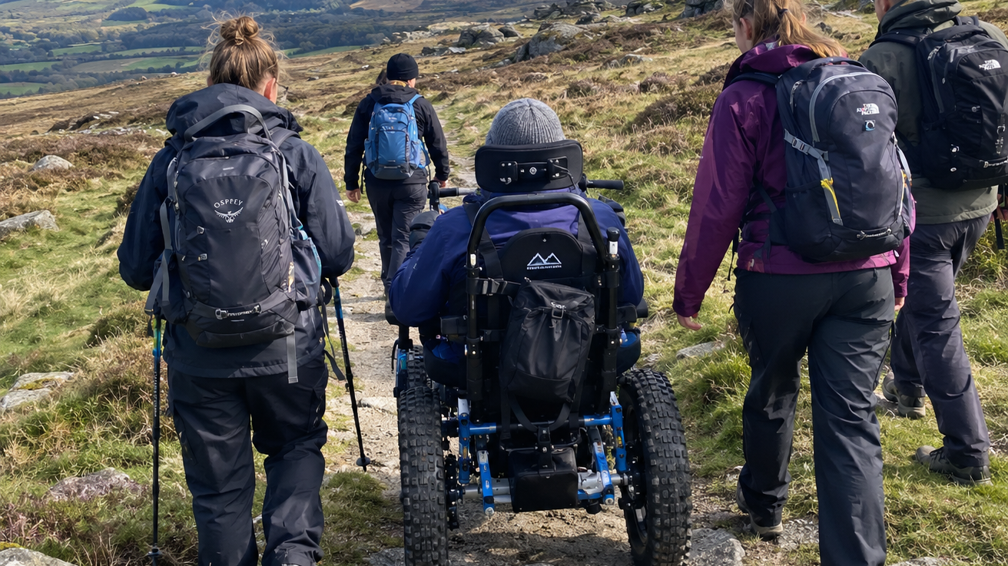

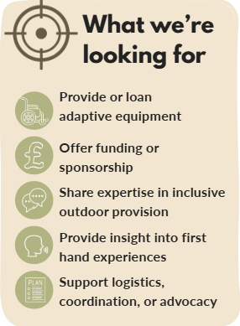
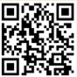
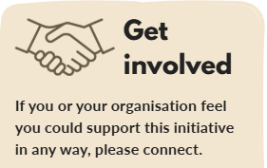
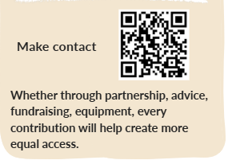
Jubilee Challenge Accessibility Project
Supporting Inclusive Access to the Jubilee Challenge

Slide 63
safeguarding
MAJ Paul Mcdougall
so2 ten tors
On behalf of Nathan ditton
DESIGNATED SAFEGUARDING LEAD
Notes:
Theme: Outdoor Adventure

Slide 64
THE EVENT
Safeguarding
Safeguarding is Everyone’s Responsibility
Policy: Read and understand the TT Safeguarding Policy.
Roles: Army Cadet Safeguarding Hub leads event safeguarding; TMs must actively partner.
TMs: Ensure adults are trained, prepared, and able to support safeguarding throughout.
Reporting: Use the safeguarding reporting form or raise concerns via TT Ops Room. TT Safeguarding Leads will coordinate.

Slide 65
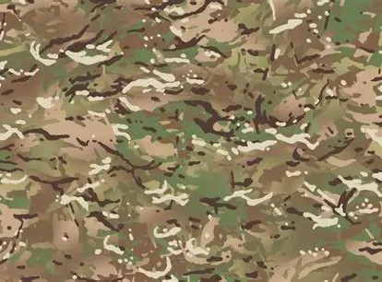
THE event
Safeguarding
Timeline: TMs lead safeguarding pre-event; Military Safeguarding Team leads during the event.
Information Sharing: Share safeguarding concerns early and proactively.
Post Event: Incidents reported to organisations, DSLs, and statutory agencies as required.
Pre-event Training
TM
D -1
TM
0730 D
MILITARY
D +1
MILITARY
Post
TM

Slide 66
TRAFFIC MANAGEMENT
TEN TORS OVERVIEW
TEN TORS 26
3445 prepaid parking tickets sold Saturday.
3445 prepaid parking tickets sold Sunday.
Only 50 vehciles arrived without passes.
No traffic issues in Okehampton.
No traffic issues entering or exiting Okehampton camp.
Traffic Management Company.
TEN TOR 27
Increase to £10 per day.
3445 parking space available each day.
Each team allocated 1 vehicle pass.
Support vehicles attending on Thursday and/or Friday do not require a pass but must depart by Friday evening.
Purchase tickets through the website site.

Slide 67
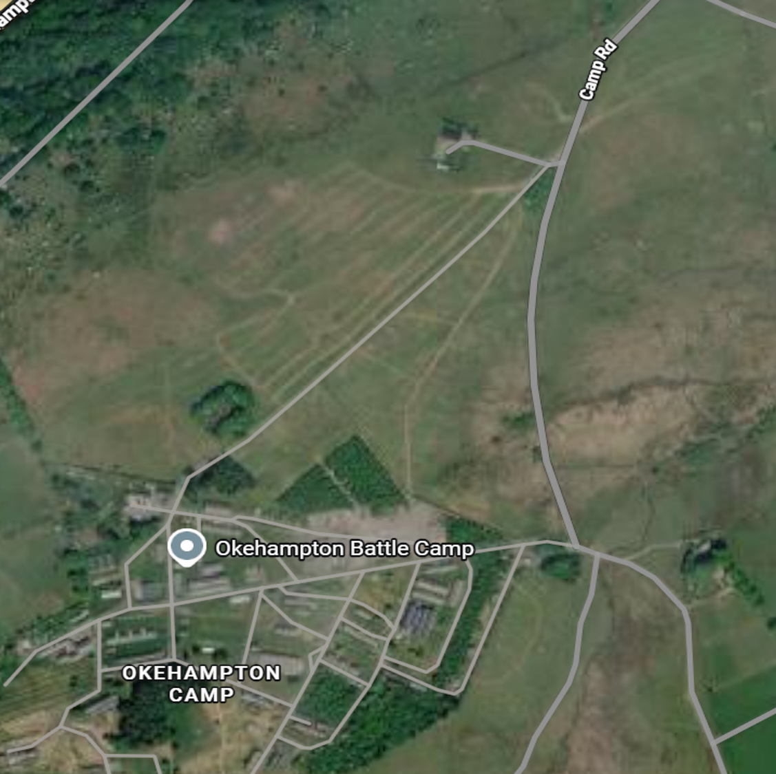
Moor gate
Y
Z

Slide 68
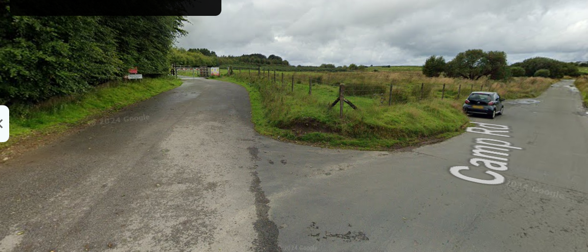
TRAFFIC MANAGEMENT
Moor Gate TRAFFIC Control - Campsite Y & Z
TRAFFIC MANAGEMENT MEASURES
Manned Vehicle Control Point (VCP) established at Moor Gate.
No Parking Zone enforced between Moor Gate and the VCP.
No Team Vehicles permitted beyond the RED Control Point from D-2 onwards.
From 0630hrs D-2, vehicles admitted under control of the TMG.
Additional vehicles released only when capacity permits and under TMG/CSG direction.
Vehicle must be manned at all times when on Camp Road

Slide 69
TRAFFIC MANAGEMENT
Moor Gate TRAFFIC Control - Campsite Y & Z
WHY THESE MEASURES
Mitigates vehicle and pedestrian collision risks
Preserves emergency access routes
Prevents congestion at Moor Gate
Improves coordination of staff, volunteers and support agencies
Enhances safety during peak arrival periods

Slide 70
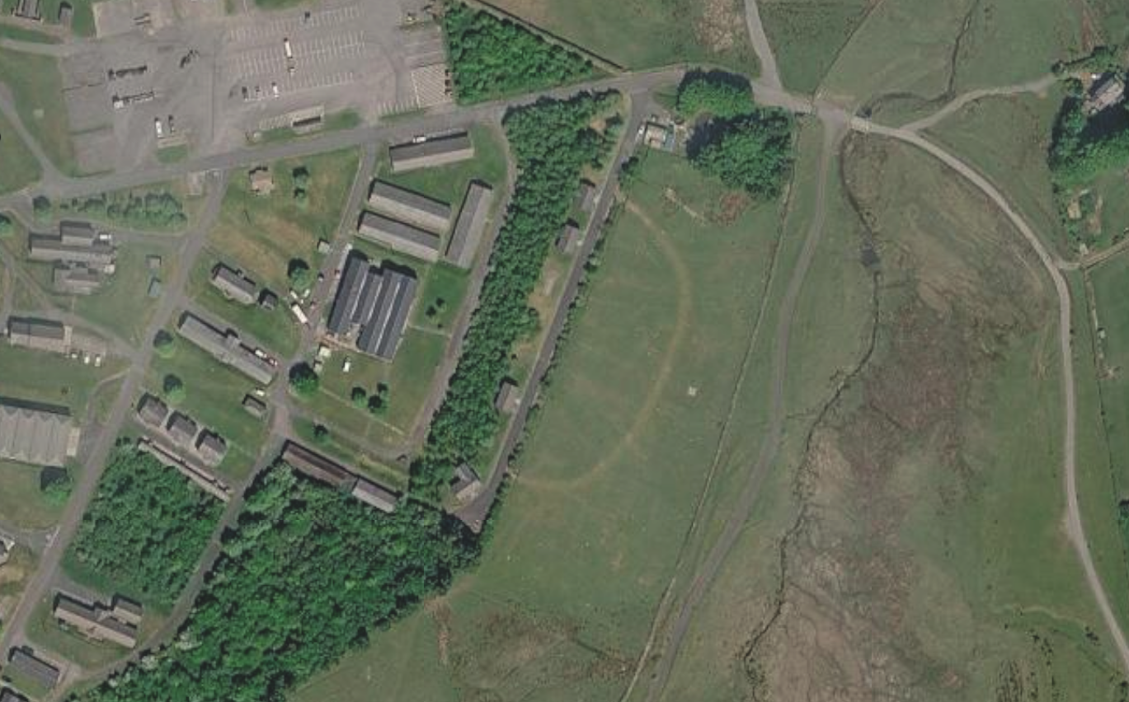
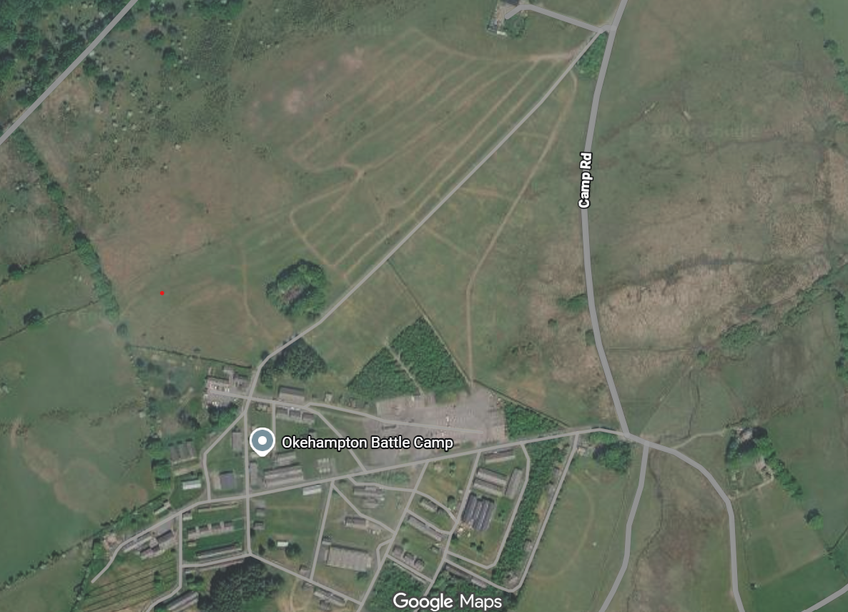
TRAFFIC MANAGEMENT
Moor Gate TRAFFIC Control - Campsite Y & Z
ADDITIONAL AGREEMENT BY TM
Team vehicles are to remain occupied at all times whilst awaiting access.
Vehicles are to park tightly against the left-hand verge between APEX and the Vehicle Control Point.
The wall between the campsite Y & Z must NOT be climbed over.
Drivers are to comply with all instructions issued by the TMG
APEX
Do NOT climb wall – each year it is being damaged

Slide 71





event
awards
AWARDS PORTAL
All awards submitted online via the Awards Portal on the main website.
One nomination per entry
Opens 01 JAN 27
Last submission 30 APR 27

Slide 72
THE event
awards
D-DAY AWARD CEROMONY
Award recipients to arrive and be seated no later than 1815
All other guest arrive from 1845
Award ceremony commences 1900
Notices

Slide 73
WHY THIS MATTERS
YOU CAN HELP CLOSE THE GAP
A changing recruiting system
25,000
1
Transition to the Armed Forces Recruiting Service: a new tri-Service contract from 2027.
ADDITIONAL APPLICATIONS
An uncertain handover period
2
Op INVECTOR
ATTRACT LoE
Young people still need clear, consistent and trusted information while arrangements change.
Awareness → interest → application
Old myths still get in the way
3
“It is all combat.” “You must already be super-fit.” “There are no real qualifications.”
Our ask of you – please ensure curiosity/interest reaches the right place
Notes:
Suggested timing: 2–3 minutes. Frame the issue, then move quickly to the practical role of the team manager: trusted signposting, not recruiting.
Sources / accuracy notes:
Op INVECTOR 25,000 figure: internal Army direction supplied for this brief.
AFRS transition: GOV.UK and MOD material.

Slide 74
TT27 – Team managers brief
Attract/engagement
SELL THE OFFER
7 CAREER STREAMS. 100+ JOB ROLES.
Combat is only one part of the Army story.
COMBAT
ENGINEERING
LOGISTICS & SUPPORT
MEDICAL
INTELLIGENCE, COMMS & IT
HR, FINANCE & SUPPORT
MUSIC
CYBER OPERATOR
VETERINARY NURSE
</>
+
Defend networks • investigate threats • work with cutting-edge technology
Care for military working dogs and horses — in clinics, on exercise and in the field.
A ROLE THEY MAY EXPECT
A ROLE THEY MAY NOT EXPECT
5×
UK's No.1 apprenticeship employer
14,000
soldiers on 43 nationally recognised
apprenticeship programmes at any one time
2020 • 2022 • 2023 • 2024 • 2025
Notes:
Suggested timing: 3–4 minutes. Use the contrasting roles to demonstrate breadth, then land the apprenticeship message.
Sources / accuracy notes:
Army Jobs role pages.
Army ranked No.1 in 2020, 2022, 2023, 2024 and 2025.
Around 14,000 soldiers on 43 programmes: British Army learning and development.

Slide 75
TT27 – Team managers brief
Attract/engagement
ROUTES IN
THERE IS MORE THAN ONE STARTING LINE
Age, education and life plans shape the route — not the level of ambition.
JUNIOR
SOLDIER
OFFICER
AFC HARROGATE
REGULAR ARMY
REGULAR ARMY
Apply from 15 years 7 months • start from 16 • earn, learn and train together.
Full-time career • role-specific training • apprenticeships and qualifications.
Lead people and capability • degree not always required • funded higher education pathway.
RESERVIST
CADET FORCE ADULT VOLUNTEER
OFFICER OR SOLDIER
VOLUNTEER ROUTE
Serve alongside a civilian career • local units and specialist roles • training, pay and adventure.
Inspire young people • develop leadership skills • serve in your local community.
SOLDIER STARTING SALARY
OFFICER BURSARIES
£27,282
FROM THE FIRST DAY OF TRAINING
UP TO £24,000
Higher specialist sponsorship may be available.
Eligibility and selection apply.
Notes:
Suggested timing: 3 minutes. Present these as signposting routes, not a complete eligibility brief. Make clear that CFAV is a volunteering route, not Army employment.
Sources / accuracy notes:
AFC Harrogate: Army Jobs.
Regular soldier starting salary £27,282 from the start of training: Army Jobs.
Officer bursaries up to £24,000, with specialist schemes potentially higher.

Slide 76


TT27 – Team managers brief
Attract/engagement
OUR SIMPLE ASK
BE THE BRIDGE — THEN SIGNPOST
You do not need every answer. You only need to know where the trusted answers are.
THREE QUESTIONS
1
What do you enjoy?
Technology, outdoors, practical work, helping people, leadership…
2
What kind of commitment?
Full-time Regular Army or part-time Army Reserve?
ARMY JOBS
BASE
Explore roles • Find your fit • Apply
Trusted guidance for adults supporting young people
3
Ready now — or exploring?
Career search, Harrogate, bursaries, work experience or a school workshop.
jobs.army.mod.uk
jobs.army.mod.uk/base
Then let the official sites do the rest.
“Have a look, the Army is be broader than you think.”
Notes:
Suggested timing: 2–3 minutes. Finish with a simple ask: ask three questions, encourage exploration, and point people to trusted official sources.
Sources / accuracy notes:
Army Jobs: https://jobs.army.mod.uk/
BASE: https://jobs.army.mod.uk/base/
Army careers: 0345 600 8080.

Slide 77
TT27 – Team managers brief
Attract/engagement
THE ENGAGEMENT VILLAGE
SEVEN ZONES — ONE JOINED-UP EXPERIENCE
Participants can explore freely or head straight to the career area that matches their interests.
INDICATIVE ZONES
THE ASPIRATION
COMBAT
ENGINEERING
INTEL, COMMS & IT
MEDICAL
One relevant platform, vehicle or high-quality interactive capability in every zone.
1
2
3
4
Foxhound
JCB / light plant
Comms vehicle
Battlefield ambulance
CENTRAL CAREERS &
SIGNPOSTING HUB
ARMY CADET FORCE
1
FIND
Use the map to identify an interest.
Regular • Reserve • Harrogate • bursaries
Youth & CFAV pathways
2
EXPLORE
Meet soldiers and get hands-on.
5
LOGISTICS
6
HR, FINANCE & SUPPORT
7
MUSIC
MAN SV
Mobile HQ / RMP
Performance stage
3
SIGNPOST
Visit the hub or scan for more.
FRI: MAIN CAR PARK | SUN: FINISH AREA
Notes:
Suggested timing: 2 minutes. Explain that the plan is indicative and that each zone should combine serving people, a platform or meaningful attraction and an activity.
Sources / accuracy notes:
Indicative JMC SW planning concept; subject to site recce, access, safety, availability and formal tasking.

Slide 78








event
Please share your stories: @armytentors
SOCIAL MEDIA

Slide 79
conclusion
Q&A
1472286

Slide 80

conclusion
close
  Col Bird

Slide 81
THE EVENT
Revised Terminology
Withdrawals: formerly Dropout or Crashout
Individual Voluntary Withdrawal (VW): Individual Team Member chooses to withdraw at a SC.
Individual Directed Withdrawal (DW): Individual Team Member told they must withdraw by an enabler. Examples:
  Medical opinion is that they cannot safely complete the challenge.
  Scrutineer opinion is that their equipment will not allow them to safely complete the challenge.
Team Directed Withdrawal (TDW): Whole team told they must withdraw by an enabler. Examples:
  Medical or safety concerns for the whole team
  Missed cut-off time
  Less than 4 team members remaining due to IVWs or IDWs
Controls:
Safety Controls (SC): no change
Basic Controls (BC): formerly known as Check Points

