Slide 1
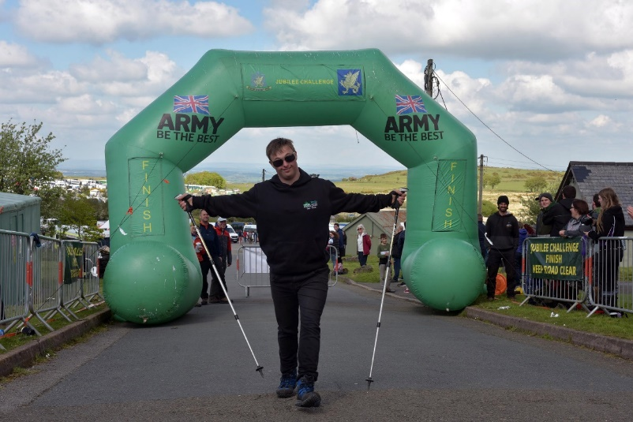
THE EVENT - JC
Capt Paul McDOUGALL

Slide 2
The event
JUBILLEE CHALLENGE
Specialist Challenge for those with a range of challenging conditions.
Run by EUOTC.
Around 400 Participants.
X4 Routes ranging from 7.8 miles to 15 miles
OCdt shadows available if requested
Saturday only 0730 to Dusk

Slide 3
THE EVENT
Jubilee challenge
JUBILEE CHALLENGE FAQ:
Individual or Team event?
What route should we do?
How to book campsite?
What to do on arrival to Oke?
Help if required during the event?
Training expected?
What medals do we get?
What’s at a checkpoint?
Do we have trackers?
What if someone can’t attend on the day?
What happens at the Finish line?

Slide 4

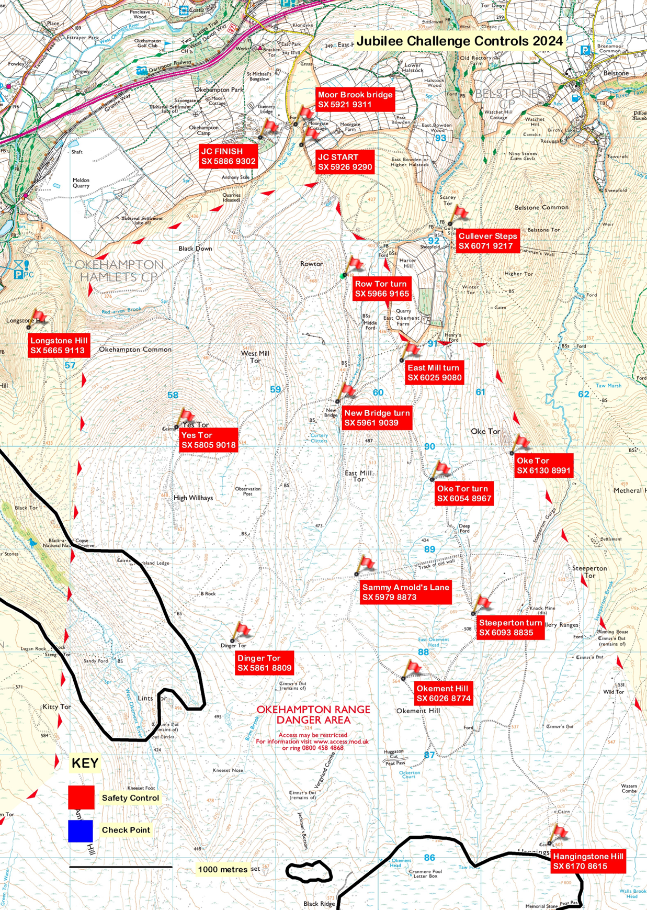
All 4 JC routes orbit around the central Range Road.
Okement Hill – Admin station
D&C 4x4 and UOTC Vehicles

Slide 5
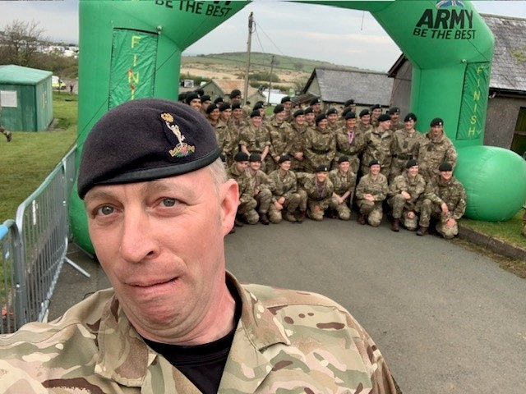
THE EVENT
ADMINISTRATION

Slide 6
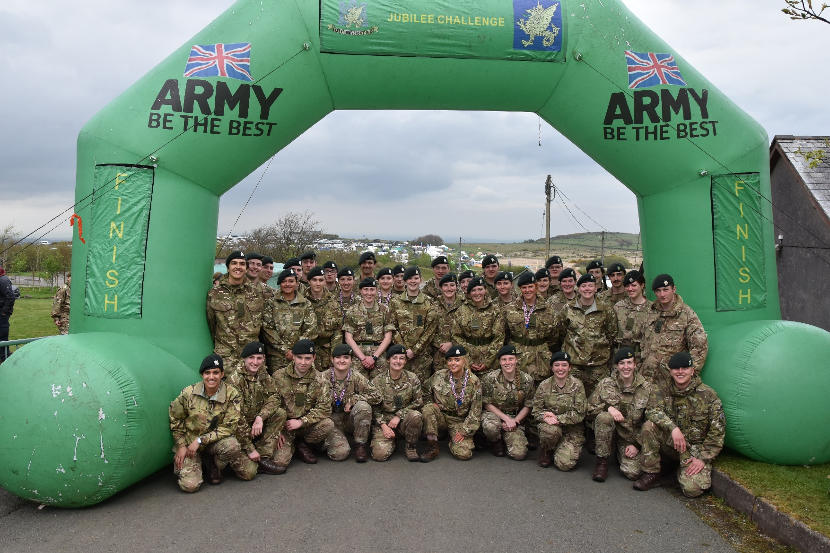
THE EVENT
ADMINISTRATION

Slide 7
THE EVENT – JC+
Maj ruth gilbert

Slide 8
THE EVENT
Jubilee challenge plus 24
This Challenge is aimed at young adults with SEND[1] (i.e. SEMH, ASD, SpLD, etc.) who would find the Jubilee Challenge too easy but the Ten Tors Challenge inaccessible due to their respective SEND. It provides an appropriately arduous Challenge across difficult terrain and in very changeable weather over at least 18kms, including an overnight camp.
[1] Special Educational Needs and Disability (SEND), Social, Emotional and Mental Health (SEMH), Autism Spectrum Disorder (ASM), Specific Learning Difficulties (SpLD)
Individual / Team event (max of 4 in a team, plus accompanying adults)
1 Route
Sat 0730 – Sun 1100

Slide 9
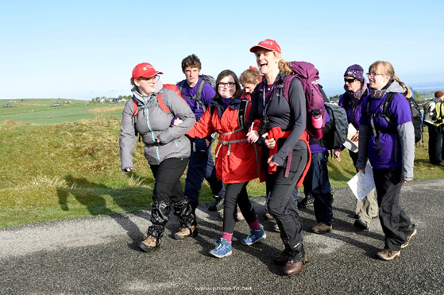
THE EVENT
Jubilee challenge plus
JC+ 24 (proof of concept):
Lessons learnt from TT22/23 Pilot = Massive success!
Individual / Team event
1 Route
Supported overnight Camping.
Sat 0730 – Sun 1100

Slide 10
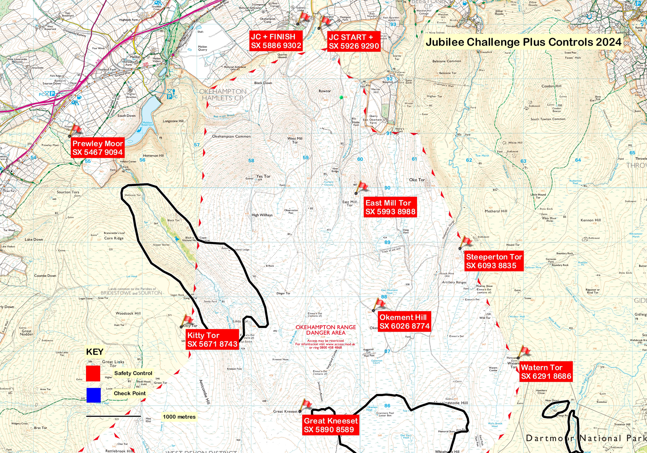
THE EVENT
Jubilee challenge plus controls
TMs please stay behind afterwards so we can meet you and answer any specific questions.

Slide 11
KeY EVENT Timings
Date / Time | Event | Remarks
D-1 10th May 0900 -1700 TTC 1100 -1800 JC/JC+ | Teams register in Sgts’ Mess | Please refer to camp layout to find it if needed.
1030 | Engagement activities | Band, climbing wall, etc
D Day 11th May 0645 | TTC participants in place | Speech, guns, parachutists, etc
0700 | TTC starts | No running!!!
0730 | JC/JC+ starts
1800 | JC ends
2000 | 35 Milers & JC+ camp
2200 | 45 & 55 Milers camp
D+1 12th May 0600 | SC and CP open
1100 | JC+ ends
1700 | TTC ends

Slide 12
THE EVENT
ADMINISTRATION
Car Parking:
  Payment online in advance preferred
  Payment in cash on the day
  No physical passes issued for one day parking
Please read the website, then email if your question remains unanswered.

