Slide 1

JCSys
DAVID HARRIS
David.harris@jcsys.co.uk

Slide 2
JCSys
SCOPE
JCSys support Ten Tors through :
  Trackers on moor
  Website in the cloud
  Management Information System (MIS) points of presence
    Highlight the importance of correct data in the MIS
Tracking
Website (for pre-registration)
Management Information System
Ongoing streamlining of Registration
  Continue Printing own control cards and wristband inserts
  Self Help system at Registration
Key Dates

Slide 3
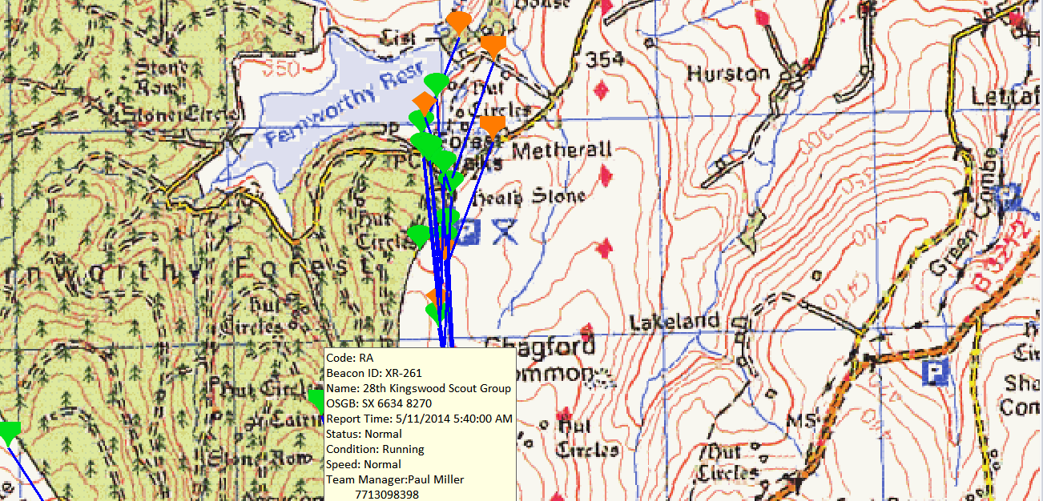


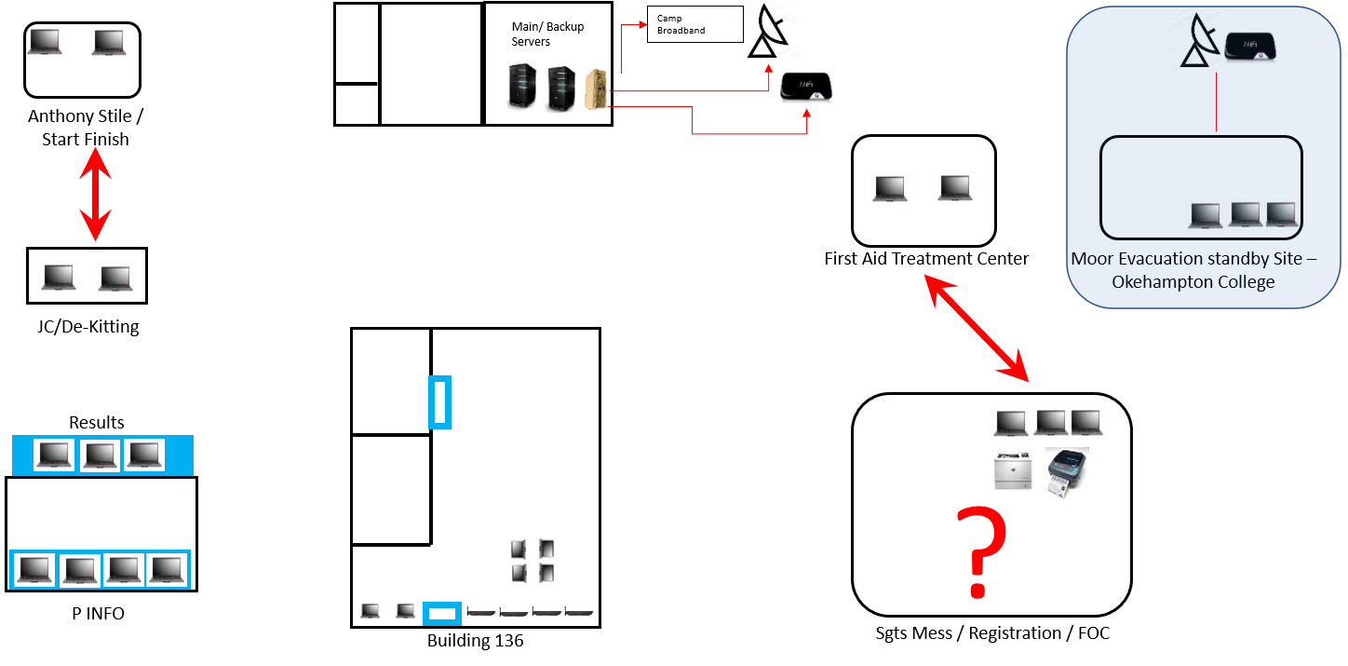
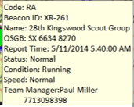
JCSYS
INTRODUCTION
Website
Team Trackers
Management Information System

Slide 4
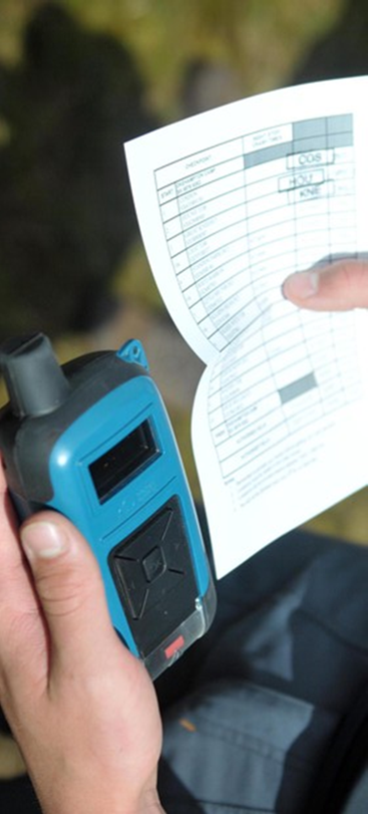
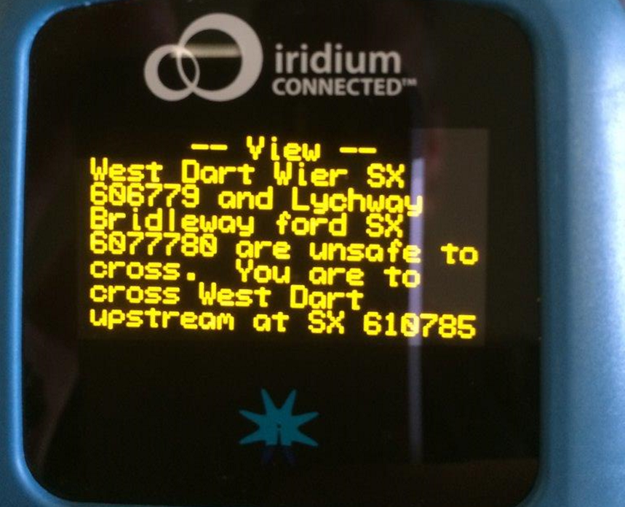
JCSYS
TRACKING
GPS Location
2-Way Communication via Iridium Satellite
  Worldwide
2 Way Text Function
Emergency Button
  Sets off visual and audio alarms in Ops Room
Positions NOT published until after the Event

Slide 5
JCSYS
BEACON FAMILIARITY
2022/3 Teams were not familiar with beacon operation
  Spurious Emergency call as opposed to manual position location
  Many beacons handed in “Beeping” hence unread message
  Poor location of beacon
Video made available this year and played in Registration after beacon issue
Questions, please ask when beacon issued.

Slide 6
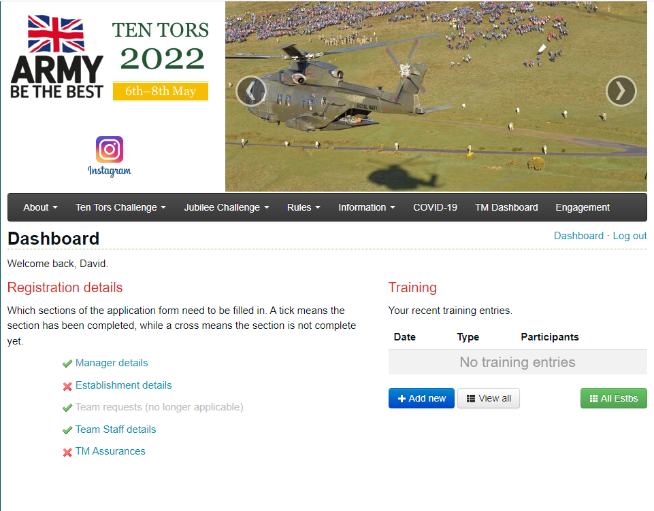
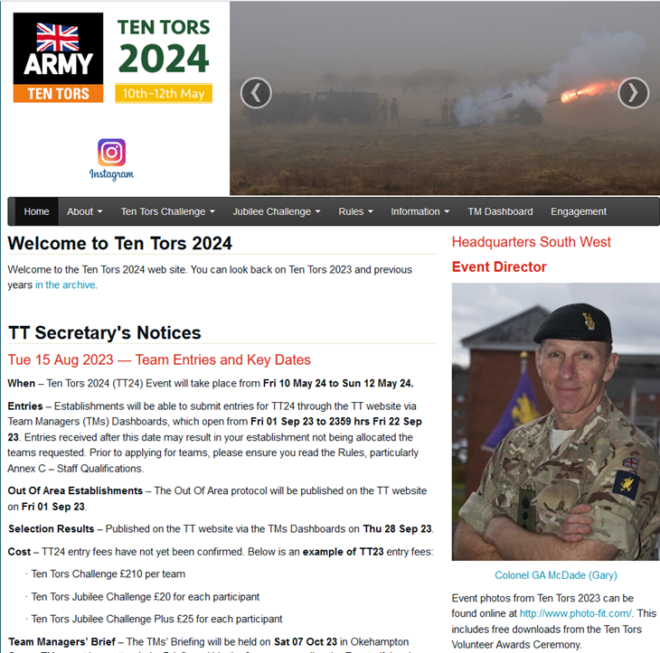
JCSYS
WEBSITE

Slide 7
JCSYS
MIS POINTS OF PRESENCE
Management Information System

Slide 8
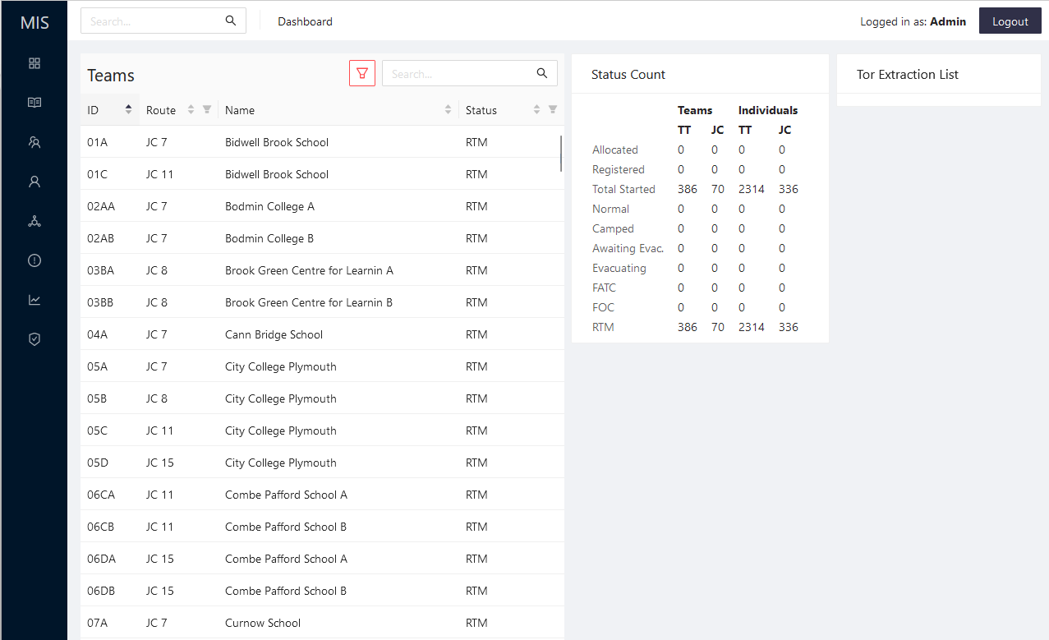
JCSYS
MIS
MANAGEMENT INFORMATION SYSTEM

Slide 9
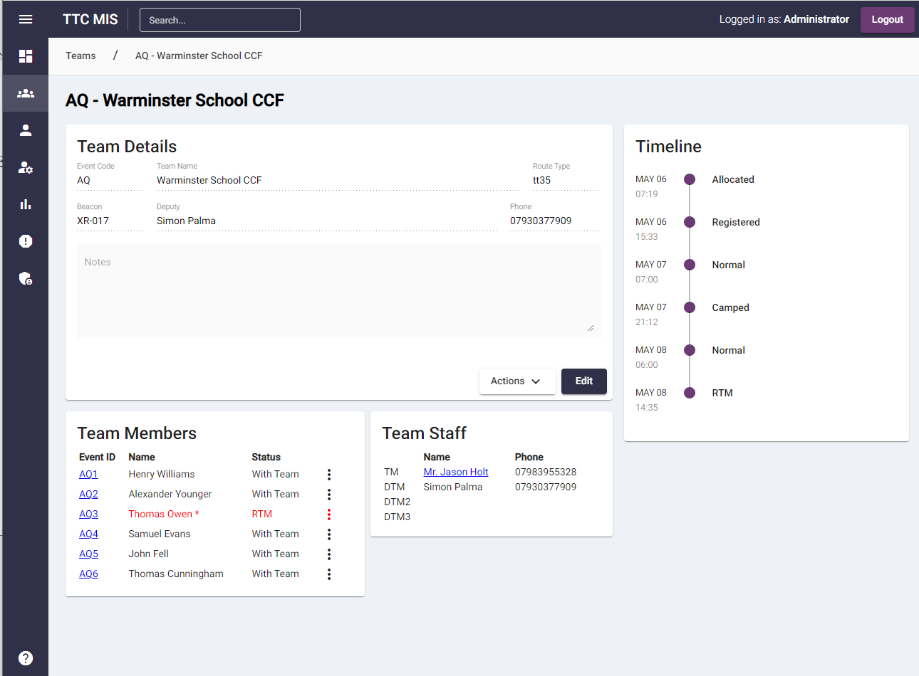
JCSYS
MIS
MANAGEMENT INFORMATION SYSTEM

Slide 10
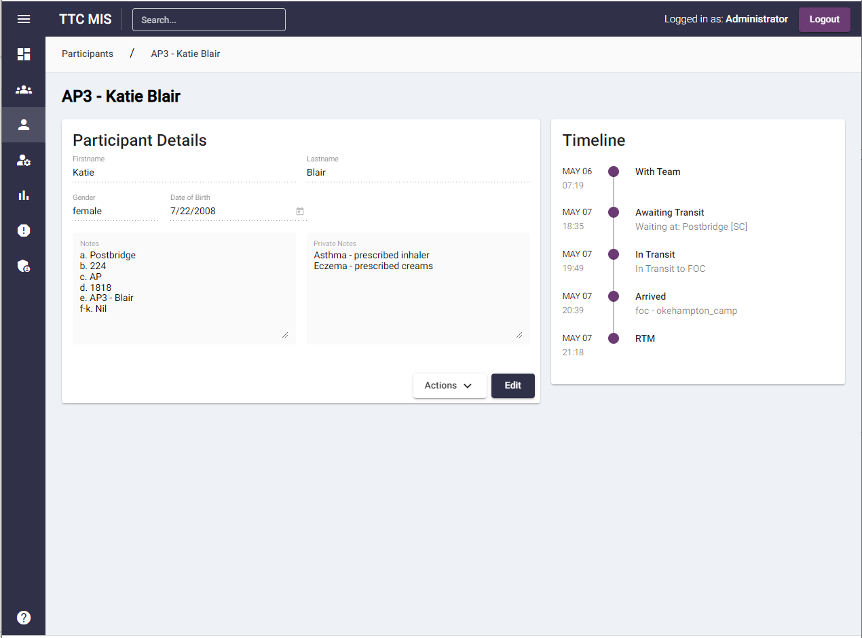
JCSYS
MIS
MANAGEMENT INFORMATION SYSTEM

Slide 11
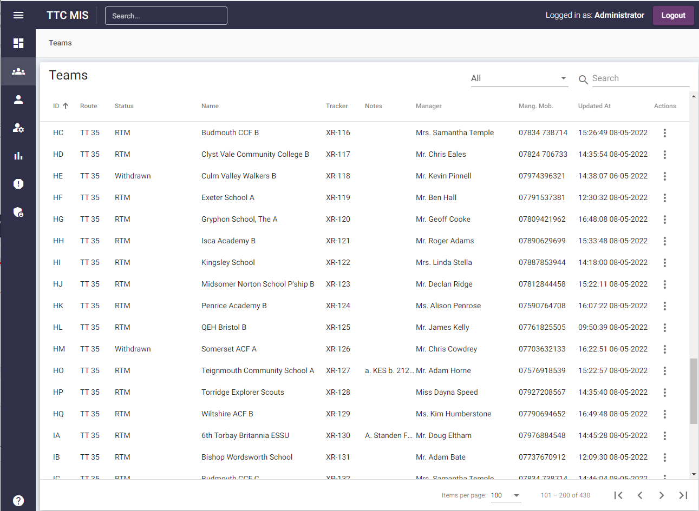
JCSYS
MIS
MANAGEMENT INFORMATION SYSTEM

Slide 12
JCSYS
Registration 2024
  Documents to be printed out by TMs
 | TTC | JC
Item
Tent Panel (35 mile only) | √
Control Card | √ | √ | Available from 0800 2 may D-5
Wristband Insert | √ | √ | Available from 0800 2 may D-5

Slide 13
JCSYS
Registration TTC 2024
  Venue Sgts’ Mess, will be signposted.
  TMs checked in on entry
  Handover completed tent site location form
  Collect replacement map if required
  MIS team details (inc photo consent)
  If no changes to team details, collect tracker and leave
  For any changes there will be a self help area with laptops with MIS access
  Registration and JCSys staff will be on hand to help

Slide 14
JCSYS
Key DATES
Notes:
TMs will be able to change their entry and reprint their control cards and wristband inserts until pre-registration closes 2000 hrs Thurs 09 May 24
Changes after this time can be sent to SWHQ-TenTors-MAILBOX@mod.gov.uk so that they can be actioned before Registration opens on Friday morning.

