Slide 1
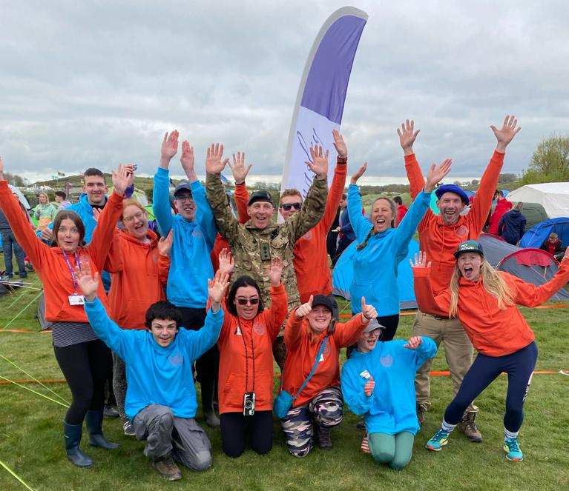
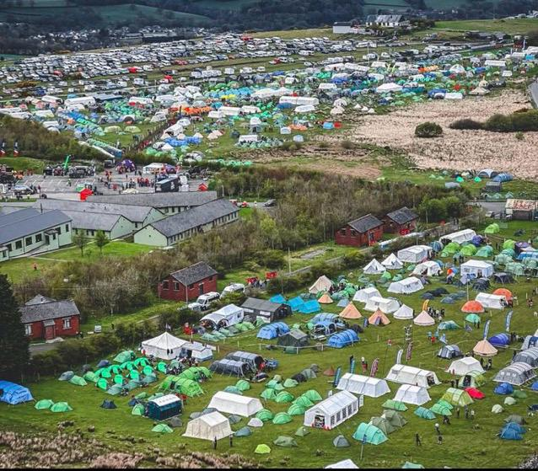
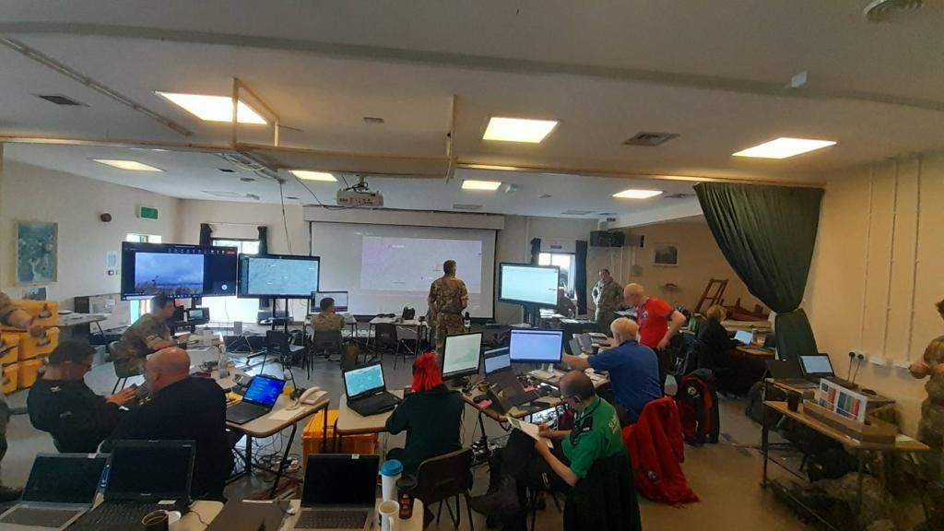
Event director
OPENING ADDRESS
COL gary mcDade

Slide 2
INTRODUCTION TO TEN TORS
ten tors STRATEGIC OBJECTIVES
Demonstrate the value of Ten Tors to Chain of Command and Stakeholders.
Broaden participation*.
Achieve equal status for all challenges.
Attract sponsorship.
Quantify the military training value of Ten Tors*.
Create and maintain the TT Handbook*.
Develop a Communications Strategy*.
Maintain a continual appetite to innovate.
Support increased cadet involvement*.
* And bold signifies focus area for TT24.

Slide 3
INTRODUCTION TO TEN TORS
TEN TORS policy committee
Director Ten Tors
Ten Tors delivery team
Director’s advisor
Scrutineers
ECMs
Routes Lead
DNPA
Team Manager
Duchy of Cornwall
Education sector (x 3)
SW Scout Association

Slide 4
INTRODUCTION TO TEN TORS
delivery realities
Huge oversubscription
The pace of life in Defence
Availability of personnel and assets (military and civilian), a huge number of whom are volunteers
Dartmoor accessibility
Enduring impact of COVID
Enormous popularity and the impact on local community and infrastructure
Ensuring safety and standards are maintained
Social Media
The Challenge:
How to move Ten Tors forward whilst maintaining its considerable heritage.

Slide 5
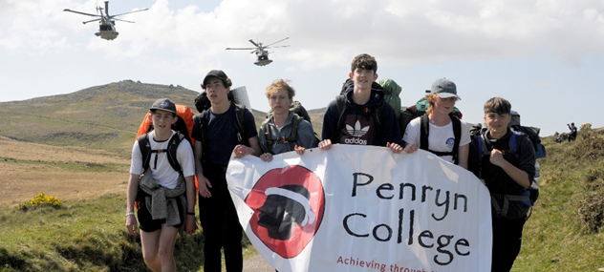
INTRODUCTION TO TEN TORS
Lt col Dom Maxwell-batten
Lt Col Tim Gilbert
so1 ten tors
Notes:
Theme: Outdoor Adventure

Slide 6
INTRODUCTION TO TEN TORS
TEN TORS OVERVIEW
WHAT
TEN TORS 24 – 75th Anniversary National Parks Act
UK’s largest outdoor youth engagement event
TEN TORS CHALLENGE
Team event
3 Categories – set by age
Saturday 0700 – Sunday 1700
‘Without outside assistance’
JUBILEE CHALLENGE
Individual / Team event
5 Routes – set by Establishment
Saturday 0730 – 1800
Assistance as required
JUBILEE CHALLENGE +
Individual / Team event
Supervised at all times
Saturday 0730 – Sunday 1100
Overnight stay

Slide 7
INTRODUCTION TO TEN TORS
TEN TORS OVERVIEW
WHO
2800 participants
2000 Team Staff
1000 enablers
6000 spectators
WHERE
Dartmoor Training Area
Duchy and other owners’ land
Dartmoor National Park
Dartmoor Commons
WHEN
Training Oct – May
W/E post-May Day BH
11 & 12 May 2024
WHY
Training benefit
Social responsibility MOD
Engagement

Slide 8
ADMINISTRATION
Selection committee – TTC
491 team requests for 400 spaces
Allocated 464 teams and 23 reserves to 192 estb
Committee decisions:
Estb capped at 4 teams
Out of area estb:
4 estb within criteria
Allocated 1 team each
Can change distance allocation until 30 Nov, email multiuser
Reserve teams will be allocated when spaces become available, often end of Jan after payment window closes
Withdrawing teams, you will not be penalised, the sooner the better

Slide 9
ADMINISTRATION
Selection committee – JC & JC+
471 JC participants applied from 42 estb
All allocated
Distance allocation can be changed up to the event
35 JC+ participant requests from 8 estb
Allocated 27 places
Estb capped at 1 team of 4
8 individual reserves

