Slide 1
Clothing & equipment
Sqn ldr (Retd) Kev 'Scotty' Scott
Chief scrutineer

Slide 2
CLOTHING & EQUIPMENT
scrutineers
31 Scrutineers, with a further 6 provisional, drawn mainly from RN and RAF
Dynamic Safety of the Event, as well as setting standards of equipment and clothing
547 years of TT Experience
Approx 1000 years of hill experience
20 individuals qualified and the remainder have other skill sets, Paramedics, DBS, First Aid etc

Slide 3
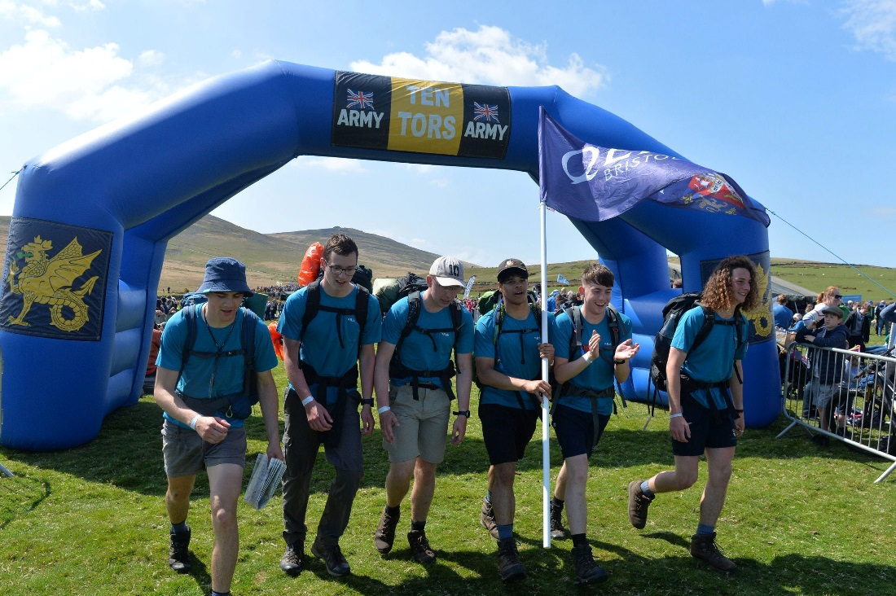
Clothing & equipment
Annex B – mandatory clothing & equipment
Mandatory minimum (can have more).
‘Notwithstanding compliance with this list, the organisers may remove participants from a Challenge … if they consider them to be unsuitably clothed or equipped to complete it in the forecast conditions.’

Slide 4
CLOTHING & EQUIPMENT
Annex b
MANDATORY Clothing & Equipment - Personal
Emergency Rations – high energy & sealed
Water & Water Sterilization
Ensure individuals hydrated pre-Event start, during Event and Post Event (iaw JSP375 Vol 1 Chap 41)
Timing of Sterilization
2 ltrs of water at start (Hyd Sys)
Whistle – Know its use
Survival Bag – Know its use
Personal Medication
Rucksack – Rucksack Liner
Clothing – On separate slide
Rations – Arrange meals

Slide 5
CLOTHING & EQUIPMENT
TEN TORS EQUIPMENT

Slide 6
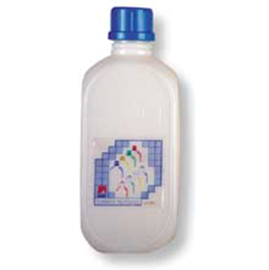
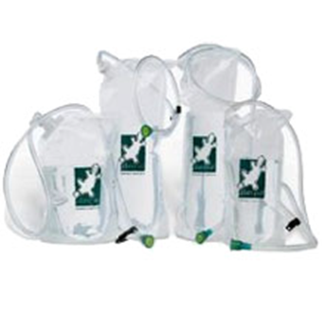
CLOTHING & EQUIPMENT
Expected equipment - personal
Water Container Recommend: Platypus type with a separate hard bottle provides an effective system. Total capacity 2 litres Min

Slide 7
Clothing & equipment
Expected equipment - personal
Intermediate Layer – Micro-fleece, sweatshirt etc
Insulation Layer – Robust enough to keep the wearer warm in a static environment
Socks Pair – thick walking type
Trousers – ideally wind resistant and quick drying – Shorts/Thin Leggings/Track Suites/Jogging Trousers are not acceptable
Waterproof Clothing – Knowledge of when and when not to use it
Boots – boots with ankle protection and in good condition
Gaiters – Know how to wear them with waterproof trousers specifically

Slide 8
CLOTHING & EQUIPMENT
Personal - health

Slide 9
Clothing & equipment
Expected equipment - personal
Intermediate Layer – Micro-fleece, sweatshirt etc
Insulation Layer – Robust enough to keep the wearer warm in a static environment
Socks Pair – thick walking type
Trousers – ideally wind resistant and quick drying – Shorts/Thin Leggings/Track Suites/Jogging Trousers are not acceptable
Waterproof Clothing – Knowledge of when and when not to use it
Boots – boots with ankle protection and in good condition
Gaiters – Know how to wear them with waterproof trousers specifically

Slide 10
Clothing & equipment
Waterproof trousers

Slide 11
Clothing & equipment
Expected equipment - personal
Intermediate Layer – Micro-fleece, sweatshirt etc
Insulation Layer – Robust enough to keep the wearer warm in a static environment
Socks Pair – thick walking type
Trousers – ideally wind resistant and quick drying – Shorts/Thin Leggings/Track Suites/Jogging Trousers are not acceptable
Waterproof Clothing – Knowledge of when and when not to use it
Boots – boots with ankle protection and in good condition
Gaiters – Know how to wear them with waterproof trousers specifically

Slide 12
Clothing & equipment
Footwear

Slide 13
Clothing & equipment
Know how to wear gaiters

Slide 14
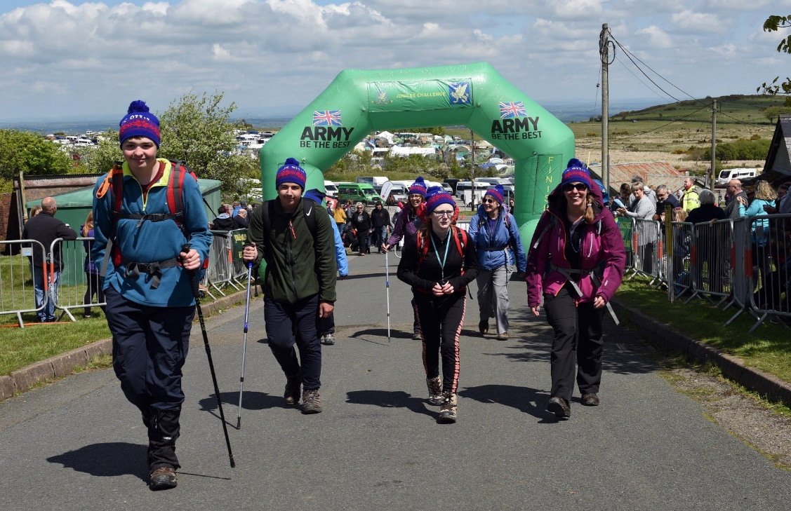
Clothing & equipment
Annex b Mandatory clothing & equipment - TEAM
Map TT24 Map with Bird Nesting areas and Out of Bounds
Compass – 10cm Baseplate
High Viz Surcoats – knowledge how to use them on roads

Slide 15
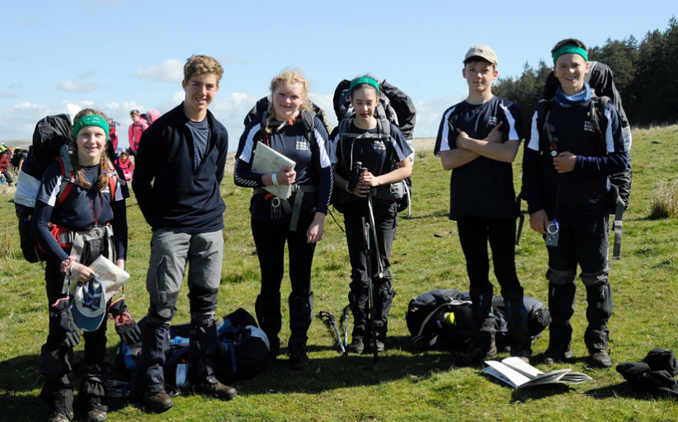
EQUIPMENT & CLOTHING
STATIC THERMAL LAYER
Softshell
Thick Fleece
Primaloft
Hydroloft
Down

